Slide 1
CEOS STAC Collection & Granule Discovery Best Practices
Yves Coene (Spacebel for ESA), Doug Newman (NASA)
STAC Workshop
Frascati, 06/06/2024

Slide 2


Outline
Context
Approach
Status Best Practices
Action Plan and Timeline

Slide 3
Context
CEOS OpenSearch Best Practices successfully used to federate and discover agency resources via IDN, CMR and FedEO.
  Reduced interoperability risks
“STAC” as successor of “OpenSearch” for resource discovery (JSON, OpenAPI, REST, OGC API) ?
  Similar capabilities ?
  Similar Best Practices ?
Many options for “STAC” implementations
  Multiple options lead providers and open-source tools developers to implement arbitrary (different) subsets, causing interoperability risks.
  Implementing all options is unnecessary and increases costs
Need for “CEOS Best Practices” identified: Best Practices should reduce cost and interoperability risks for both client and server implementations

Slide 4
Approach
CEOS Working Group on Information Systems and Services (WGISS-55, Cordoba, April 2023)
  STEP 1 (WHAT): Propose applicable list of uses cases to narrow scope of STAC Best Practices:
    Get WGISS DAIG group feedback/confirmation and/or priorities for proposed use cases (or additional/other use cases)
  STEP 2 (HOW): Prepare draft STAC Best Practices addressing selected use cases by solving issues in one of three ways:
    Recommend or mandate one method over another in the Best Practices
    Raise issue with appropriate STAC standards body to consolidate on single solution
    Create extensions for missing/needed areas (unlikely).
  STEP 3 (MEASURE): Obtain WGISS DAIG (and other) feedback on STEP 2 and iterate…

Slide 5


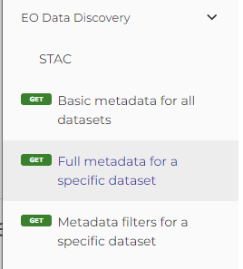
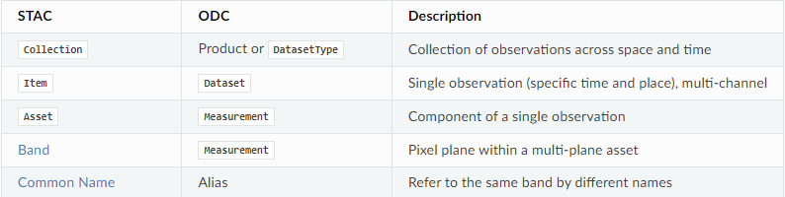

STEP 1 “define scope” - survey
STAC is used “in the wild” for multiple use cases :
  Collection and Granule discovery ( STAC Collection / Item )
  DataCube-related (STAC Item / Asset / Band)
  OpenEO - cloud-based Earth Observation data processing
Scope of STAC Best Practice
from DAIG (as replacement of OpenSearch Best Practice)
(*) e.g. https://odc-stac.readthedocs.io/en/latest/stac-vs-odc.html
Notes:
https://api.openeo.org/1.2.0/#tag/EO-Data-Discovery/operation/describe-collection

Slide 6
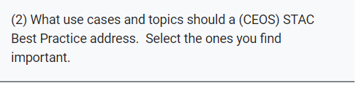

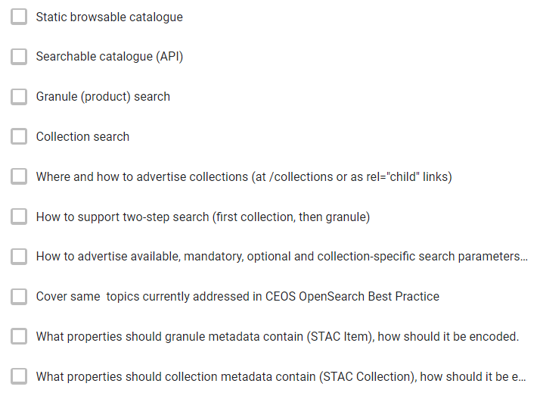
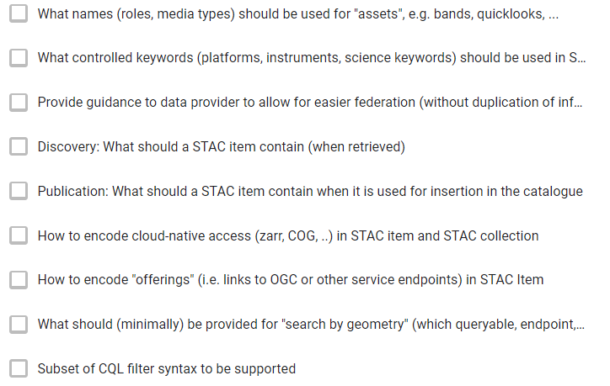
STEP 1 “define scope” - survey

Slide 7
STEP 1 “define scope” – survey results
Top Responses
  STAC API (75%)
  Granule search (70%)
  Guidance to allow federation (70%)
  Advertise available queryables (65%)
  Encode granule metadata (65%)
  Collection metadata (60%)
  Controlled keywords, media types, roles (60%)
  Cloud-native assets (60%)
  Collection search (55%)
  “other topics” proposed:
    e.g. asset-level search, highly recommended extensions, ..

Slide 8

STEP 2 “Best Practices” – current status v survey priorities
Most demanded topics to be ad
  STAC API (75%) §3.2, §4.3, §5.3
  Granule search (70%) §4 Granule Catalog
  Guidance to allow federation (70%) §*
  Advertise available queryables (65%) §3.2 Catalog
  Encode granule metadata (65%) §6 Granule Metadata
  Collection metadata (60%) §7 Collection Metadata
  Controlled keywords, media types, roles (60%) §3.3, §7.2 Metadata
  Cloud-native assets (60%) §6.3 Granule Metadata
  Collection search (55%) §5.3 Collection Catalog
  “other topics” proposed:
    e.g. asset-level search, highly recommended extensions, ..

Slide 9
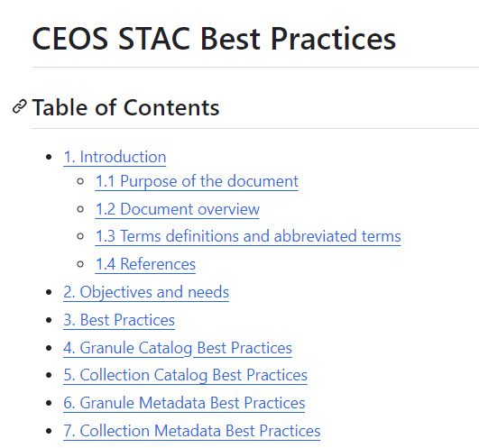
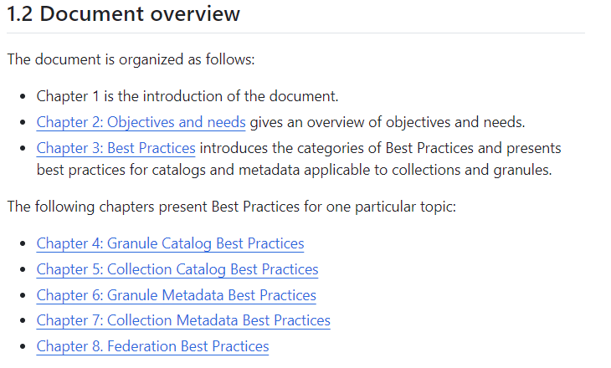
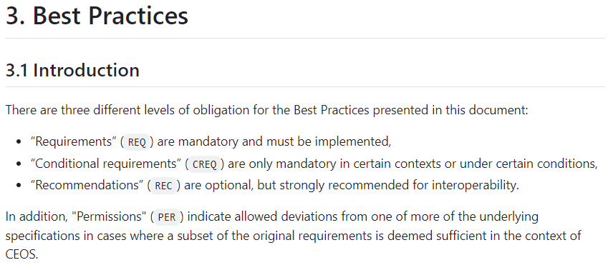
STEP 2 “Best Practices” – current status
  Current draft at https://github.com/ceos-wgiss/stac-collection-and-granule-discovery-best-practices

Slide 10
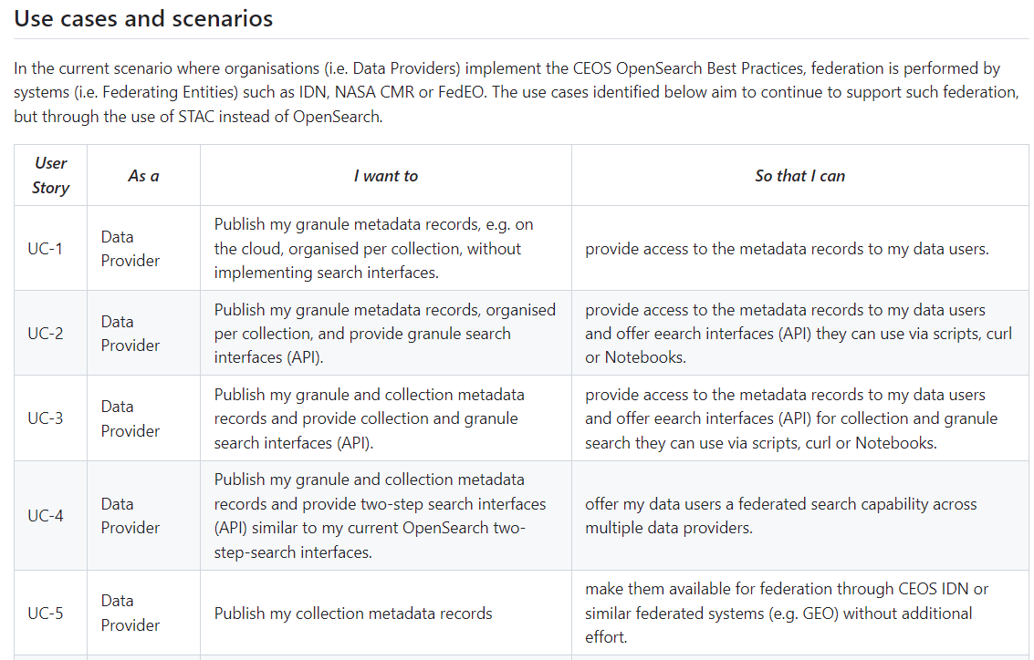
STEP 2 “Best Practices” – current status

Slide 11
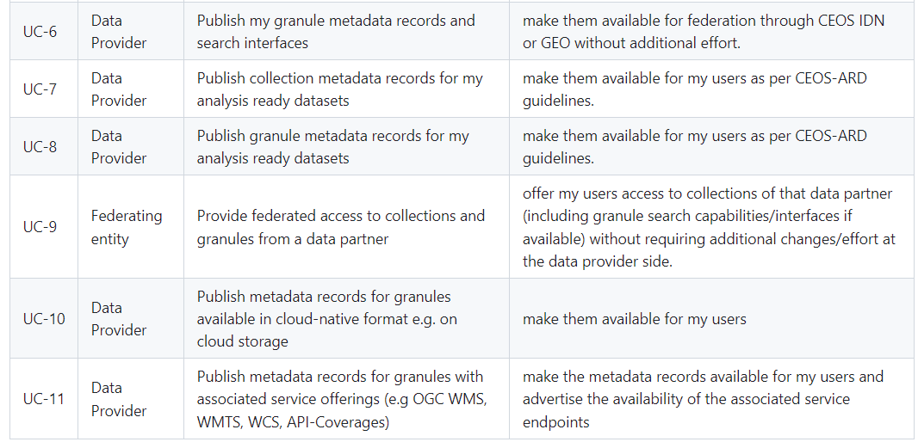
STEP 2 “Best Practices” – current status

Slide 12
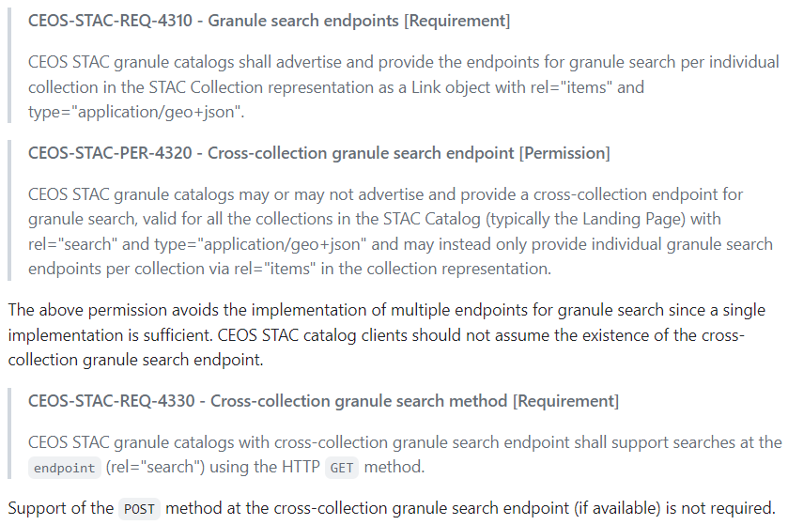
Best Practices – Example requirements
Requirement presentation

Slide 13
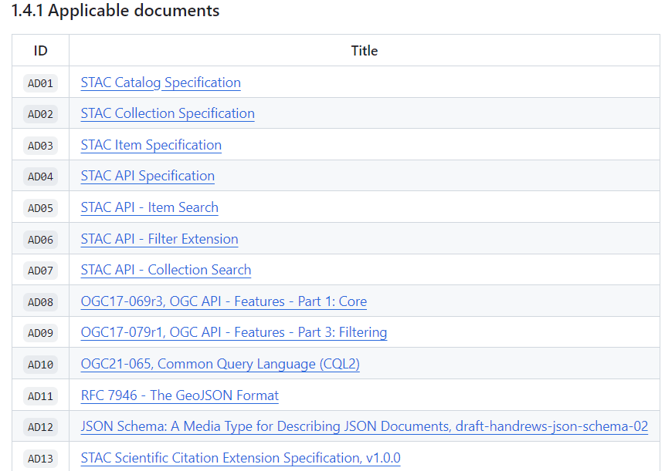
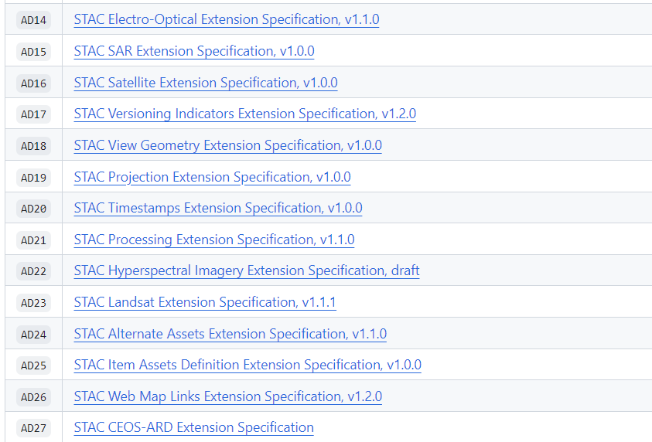
Best Practices – Underlying “STAC” specifications
Proposed Practices rely on parts of STAC/STAC API, underlying OGC specifications and parts of (available) “extensions” of STAC and STAC API
Expected scope “OGC STAC/
STAC API” Community Standard
CEOS STAC ARD Extension

Slide 14
Action Plan and Timeline
March 2024 – WGISS 57 – STAC DAIG session with STAC community participation. “Best Practices” renamed. Remaining steps agreed.
Collect contributions, questions and feedback from interested parties in next period on draft Best Practices available at https://github.com/ceos-wgiss/stac-collection-and-granule-discovery-best-practices
Discuss/agree contributions/feedback received before or at planned dedicated virtual meetings
  30 April 2024 virtual meeting #1: 33 participants incl. CEDA, CSIRO, DLR, EC-JRC, ESA, JAXA, NASA, NRCan, USGS, VITO, etc.
  28 May 2024 virtual meeting #2: 24 participants incl. CloudFerro, DLR, ESA, EU, GA, IFremer, ISRO, JAXA, KSAT, NASA, UK CNEO, etc.
June 2024 - Consolidate final version of Best Practices.
End July 2024 – Publish final version.
October 2024 - Present finalized Best Practices (First release) at WGISS-58.
We are here

Slide 15
Action Plan and Timeline
STAC Meeting #1 (30/04/2024)
  Number of Participants: 33
  Discussion:
    Definition of collection used in document.
  Main decisions:
    §3 add a “Conditional” category in addition to Permission, REQuirement, RECommendation.
    §3.2.1 No minimum/maximum for datetime parameters in JSON schema (Queryables). Possible in OSDD). Recommend to use extent from STAC collection.
    §5.3.1 (Collection Catalogs): Make “/collections” endpoint a REC.
    §6.6, §7.6 -> Remove “CEOS ARD” section and requirements as STAC ARD documents referenced are draft/incomplete.

Slide 16
Action Plan and Timeline
STAC Meeting #2 (28/05/2024)
  Number of Participants: 24
  Main topics:
    #1 - Include guidance for migration path: align queryables with OpenSearch
    #2 – Recommendation to choose collection identifiers taking info account federation. Add reference to forthcoming “WGISS Data Collection Mgt Practices White Paper”.
    #3 – Collection search intro section. Mention content negotiation with media types.
    #4 – product:type preferred over sar:product_type in examples.
    #5 – Responsible organisations: leave STAC “roles” as-is. Allow “email” as contact info in “Provider” object (INSPIRE) in example.
  Topics have been addressed in version which is online in GitHub.

Slide 17

Conclusion
Best Practices prepared in parallel with ongoing STAC implementations in context of CEOS Connected Data Assets:
  NASA CMR, ESA FedEO, INPE, …
Your feedback and inputs are important:
  https://github.com/ceos-wgiss/stac-collection-and-granule-discovery-best-practices
CEOS Service Discovery Best Practice (https://ceos.org/ourwork/workinggroups/wgiss/documents/)
  Forthcoming update including STAC encoding. Being reviewed internally.

