Slide 1
STAC in ESA Common Services Ecosystem
Yves Coene (Spacebel for ESA), Mattia Stipa (ESA)
STAC Workshop
Frascati, 06/06/2024

Slide 2
Outline
Introduction
EOCAT STAC Interfaces
Conclusion

Slide 3
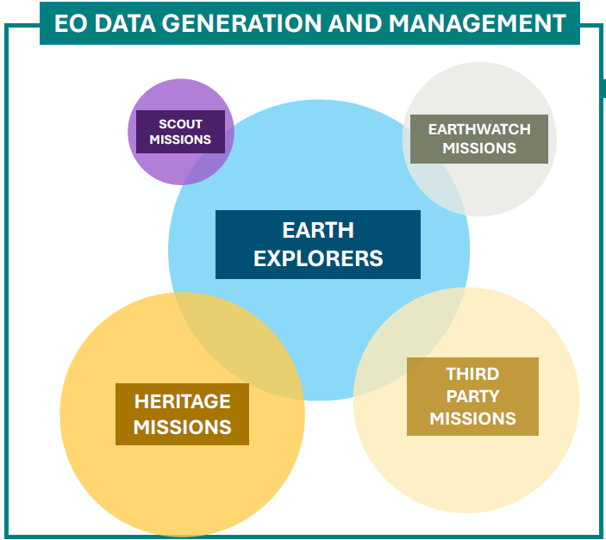
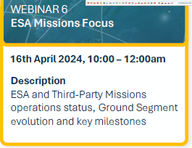
Introduction
ESA EO Data Mgt and Operations Framework (EOF) (ESA Missions Focus) was presented in April.
EO Ground Segment “Common Services” infrastructure:
  Common solutions for EE, HM, TPM, EW mission data.

Slide 4

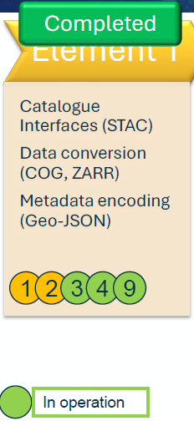
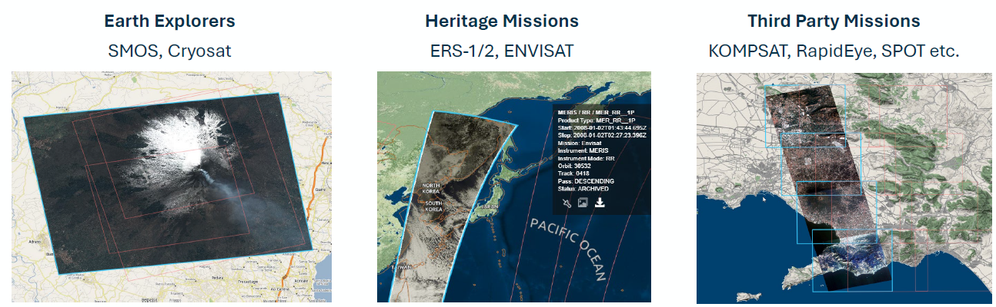
EO-CAT Catalogue
EO-CAT Catalogue provides services for discovery of EO collection and product metadata from multiple missions.
First version of EOCAT STAC interfaces now in “operation”.

Slide 5










EO-CAT Catalogue
EOCAT Discovery interfaces:
  RESTful OGC API Features / OpenSearch / STAC API interface covering:
    “collection” resources
    “granule” resources
    [ “service” resources ]
  Search parameters advertised in:
    OpenAPI definition
    OpenSearch OSDD
    Queryables (OGC API Features Part 3 Filtering)
  Search responses in Atom / GeoJSON / JSON-LD / RDF / Turtle etc.
    Content negotiation

Slide 6
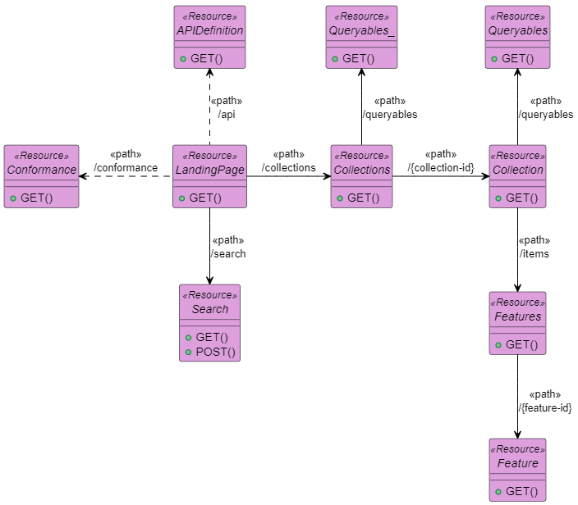

EOCAT RESTful API
RESTful API offering multiple interfaces:
  OGC API – Features (Part 1: Core, Part 3: Filtering)
  STAC (+ STAC API Extensions)
  OpenSearch
Content negotiation
  e.g. (GeoJSON) representations / profiles
  httpAccept or HTTP Accept header.
Read/write interface
  Consumed by OpenSearch clients,
  OGC API - Features clients,
  STAC clients, Google crawler, Linked Data client,
  Metadata Editor, …
E.g. metadata
representations:
/collections/{collection-id}/items/{id}

Slide 7
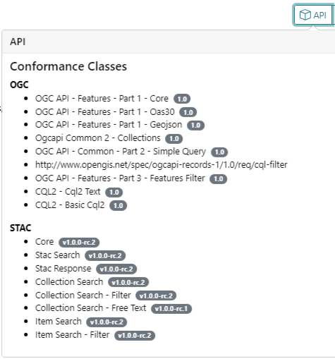
EOCAT STAC Interfaces
Accessible at
  https://radiantearth.github.io/stac-browser/#/external/eocat.esa.int/eo-catalogue
Static STAC catalogues:
  Browse by platform, instrument
  Browse by science keyword
STAC API:
  STAC API - Item Search (POST, GET)
  STAC API – Collection Search
  STAC API – Filter Extension
  OGC API – Features – Part 1
  OGC 21-065, Common Query Language (CQL2)
    CQL-Text, Basic-CQL2

Slide 8
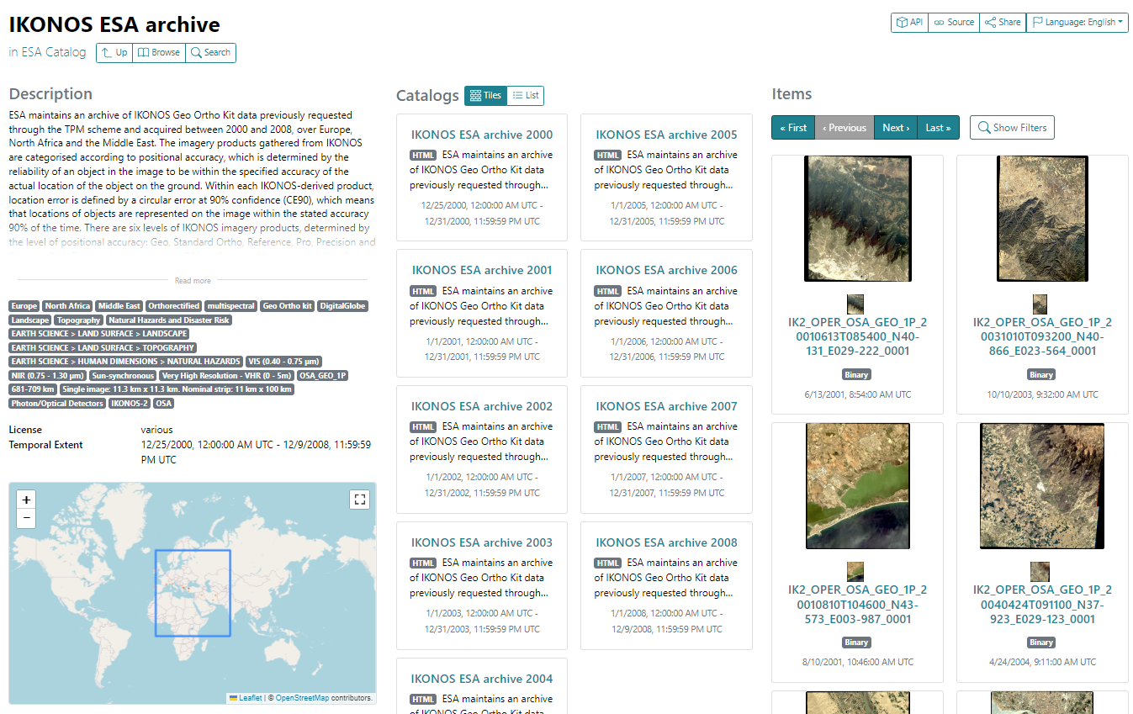
Static STAC Catalogs
Collections
  By platform
  By instrument
  By science keyword
Granules/products
  By Year
  By Month
  By Day

Slide 9
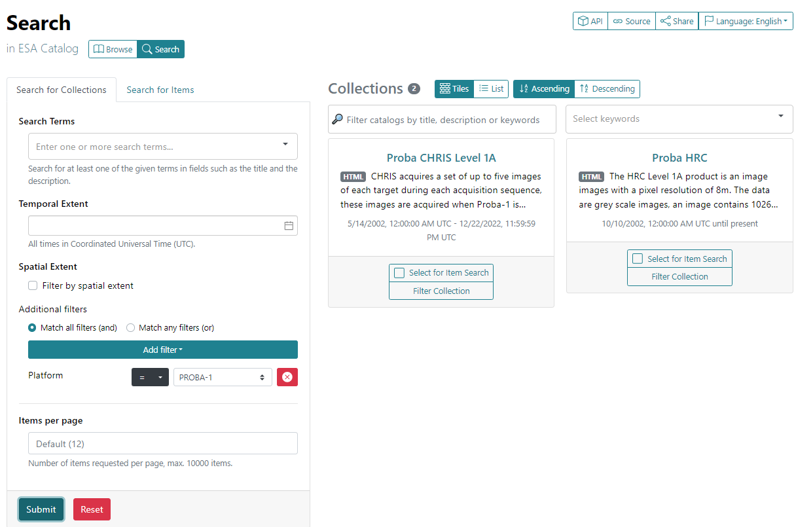
STAC – Collection Search (/collections)
STAC Collection Search
Search parameters:
  Queryables (OSDD)
  /collections/queryables
Filter extension (CQL2)
STAC Collection:
  Scientific Extension (DOI)
  Collection Assets
    Metadata formats
  Summaries
    instruments
    platform
STAC API
Filter Extension (CQL-Text)
Notes:
https://radiantearth.github.io/stac-browser/#/search/external/eocat.esa.int/eo-catalogue

Slide 10
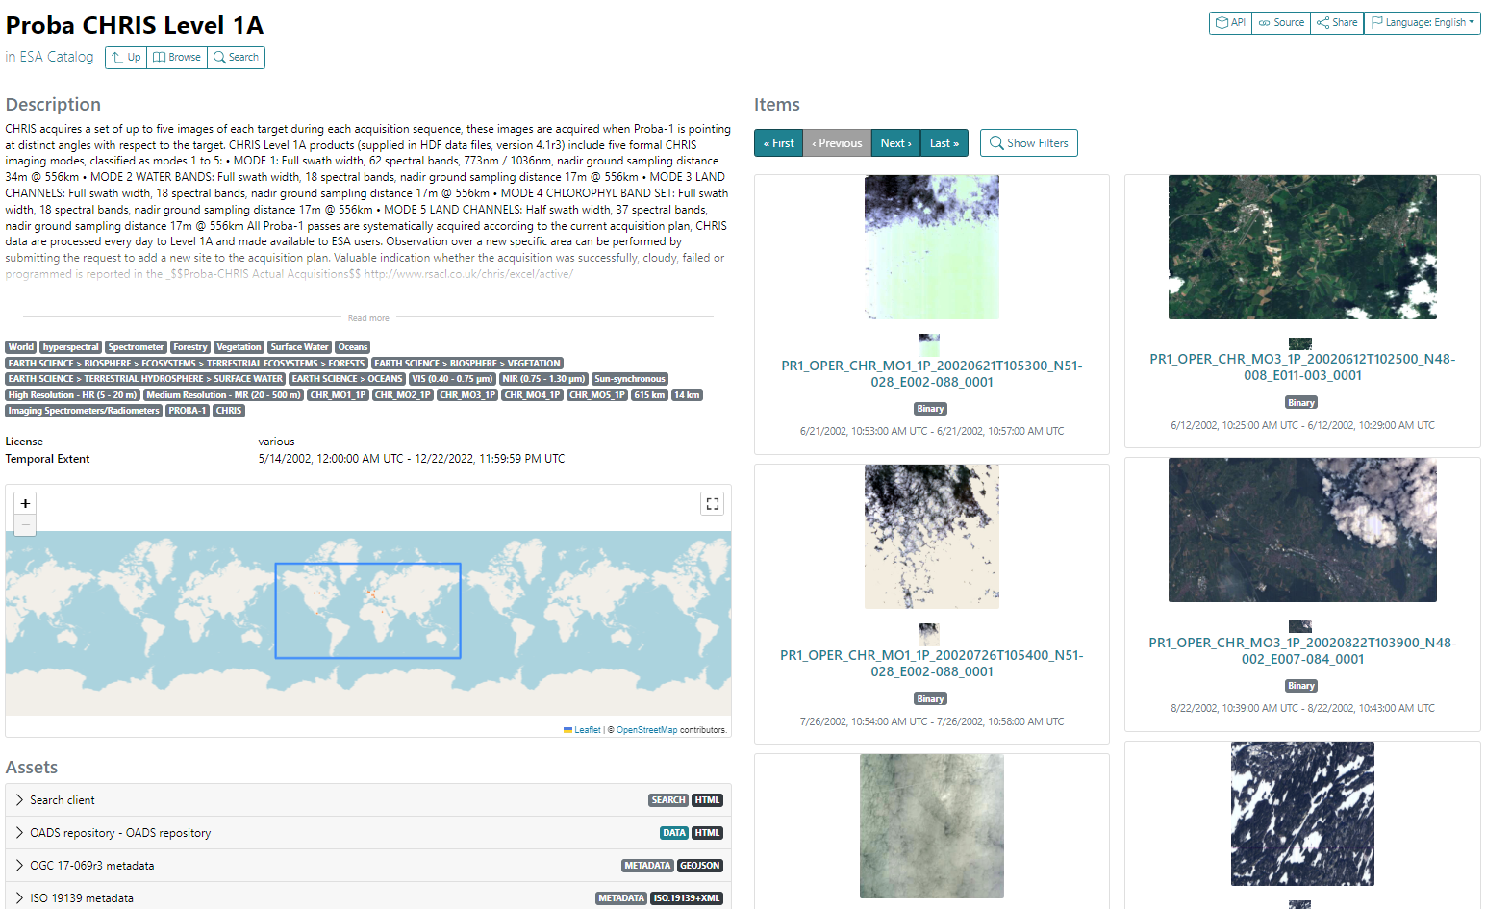
STAC – Granule Search (/items)
OGC API-Features
/collection/{id}/items
/collection/{id}/queryables

Slide 11
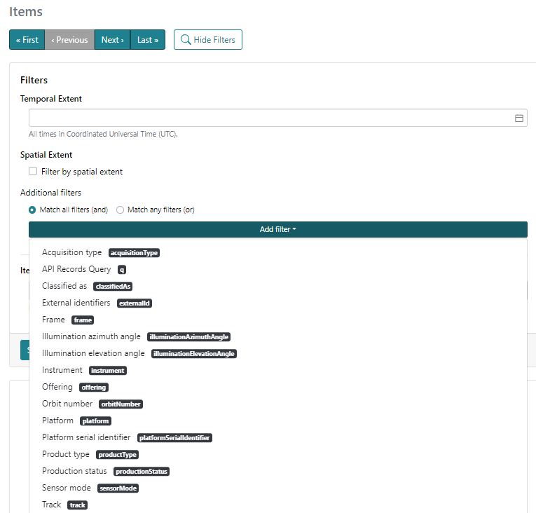
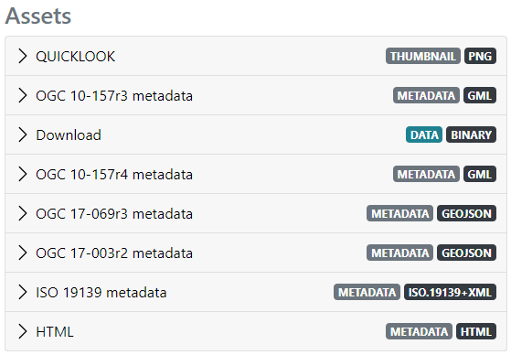
STAC – Granule Search (/items)
Search parameters advertised via Queryables response
Filter Expression
Metadata formats, quicklook, thumbnail and
product provided as “assets”.
STAC API
Filter Extension (CQL-Text)

Slide 12
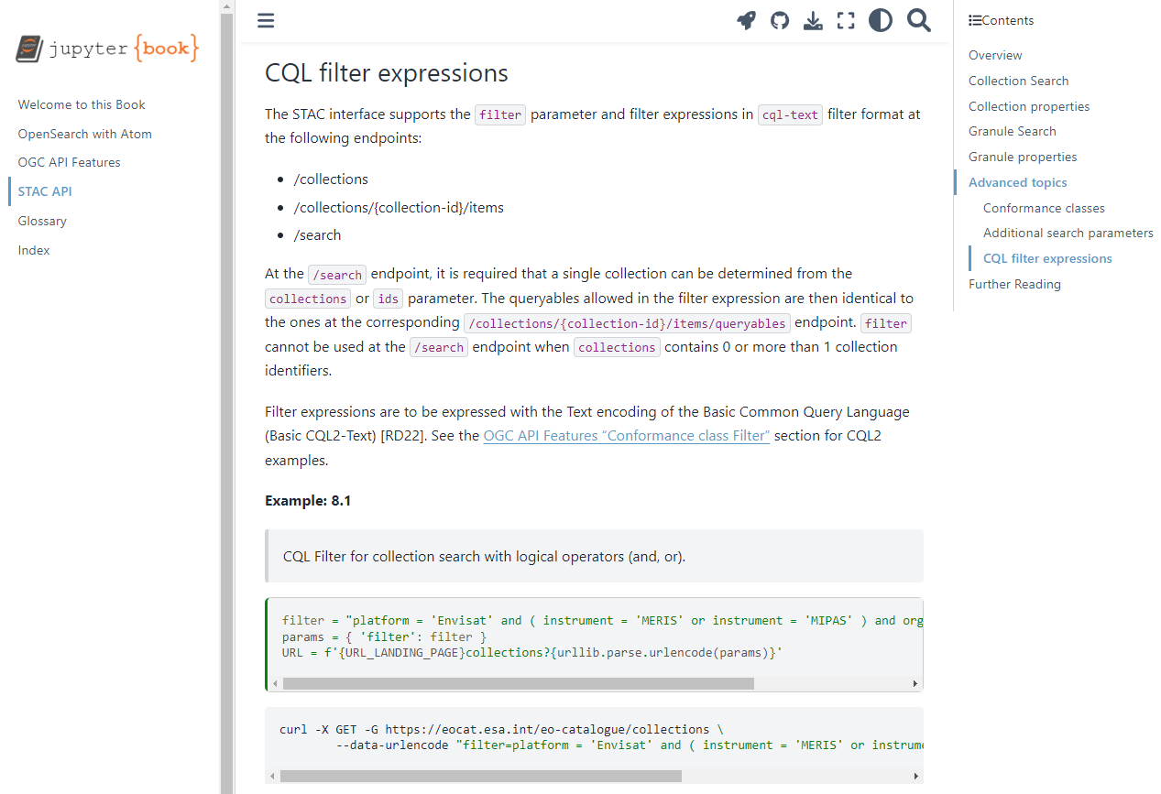
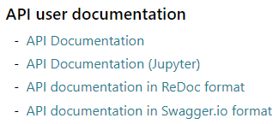
STAC Online Documentation
https://eocat.esa.int/eo-catalogue/intro.html
Jupyter Book

Slide 13
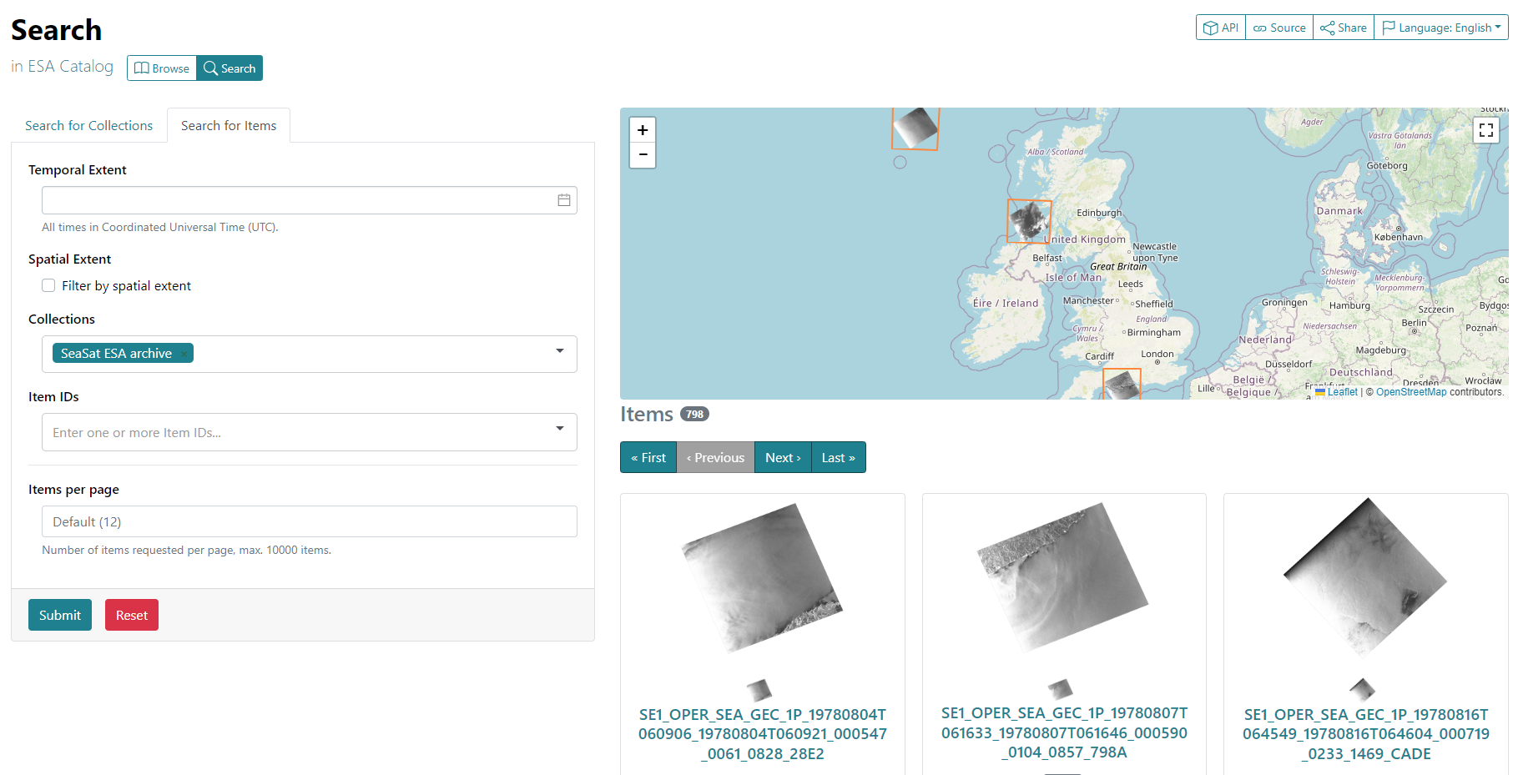
STAC - Item Search (/search)
Less useful as few search criteria available
HTTP POST and GET interfaces

Slide 14
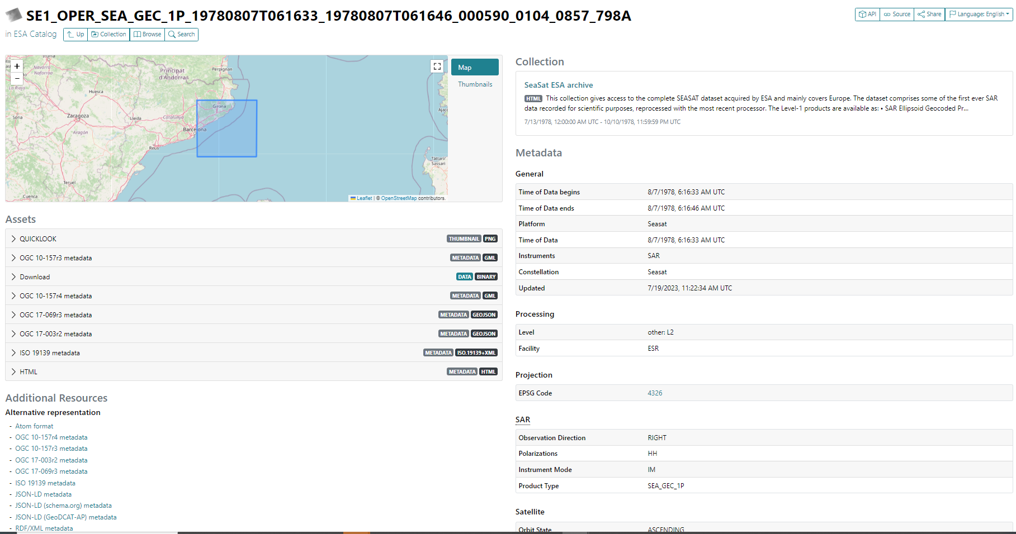
STAC Item encoding

Slide 15
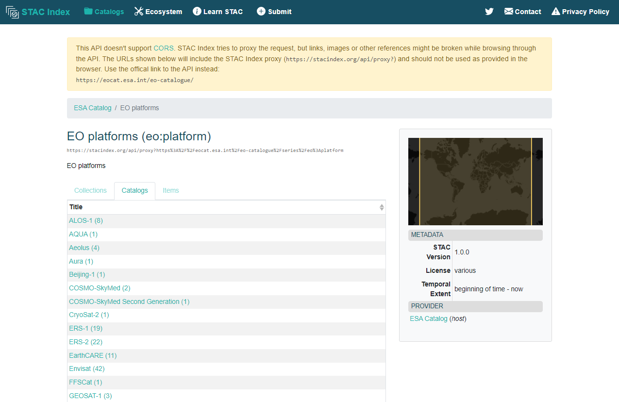
Conclusion
STAC endpoint also available via STAC Index:
  https://stacindex.org/catalogs/esa-catalog#/
Mapping from OGC 17-003r2 to STAC Item at:
  https://github.com/stac-utils/stac-crosswalks/tree/master/OGC_17-003r2

Slide 16
Conclusion
All collection and granule Common Services (EE, HM, TPM, EW missions) metadata available via:
  Browsable static STAC catalogs
  Searchable catalog (STAC API) including “Two-step” search
Implementation accessible by open-source STAC software:
  STAC Browser (https://github.com/radiantearth/stac-browser)
  pystac_client (https://pystac-client.readthedocs.io/en/stable/)
Detailed examples of all supported API as Notebooks.
Next steps:
  STAC Sort Extension
  Service/tool discovery (already available at fedeo.ceos.org) - https://radiantearth.github.io/stac-browser/#/external/fedeo.ceos.org/services/eo:organisationName/ESA
  Interface with WMTS (possibly using STAC Web Map Links Extension).
  STAC as metadata ingestion format (TBC)

Slide 17

Conclusion
Contacts:
  Mattia.Stipa@esa.int
  Yves.Coene@spacebel.be

