Slide 1
STAC in EUMETSAT
EUMETSAT
STAC workshop, ESA-ESRIN, 6th of 2024

Slide 2
STAC in EUMETSAT context
Destination Earth
  EUMETSAT responsible for the DestinE Data Lake
  Harmonised Data Access implementation (STAC based)
    discovery & search of DestinE Data Portfolio
    Earth Observation data & Digital Twin data (Simulations)
    Statistical data, IoT, data from other data spaces
WEkEO
  Assessment made and migration to STAC envisaged (from early 2025)
Big Data Services
  Data Store/ Eumetsat Data Lake
  Plans exist to provide also STAC compliant interface (from early 2025)

Slide 3
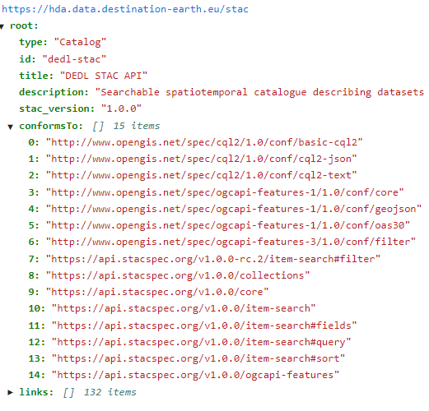
DestinE - STAC catalogue (conformance)
Catalogue URL
STAC : v1.0.0
STAC API: v1.0.0
Supported STAC Extensions:
  eo, order, published, processing, sar, sat, storage, sci, version, view
Supported STAC API Extensions:
  query, filter (cql2, queryables), sort
Feature Collection
https://stac-extensions.github.io/timestamps/v1.0.0/schema.json"
https://stac-extensions.github.io/processing/v1.0.0/schema.json"
https://stac-extensions.github.io/sat/v1.0.0/schema.json"
https://stac-extensions.github.io/sar/v1.0.0/schema.json"
https://hda.central.data.destination-earth.eu/stac/extensions/oseo/json-schema/schema.json
Collection
https://stac-extensions.github.io/sar/v1.0.0/schema.json
https://stac-extensions.github.io/sat/v1.0.0/schema.json
https://stac-extensions.github.io/item-assets/v1.0.0/schema.json

Slide 4
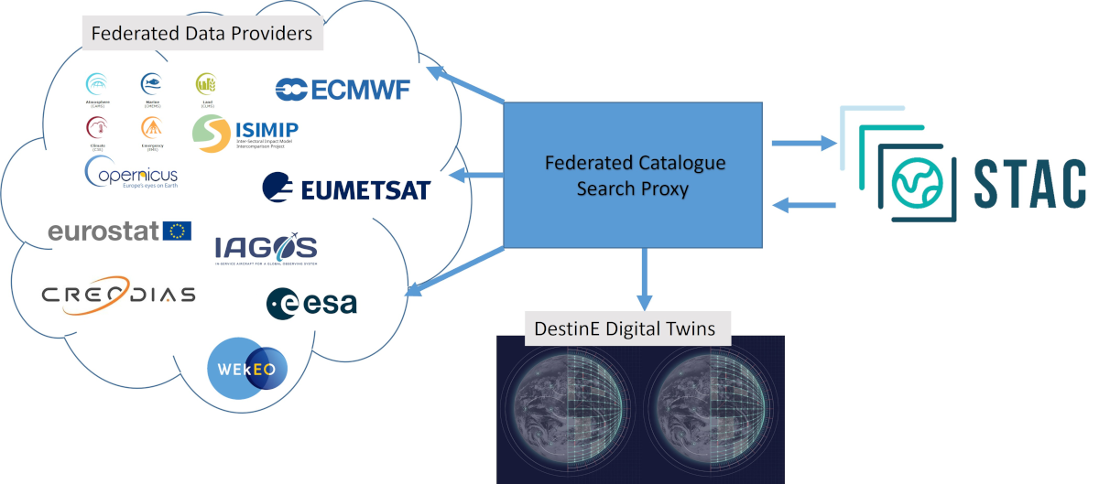
DestinE – STAC implementation
Datasets are presented as STAC collections, along with the list of associated providers
Discovery of services and datasets with related metadata information
Search within datasets
Access data
Based on EODAG by CS-Group France
EODAG is licensed under Apache License v2.0
https://github.com/CS-SI/eodag

Slide 5

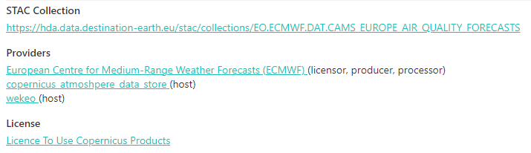
STAC with EODAG - Context
Federation of remote providers
Diverse data sources and kind
  in-situ
  earth-observation
  forecast
  Etc.

Slide 6
STAC with EODAG - Challenges
Multiple providers per dataset
Heterogeneous provider interfaces
Harmonised Uniform output interface
Remote data providers
Rely on remote catalogues (no replication of catalogue information) !!!
  Only collection information stored
Usually more metadata available, but not mapped yet in STAC catalogue (requires extensions)
Harmonisation of ontologies potentially needed (keywords, naming, etc)

Slide 7
STAC with EODAG – Multi provider catalogue
Implementation
Fallback mechanism
  Providers are sorted by a priority order
  Mitigate provider unavailability impact on the HDA
Allow users to target a specific provider
Current limits
No cross-provider search
No cross-collection search

Slide 8
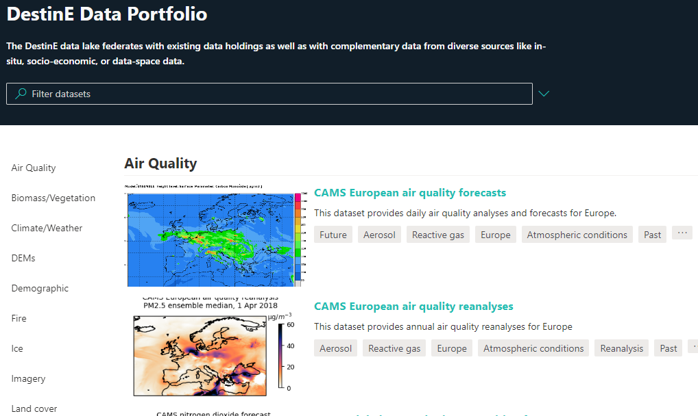
STAC with EODAG – STAC API Extensions supported
Collection-search
Sort (on supported providers)
Query (only a few operators)
Filter (basic implementation)

Slide 9
STAC with EODAG – STAC API Extensions supported
Electro-Optical
Order
Timestamps
Processing
SAR
Satellite
Storage
Scientific Citation
Versioning Indicators
View Geometry
OpenSearch for EO (custom generated by EODAG)

Slide 10
STAC with EODAG – ECMWF Datasets
Challenge
Data is within Data cube instead of pre-existing items
one request at once supported
Implementation
STAC to support users into generating proper ECMWF requests (constraints)
Queryables change dynamically based on combination of attributes (type of parameter, pressure levels, etc)
Limits
Always a single item per search result (basically a remote job)
Search by ID unavailable

