Slide 1
Introduction to Spatio Temporal Asset Catalogs (STAC)
Vincent Dumoulin, Davide Castelletti, Roberto De Bonis
ESA ESRIN
06/06/2024

Slide 2
What is STAC?
STAC stands for Spatio Temporal Asset Catalog
It is a specification to standardize the way geospatial assets are described and cataloged.
  Open specification, started in 2018 by Radiant Earth, current version 1.0.0 ​
The specification is divided in two parts
  STAC Core: A set of common data structures using JSON and GeoJSON
  STAC API: A RESTful API
Purpose: To make it easier to find, share, and use geospatial data.

Slide 3
Why STAC?
Challenges:
  Geospatial data is often scattered across different platforms.
  Inconsistent metadata makes it hard to find relevant data.
  Difficulties in sharing and integrating geospatial data.
Solution:
  STAC provides a standardized and consistent way to catalog geospatial data.
  Enhances discoverability and usability of geospatial assets.
Benefits:
  Simplifies the process of finding and accessing geospatial data.
  Facilitates interoperability across different systems.
  Promotes the sharing and reuse of geospatial data.
  Standardization (OGC API) facilitates integration with other tools and platforms.

Slide 4



Key Concepts
STAC API
Core
Item Search
Features
Specifies additional behaviour
Extensions
STAC Core
Properties
Properties
Properties
Properties
Catalog
url
Collections
url
Items
url
Assets
url
Specifies additional properties
Asset Data
Storage
Extensions
Extensions
Extensions
GeoJSON
STAC object files
Notes:
Core
The Core of STAC API returns a valid STAC Catalog and a description of STAC API specifications to which it conforms. The links section of the Catalog is the jumping-off point for the more powerful capabilities - it contains a list of URLs with link 'relationships' (rel) and descriptions to indicate their functionality. Note that the STAC Core specification provides most of the content of API responses - the STAC API is primarily concerned with the return of STAC Item and Collection objects via a web API. See the rendered OpenAPI document for more details.
There are then two major sets of functionality that build on the core, Item Search and Collection and Features , which are designed to be complementary, letting implementations choose which parts they want to utilize.
Item Search
The Item Search functionality is one of the most common, provided by the search rel located at a /search endpoint. It re-uses all of the OAFeat query parameters specified in their 'core', and adds a few more. It does not require a full implementation of OAFeat, but it is instead a simplified construct that can run a search across any group of STAC Item objects. See the rendered OpenAPI document for more details.
Collections and Features
The other major functionality for a STAC API is to serve STAC Collection and Item objects through the OGC API - Features endpoints. This enables any OAFeat client to access STAC Item objects in the same way they do any other data. Every STAC Collection becomes available at the /collections endpoint (making this a superset of the Collections functionality), with each /collections/{collectionId}/itemsendpoint allowing search of the items in that single collection. For STAC, this means implementing OGC API - Features Core, as well as the OAFeat GeoJSON, since STAC objects are by definition also GeoJSON objects. Full compliance involves splitting STAC Item objects into individual /collections/{collectionId}/items endpoints that expose querying single collections, as OAFeat does not currently support cross-collection search. It also adds a few other requirements, which are highlighted in the features description, in order to help STAC implementors understand OAFeat without having to read the full specification from scratch. See the rendered OpenAPI document for more details.
Stac core:
A Catalog is usually the starting point for navigating a STAC. A catalog.json file contains links to some combination of other STAC Catalogs, Collections, and/or Items.
We can think of it like a directory tree on a computer.
There are no restrictions on the way STAC Catalogs are organized. Therefore, the combination of STAC components within a STAC Catalog is quite variable and flexible. Most implementations use a set of 'sub-catalog(s)' that group the items in some sensible way. It can be easily extended, for example, to include additional metadata to further describe its holdings, as the STAC Collection does.
A STAC Collection builds upon the STAC Catalog specification to include additional metadata about a set of items that exist as part of the collection. It extends the parent catalog by adding additional fields to enable the description of information like the spatial and temporal extent of the data, the license, keywords, providers, etc. Therefore, it can easily be extended for additional collection-level metadata.
A STAC Item is the foundational building block of STAC. It is a GeoJSON feature supplemented with additional metadata that enables clients to traverse through catalogs. Since an item is a GeoJSON, it can be easily read by any modern GIS or geospatial library. One item can describe one or more SpatioTemporal Asset(s). For example, a common practice of using STAC for imagery is that each band in a scene is its own STAC Asset and there is one STAC Item to represent all the bands in a single scene.

Slide 5
STAC Core Key Concepts
Assets:
  Digital representations of real-world phenomena (e.g., satellite images, aerial photos).
Items:
  Individual entries in a STAC catalog that describe assets.
Collections:
  Groups of related items with shared properties.
Catalogs:
  Collections of items that provide metadata about the assets.
Examples:
A GeoTIFF file of a satellite image.
Metadata describing the GeoTIFF file (e.g., location, date taken).
A set of items from the same satellite.
All collections and items related to satellite imagery.

Slide 6
STAC Core Format
{
"type": "Feature",
"id": "unique-id",
"bbox": [-180, -90, 180, 90],
"geometry": {
"type": ”Polygon",
"coordinates": [[…]]
},
"properties": {
"datetime": "2020-01-01T00:00:00Z”,
"title": "Example Item",
"description": "A description of the example item."
},
"assets": {
"image": {
"href": "https://example.com/image.tif",
"type": "image/tiff"
}
}
}
JSON Format:
STAC uses JSON and GeoJSON.
JSON is easy to read and use with web technologies.
JSON can be easily extended by any fields.

Slide 7
Core Metadata of an item
{
"type": "Feature",
"id": "unique-id",
"bbox": [-180, -90, 180, 90],
"geometry": {
"type": ”Polygon",
"coordinates": [[…]]
},
"properties": {
"datetime": "2020-01-01T00:00:00Z”,
"title": "Example Item",
"description": "A description of the example item."
},
"assets": {
"image": {
"href": "https://example.com/image.tif",
"type": "image/tiff"
}
}
}
Common Fields:
id: Unique identifier for the item.
type: Type of GeoJSON object (usually "Feature").
bbox: Bounding box of the asset.
geometry: Spatial geometry of the asset.
datetime: Timestamp of the asset.
properties: Additional metadata about the asset.

Slide 8
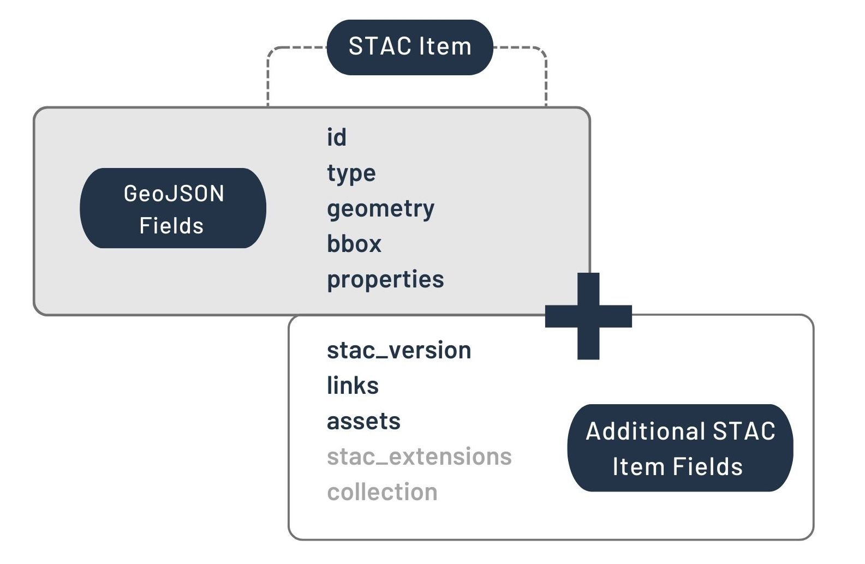
STAC Item
From https://stacspec.org/en/tutorials/intro-to-stac/
Notes:
A STAC Item is the foundational building block of STAC. It is a GeoJSON feature supplemented with additional metadata that enables clients to traverse through catalogs. Since an item is a GeoJSON, it can be easily read by any modern GIS or geospatial library. One item can describe one or more SpatioTemporal Asset(s). For example, a common practice of using STAC for imagery is that each band in a scene is its own STAC Asset and there is one STAC Item to represent all the bands in a single scene.

Slide 9
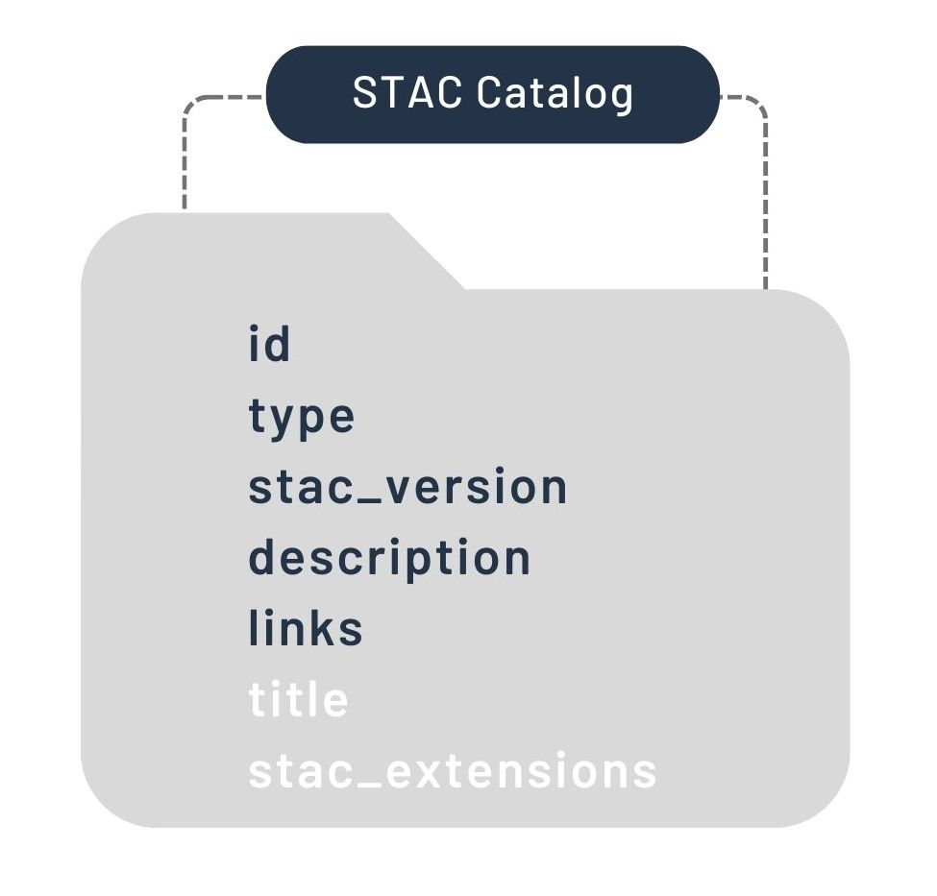
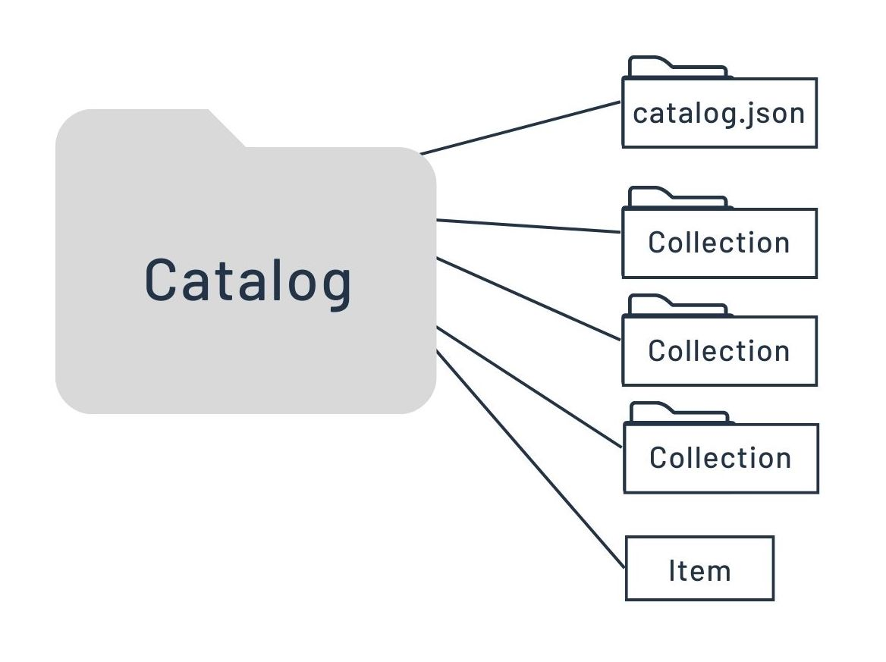
STAC Catalogue
From https://stacspec.org/en/tutorials/intro-to-stac/
Notes:
A Catalog is usually the starting point for navigating a STAC. A catalog.json file contains links to some combination of other STAC Catalogs, Collections, and/or Items.
We can think of it like a directory tree on a computer.
There are no restrictions on the way STAC Catalogs are organized. Therefore, the combination of STAC components within a STAC Catalog is quite variable and flexible. Most implementations use a set of 'sub-catalog(s)' that group the items in some sensible way. It can be easily extended, for example, to include additional metadata to further describe its holdings, as the STAC Collection does.

Slide 10
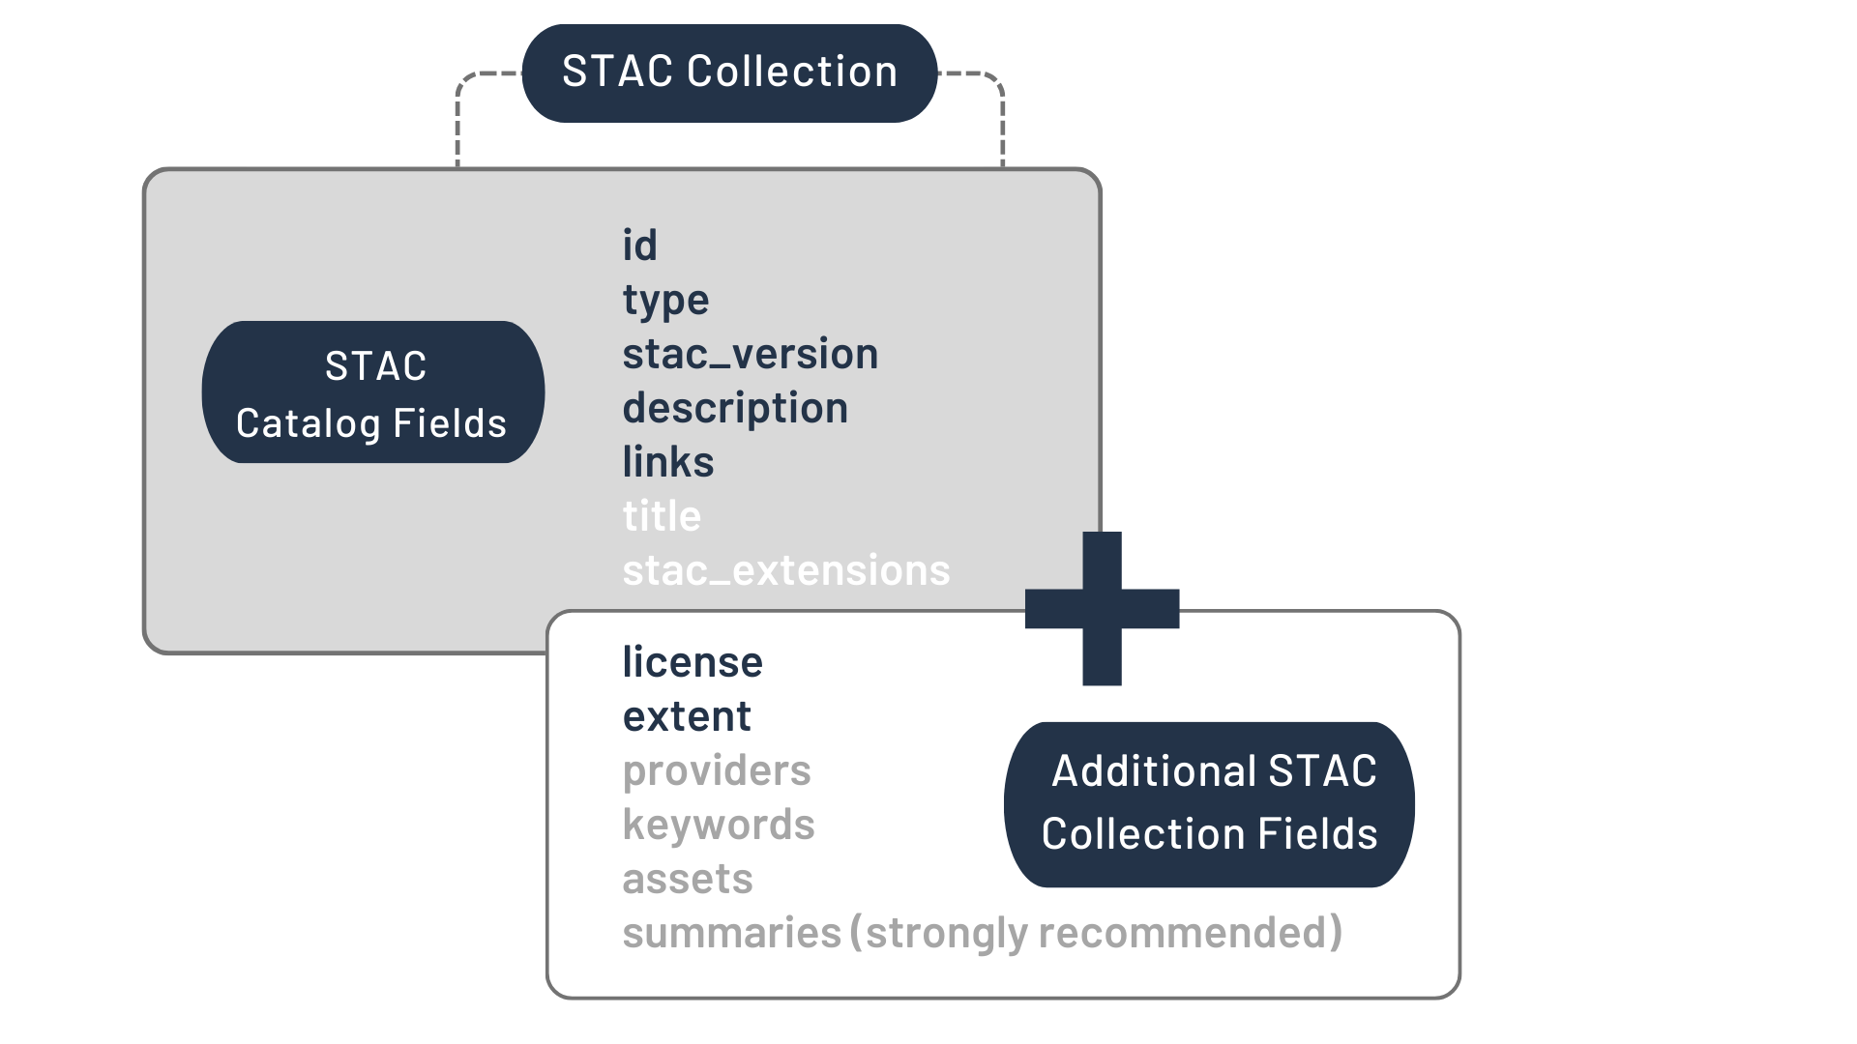
STAC Collection
From https://stacspec.org/en/tutorials/intro-to-stac/
Notes:
A STAC Collection builds upon the STAC Catalog specification to include additional metadata about a set of items that exist as part of the collection. It extends the parent catalog by adding additional fields to enable the description of information like the spatial and temporal extent of the data, the license, keywords, providers, etc. Therefore, it can easily be extended for additional collection-level metadata.

Slide 11
STAC API
The STAC API is a specification for web services that provides a standard way to search and retrieve STAC Items and Collections.
Compliant with OGC API – Features (OAFeat)
Features:
  Filtering by spatial and temporal parameters.
  Paging through search results.
  Extensibility for additional query parameters.
Benefits:
  Enables dynamic querying.
  Facilitates integration with other web services and applications.
GET /stac/search?bbox=[-180, -90, 180, 90]&time=2021-01-01T00:00:00Z/2021-12-31T23:59:59Z
{
"type": "FeatureCollection",
"features": [
{
"stac_version": "1.0.0",
"stac_extensions": [],
"type": "Feature",
"id": "CS3-20160503_132131_05",
"bbox": [],
"geometry": {},
"properties": {},
"collection": "CS3",
"links": [],
"assets": {}
}
],
"links": [
{}
],
"context": {
"returned": 1,
"limit": 5,
"matched": 314159
}
}

Slide 12
STAC Landscape
The adoption of STAC is a major trend in the remote sensing industry!
Adoption by major players to catalog and access earth observation data:
  Governmental organizations
    ESA - Copernicus Data Space Ecosystem (CDSE)
    NASA - Common Metadata Repository (CMR)
    USGS Astrogeology Provided Analysis Ready Data
  Large number of private companies support and uses STAC
    Commercial satellite imagery providers both Optical and SAR
    Data analytics companies
Examples of public catalogs: Planetary Computer (Microsoft), Earth Search (E84), Earth Engine Data Catalog (Google Earth Engine), Digital Earth Africa
Beyond satellite data: environmental models, scientific citations, Machine Learning labeling

Slide 13
STAC Extensions
{
"type": "Feature",
"id": "unique-id",
"bbox": [-180, -90, 180, 90],
"geometry": {
"type": ”Polygon",
"coordinates": [[…]]
},
"properties": {
"datetime": "2020-01-01T00:00:00Z”,
"title": "Example Item",
"description": "A description of the example item."
},
"assets": {
"image": {
"href": "https://example.com/image.tif",
"type": "image/tiff"
},
},
"stac_extensions": ["https://stac-extensions.github.io/license/v1.0.0/schema.json"]
}
Purpose:
Extensions allow for additional fields and functionality beyond the core specification.
Examples:
Temporal: Specifies temporal extent of assets.
Licensing: Provides licensing information.
Processing: Contains details about data processing steps.
Modularity: Extensions make STAC flexible and adaptable to different needs.

Slide 14
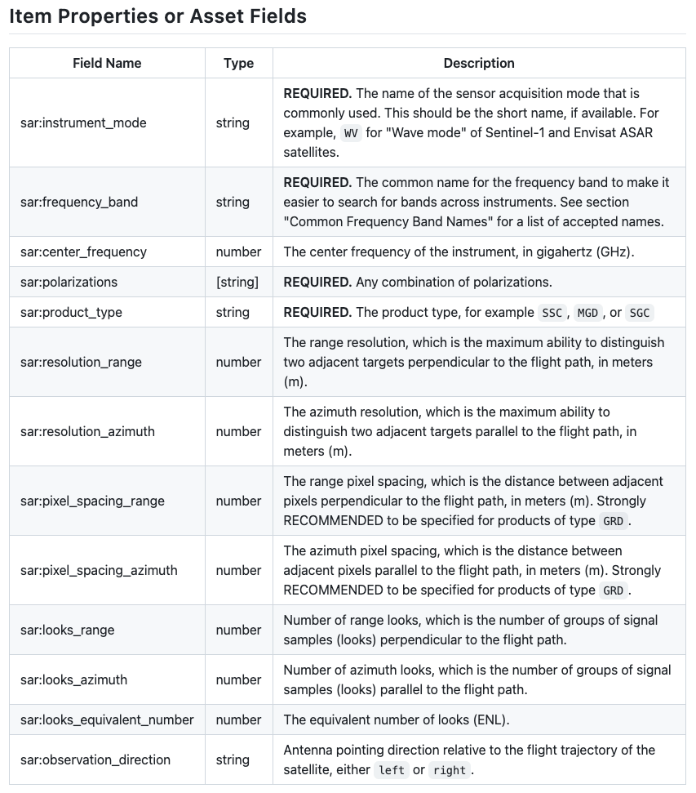
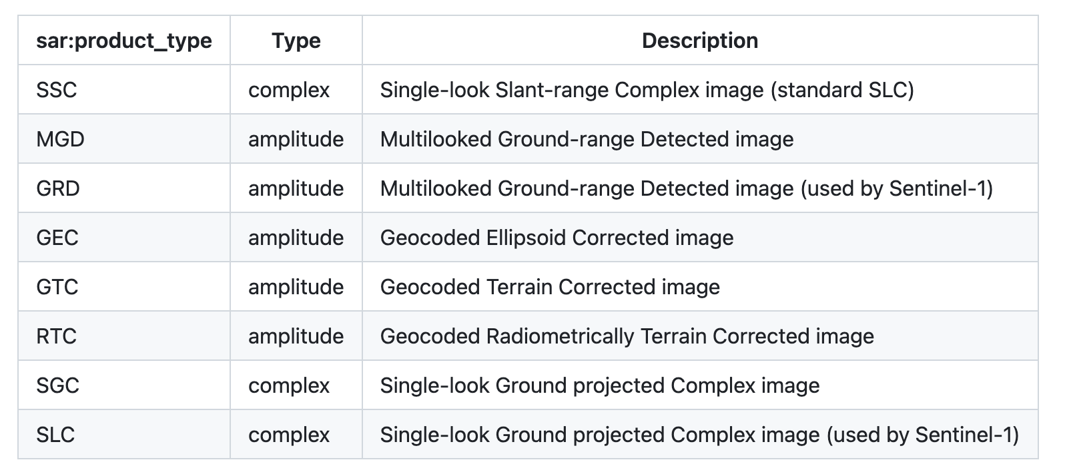
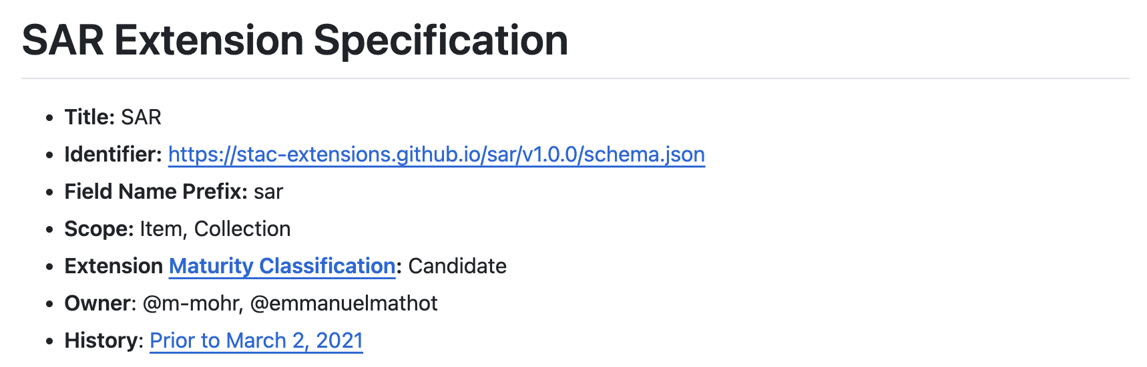
STAC Extensions
Community contributed effort https://github.com/stac-extensions
Extensions specialized on: payloads, missions, standards, models, applications and use cases
Example
"stac_version": "1.0.0",
"stac_extensions": [
"https://stac-extensions.github.io/sar/v1.0.0/schema.json"
],
"id": "sentinel-1-example",
"properties": {
"datetime": "2018-11-03T23:58:55.617217Z",
"start_datetime": "2018-11-03T23:58:55.121559Z",
"end_datetime": "2018-11-03T23:59:55.112875Z",
"platform": "sentinel-1a",
"constellation": "sentinel-1",
"instruments": [
"c-sar"
],
"sar:instrument_mode": "EW",
"sar:polarizations": [
"HH"
],
"sar:resolution_range": 50,
"sar:resolution_azimuth": 50,
"sar:looks_equivalent_number": 2.7,
"sar:frequency_band": "C",
"sar:center_frequency": 5.405,
"sar:product_type": "GRD”

Slide 15
Benefits of STAC
Discoverability: Easier to find relevant geospatial data.
Interoperability: Standardization (OGC API) facilitates integration with other tools and platforms.
Scalability: Built for Extendability through Core and API extensions mechanisms
Community Support:
Growing community and ecosystem around STAC.
Increasing adoption by space agencies and major industries: large availability of public STAC catalogs
Community Driven:
Open source
Foster open contribution

Slide 16
Getting Started with STAC
Tools and Resources:
PySTAC: Python library for working with STAC.
STAC Browser: Web-based tool for exploring STAC catalogs.
STAC Validator: Tool for validating STAC JSON files.
STAC API: Use API endpoints to query and retrieve data.
Documentation:
Provide links to the official STAC documentation and community resources:
STAC Specification
STAC API
PySTAC Documentation

Slide 17
Demo
Within the Copernicus Data Space Ecosystem (CDSE) project there are two main STAC implementations:
  Basic catalogue
  STAC development catalogue with a wide range of extensions enabled and all STAC assets loaded – an agile development to encourage feedback
The main objective of the CDSE STAC catalogue is to:
  Provide a complete archive of Sentinel user-level products including additional collections eg. COPDEM
  Provide a comprehensive set of metadata at each STAC level (collection, item, asset)
  Include a wide range of STAC extensions, maximising interoperability and functionality
  Contribute to the EOPF STAC extension and modify (slim-down) the Sentinel extensions for ESA satellite missions together with the STAC community

Slide 18
STAC in Future Sentinel Re-Engineered Data Formats
Roberto De Bonis, Davide Castelletti, Vincent Dumoulin
ESA ESRIN
06/06/2024

Slide 19
Why Data Processors Re-Engineering
Open-source code
Benefit from new technologies
Preserving the original algorithm and data quality
Legacy Sentinel data processors modernisation
Generic Framework for future missions
ESA Copernicus Earth Observation Processor Framework (EOPF) allow:
The full transition of the Ground Segment to a cloud environment
The shift to a paradigm that offers at any point in time the latest version of the data

Slide 20
Data Model and Product Design
Cloud Optimized Format
Cloud storage for data dissemination and concurrent processing
Open Source
Python-based, native support to dask/numpy/xarray
Large adoption in the data science and EO community
Self-explanatory Product
Clear documentation of the metadata
Compliant with CF standard
Cloud-optimized data formats (Zarr)
User accessibility
Based on Unidata Common Data Model
Well-established formats and best practices
Interoperability
Flexible and Scalable
Harmonized Structure
Conversion Capabilities
Unified structure across Sentinels
Standards and protocols for easy integration of EO datasets and applications
Accommodate different types of EO data and sensor technologies
From small scale observation to large datasets
Backward compatibility
New EOPF model to SAFE/COG/NETCDF
Time series ready
Copernicus Expansion

Slide 21



Cloud Native Data Format: Zarr
Xarray
PyStac
StackStac...
STAC Catalogue
New Sentinel Processors
Data Converter
COG,
NCDF, SAFE

Slide 22
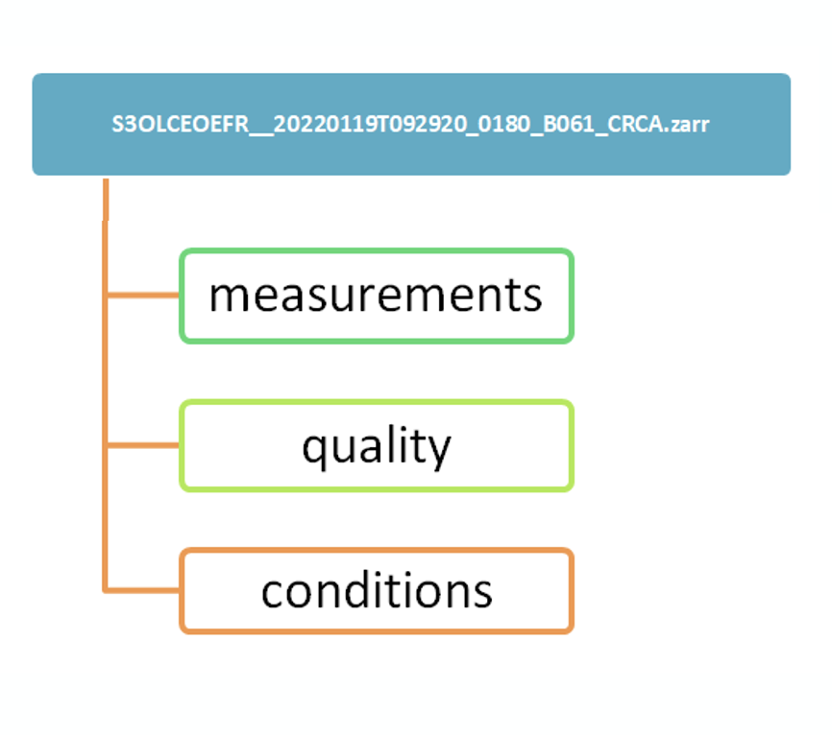
EOPF Product Structure
The EOPF Product Structure is a standardized framework applicable across all Sentinel missions, offering complete flexibility for defining extensions, which is then tailored in detail for each Sentinel product.
EOPF Product
Contains variables for the sensed data
Can contain subgroups, in particular if there are primary measurements and orphans or if there are different grids.
Contains variables with flags and quality information that help to filter measurements.
Can contains subgroups, e.g. in case of different grids.
Contains variables that describe measurement conditions:
Can be geometric (angles), meteorological (under discussion), and instrumental (detectors, clock, …).
An EOProduct comes with global attributes which are discovery metadata following the STAC standard.

Slide 23
EOPF Metadata
The Product Global Attribute incorporates three primary metadata categories:
Discovery Metadata → STAC:
  Can utilise extensions encompass “processing,” “sat,” "sar," “view,” “eo,” “scientific,” “projection,” and “classification.”
  Integration of mission-specific extensions is avoided to achieve harmonized metadata across various missions.
  Additionally, an EOPF STAC extension to accommodate specific fields typical to (ESA) EO catalogues, such as processing baseline, datatake_id, etc.
Other Metadata → JSON: elements beyond product discovery, providing extensive details such as sensor states, orbit parameters, etc.
Processing History Metadata → JSON: a comprehensive record of all processing steps post-acquisition.

Slide 24

Data Processor
The documentation describing the design and interfaces of the Re-Engineered Data Processors will be gradually availabe on the EOPF web-site in the line with the implementation schedule:
https://eopf.copernicus.eu/

Slide 25
Demo
Future Sentinel 1 analysis ready data
Sentinel 2 Stac Zarr data access:

Slide 26
Questions
ESA ESRIN
06/06/2024

