Slide 1


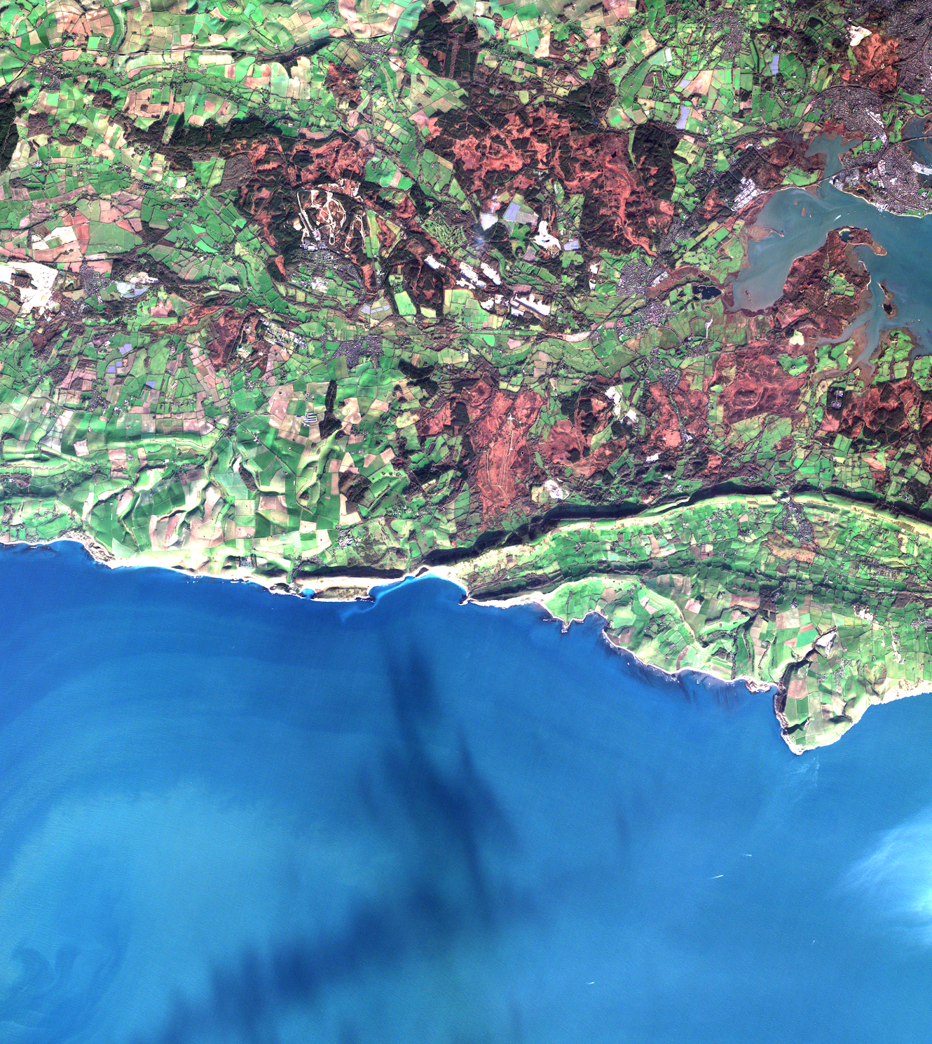






STAC at CEDA
STAC Workshop (ESA)
6th June 2024
Rhys Evans
(and CEDA/JASMIN Teams)

Slide 2

Who are CEDA
Mission: To provide data and information services for
environmental science
Centre for Environmental Data Analysis https://ceda.ac.uk
People: ~40 staff
Data scientists
Software engineers
Community outreach/training
Project management
User support/helpdesk
Range from 20+ years to early careers!
Rutherford Appleton Laboratory (RAL)
– Oxfordshire

Slide 3



Our Services
Collaborative Projects
JASMIN
CEDA Archive
jasmin.ac.uk
archive.ceda.ac.uk
Data intensive supercomputer
Over 44 Petabytes storage
Jointly managed with STFC Scientific Computing Department
Long-term data archive
Over 22 Petabytes of atmospheric and earth observation data
Working on numerous projects at a time
Split between multiple organisations

Slide 4
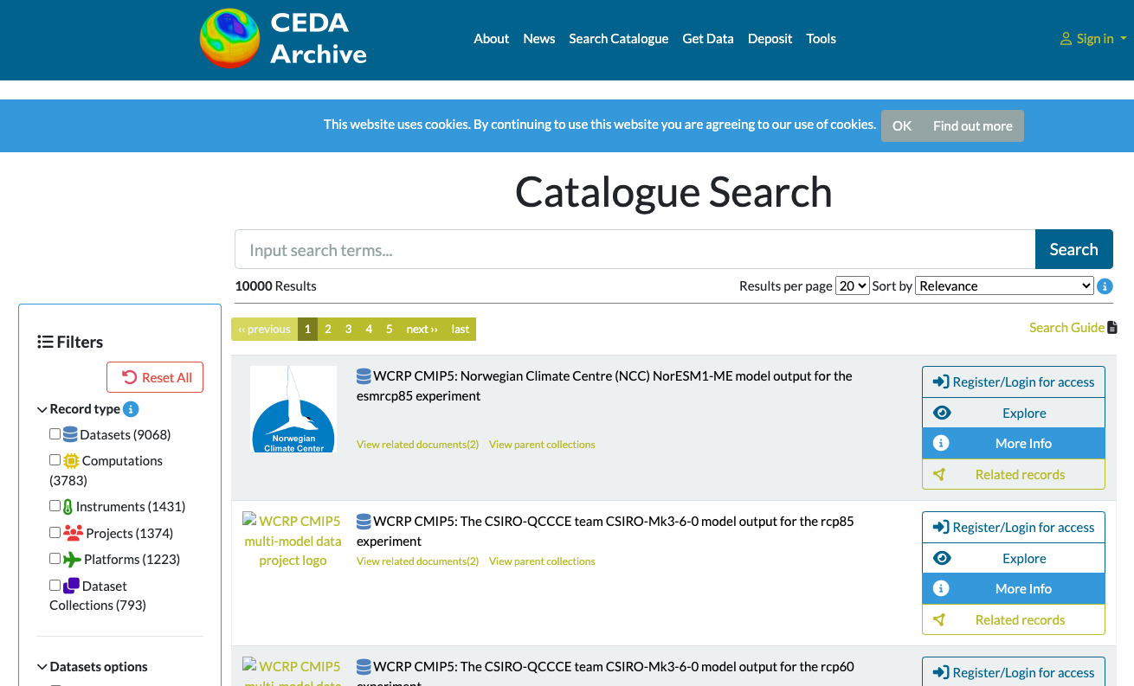
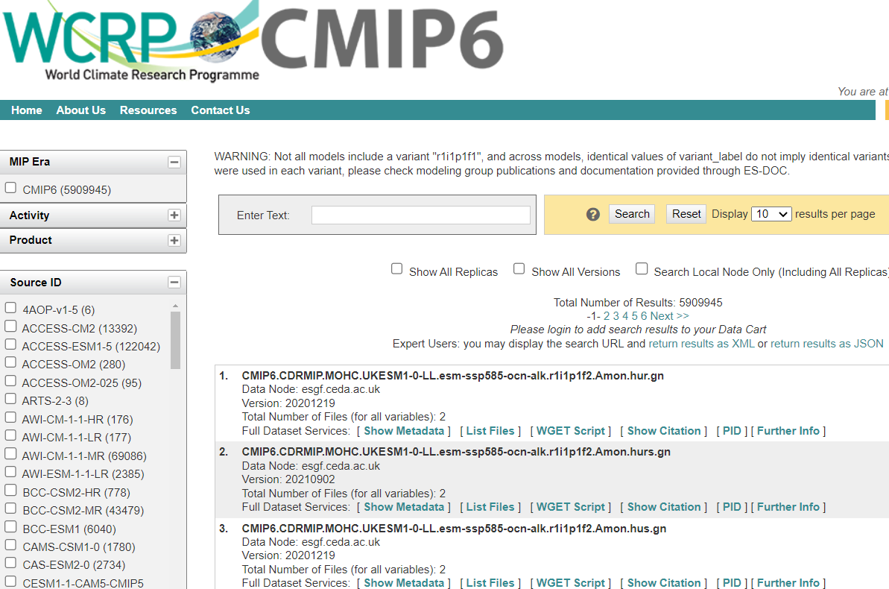
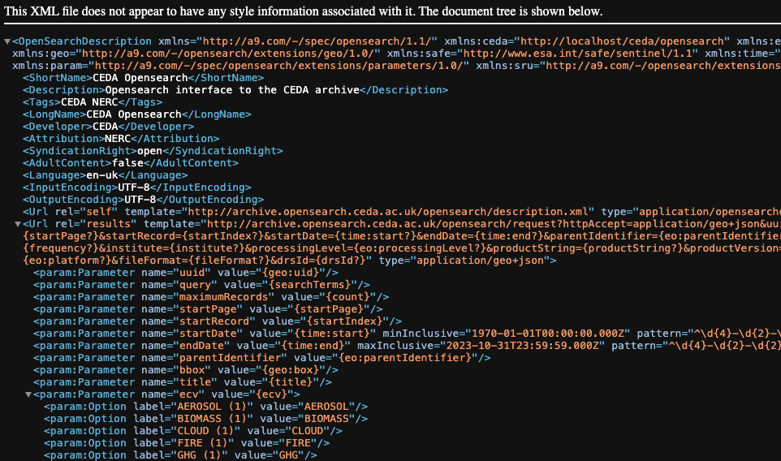
Searching at CEDA
CATALOG
ESGF
CCI
catalog.ceda.ac.uk
esgf.ceda.ac.uk/esg-search
archive.opensearch.ceda.ac.uk
CEDA bespoke
Whole archive
Elasticsearch
ESG Search
CMIP, CORDEX, obs4MIPs, SPECS, EUCLIA, CLIPC
SOLR
Opensearch
CCI products
Elasticsearch

Slide 5

One standard to rule them all…

Slide 6
Success with STAC

Slide 7

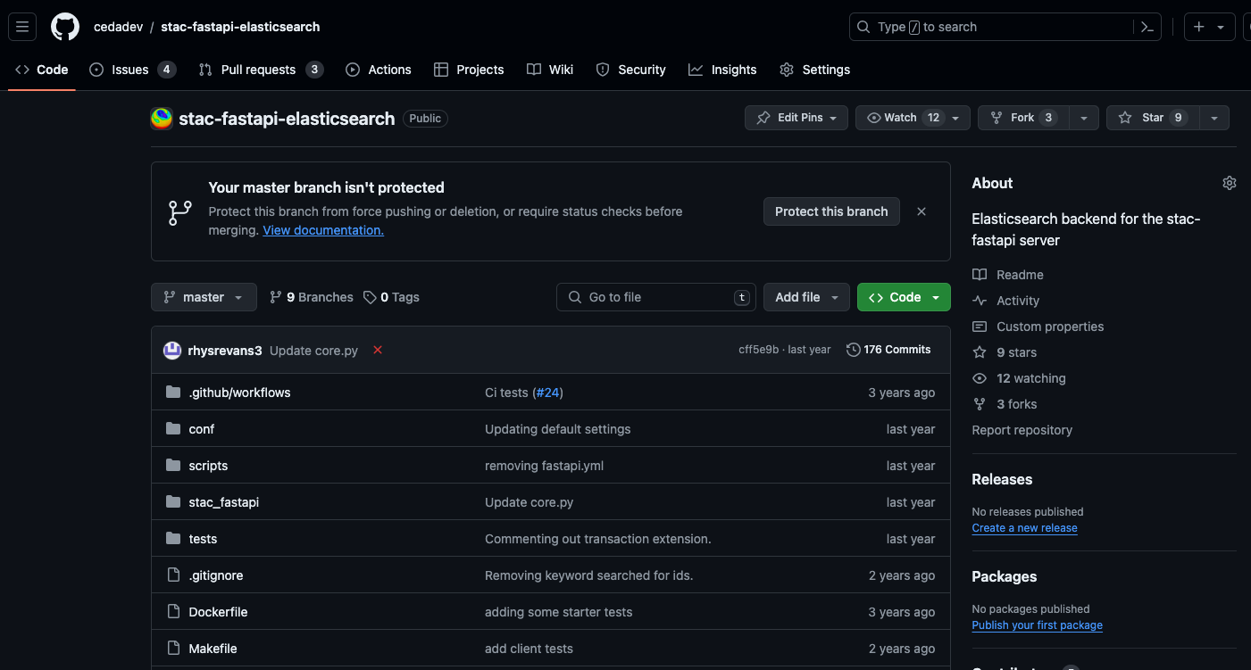
Elasticsearch backend

Slide 8
Extensions
API
Free-text search
https://github.com/stac-api-extensions/freetext-search
context-collection
https://github.com/cedadev/stac-context-collections
Asset search (deprecated)
https://github.com/cedadev/stac-asset-search
Core
CMIP6
https://github.com/stac-extensions/cmip6

Slide 9
The STAC Generator
# The paths that the recipe will be run on
paths:
- https://cmip6-zarr-o.s3-ext.jc.rl.ac.uk/CMIP6.CMIP.MOHC.UKESM1-0-LL
- https://cmip6-zarr-o.s3-ext.jc.rl.ac.uk/CMIP6.C4MIP.MOHC.UKESM1-0-LL
# The type of STAC record that will be generated
type: item
# These extraction methods will be run after `extraction_methods` and generate the record id
id:
- method: default
inputs:
defaults:
item_id: $instance_id
# The extaction methods are run in series the output dictionary is passed from one to the next
# extaction methods add, update or remove the data from the output dictionary
extraction_methods:
- method: regex
inputs:
regex: '\/(?P<mip_era>\w*)\.(?P<activity_id>\w*)\.(?P<institution_id>[\w-]*)'
- method: string_template
inputs:
template: '{mip_era}.{activity_id}.{institution_id}.{source_id}.{table_id}.{var_id}.{version}'
output_key: instance_id
# Some methods generate assets these can also include extraction methods to be run on the assets
- method: intake_assets
inputs:
uri: https://raw.github.com/cedadev/cmip6-object-store/catalogs/ceda-zarr-cmip6.json
object_path_attr: zarr_path
search_kwargs:
mip_era: $mip_era
activity_id: $activity_id
institution_id: $institution_id
source_id: $source_id
table_id: $table_id
variable_id: $var_id
version: $version
extraction_methods:
- method: default
inputs:
defaults:
roles: ["data"]
- method: lambda
inputs:
function: 'lambda assets: assets[key] for en, key in enumerate(sorted(assets))}'
input_args:
- $assets
output_key: assets
- method: remove
inputs:
keys:
- uri
# member of defines the other recipes that define a parent of this record
member_of:
- recipes/collection/CMIP6.CMIP.MOHC.UKESM1-0-LL.yaml
STAC Generator
Recipes
{
generator: ...
inputs: [...]
outputs: [...]
}
BADC
{
paths: [...]
id: {...}
ex_ms: {...}
}
FAAM
CMIP6
Inputs
Generators
Outputs
File System
Item
Rabbit MQ
Object Store
Asset
Collection
JSON
Intake ESM
CSV
text file
Extraction Methods
Intake ESM
Rabbit MQ
regex
Posix stats
JSON file
Standard out
Elasticsearch
Elasticsearch
Object store stats
Elasticsearch
header
xml
default
github.com/cedadev/stac-generator

Slide 10
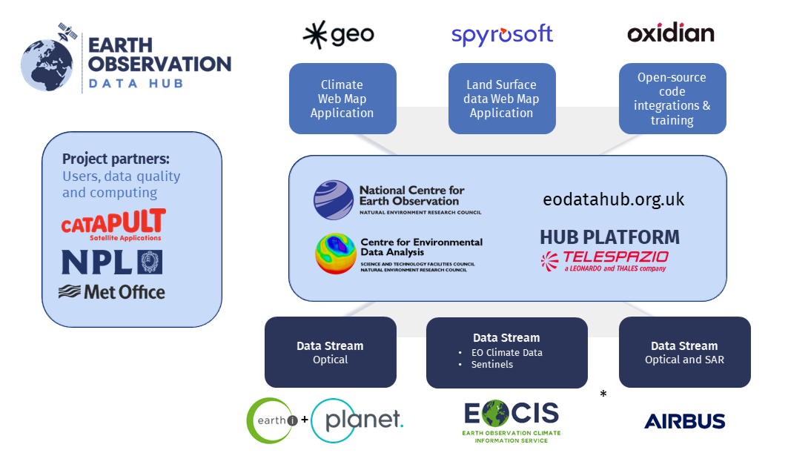
EO DataHub

Slide 11

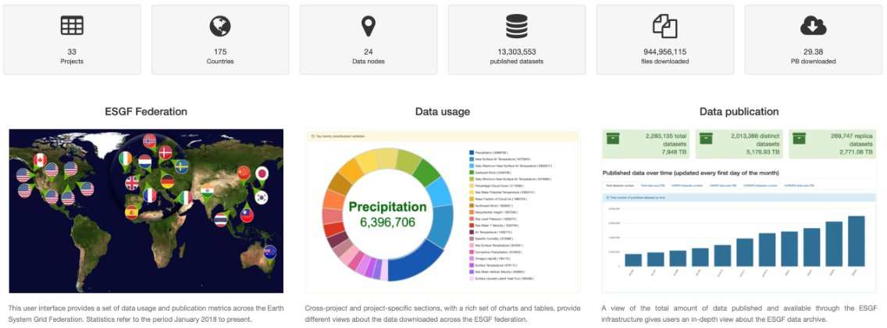
Earth System Grid Federation: a globally distributed data archive for climate data​

Slide 12
Earth System Grid Federation: a globally distributed data archive for climate data​
Consumer
CEDA
Publisher
Event store
Consumer
USA

Slide 13
Learning opportunities with STAC

Slide 14
Elasticsearch backend

Slide 15
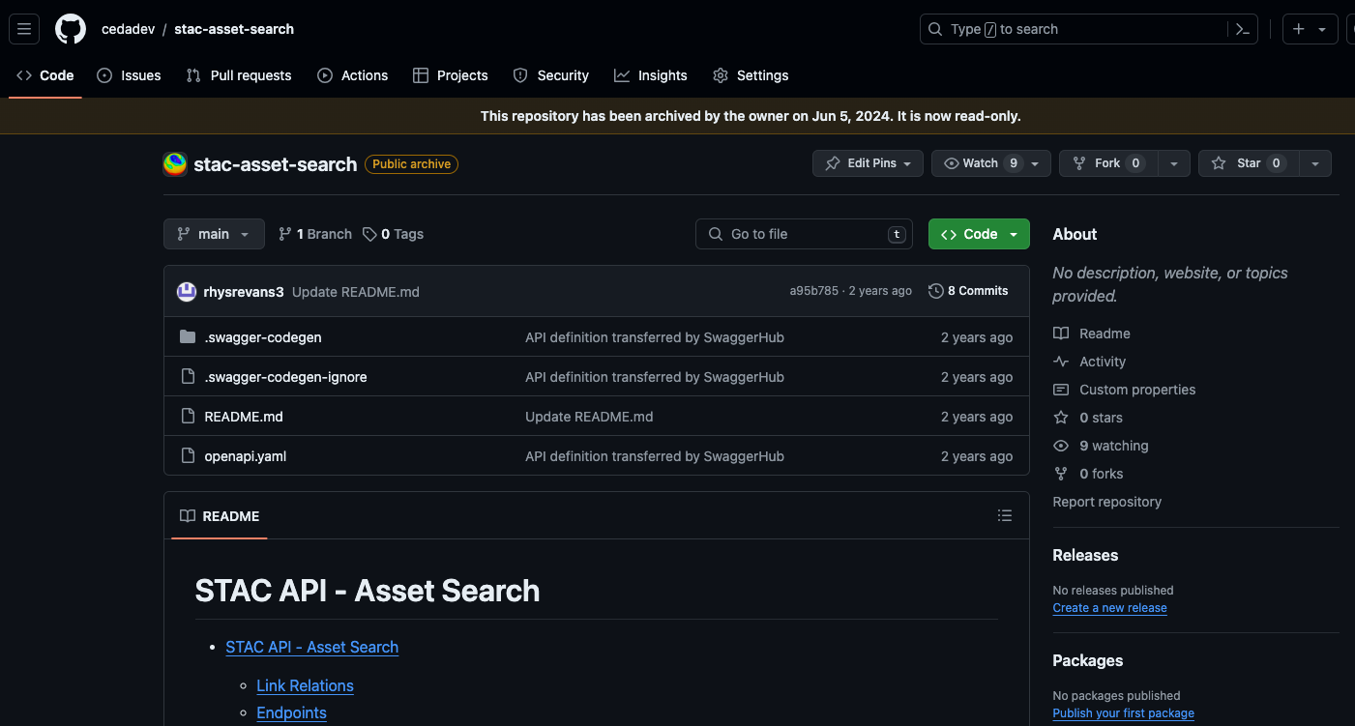
Asset Search

Slide 16
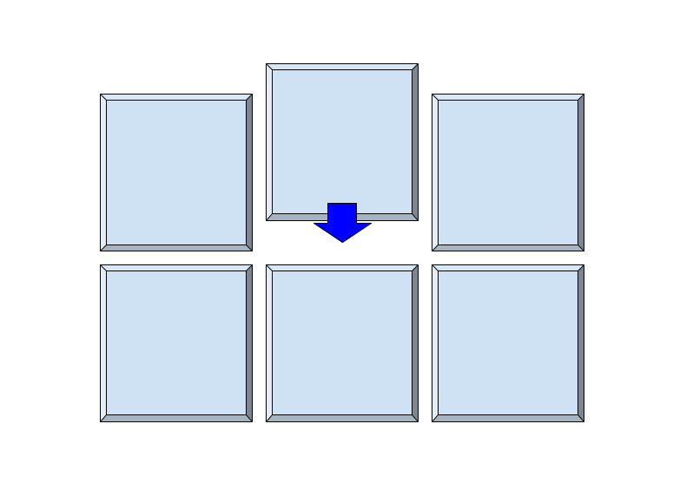
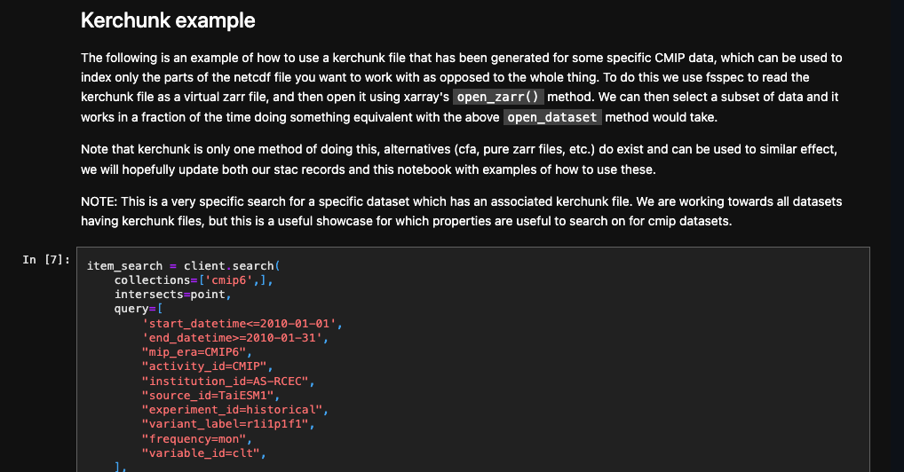
Kerchunk
github.com/cedadev/stac-notebooks
Notes:
Our solution is kerchunk
A virtual zarr format
Zarr like interface without generating the zarr file
We have a reference asset
Users can load this reference file using xarray
And perform further filtering
We’ve got a notebook demonstrating that workflow

Slide 17
Lessons Learnt

Slide 18

STAC Spec & API Spec & STAC FastAPI
are different

Slide 19

With great flexibility comes great responsibility

Slide 20

Stick with the heard

Slide 21
Questions we have
Can we use STAC to store non-spatial data?
How would non-spatial data effect discovery?
Can STAC be used to search across catalogues?
Can STAC be integrated with non-STAC catalogues?
Do we need some kind of Asset filtering?
Can we use STAC extensions for specific parts of our archive?

Slide 22

Thank you!
JASMIN: support@jasmin.ac.uk
CEDA: support@ceda.ac.uk
Twitter - @cedanews
Website - www.ceda.ac.uk

