Slide 1
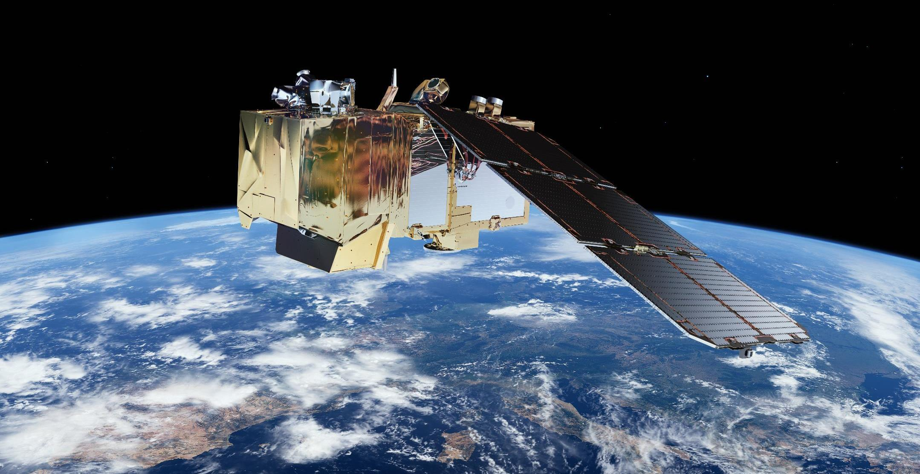
STAC in CDSE openEO
STAC workshop
Jeroen Dries

Slide 2
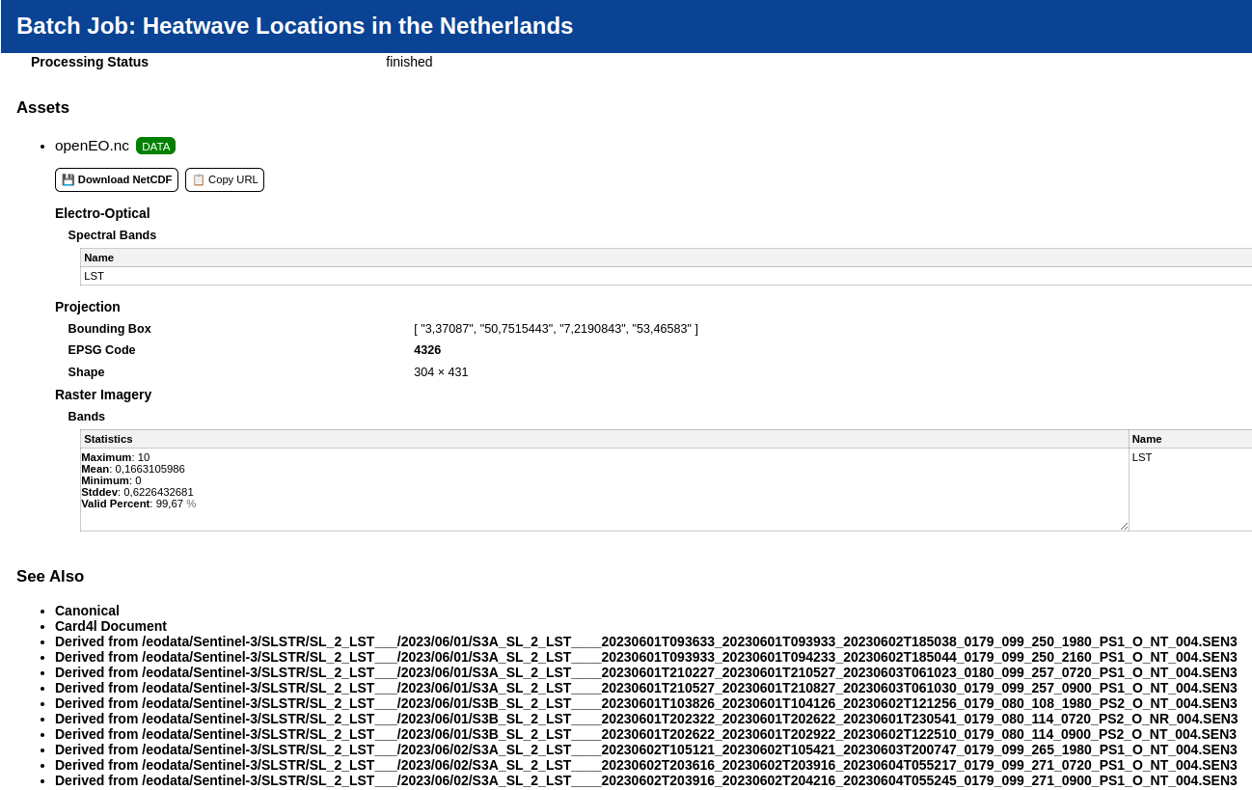
OpenEO use of STAC
Copernicus Data Space Ecosystem
Data input: openEO reads from STAC catalog
Data output: openEO generates rich STAC metadata (FAIR principles)

Slide 3
How STAC improves openEO CDSE performance
STAC in openEO - VITO
Building a 'datacube' requires knowing specific raster metadata properties:
Projection
Exact bounding box/geometry
Data type
Old approach: read metadata from raster files via many slow object storage requests
STAC approach: read all metadata as part of catalog query
=> STAC approach is drastically faster for storage systems with high latency
Depends on projection extension!

Slide 4
EO project architectures
STAC in openEO – VITO
Reference data Mgmt
openEO
Proprietary
Processing
...
Data Viewer
Ref DB
Processing DB
X
Processing DB
Y
Viewer DB

Slide 5
STAC based project architectures
STAC in openEO - VITO
Reference data Mgmt
openEO
Proprietary
Processing
...
Data Viewer
Example EU projects:
Evoland (CLMS)
EU Grassland Watch
LCFM
STAC catalog
Datastore
Object Storage

Slide 6
Final goal
OpenEO VITO
Exchange geographical datasets between (unrelated) systems, via STAC.

Slide 7
Interoperability challenge
STAC in openEO - VITO
STAC specification allows a very broad range of options.
This is what makes STAC flexible and easy to adapt to very specific use cases.
(Close to) impossible for components to support _any_ STAC catalog.
Solution: STAC 'profiles' for specific use cases

Slide 8
Interoperability: collection layout
STAC in openEO - VITO
STAC allows heterogenous collections, but:
Collection level metadata becomes very generic
Assets in returned items can differ: hard to convert to datacube
Users need to know the property to filter on to find the 'subcollection' in the collection
Best practice: favor homogenous collections whenever possible

Slide 9
Questions?
More info:
https://documentation.dataspace.copernicus.eu/APIs/openEO/fair.html
Jeroen.dries@vito.be

