Slide 1
CDSE STAC catalogue
Marcin Niemyjski, Jan Musiał

Slide 2
CDSE STAC updates
Done/Ongoing:
CDSE STAC catalogue available for testing: https://stac.dataspace.copernicus.eu/v1
CDSE STAC browser available: https://browser.stac.dataspace.copernicus.eu
CDSE STAC browser deployment available: https://github.com/eu-cdse/stac-browser-cdse
Please report CDSE STAC browser issues here: https://github.com/eu-cdse/stac-browser-cdse/issues
Browser for CDSE demo catalogue not available anymore: https://cdse-browser.mohr.ws
Browser for CDSE demo catalogue available with standard STAC Browser:
https://radiantearth.github.io/stac-browser/#/external/pgstac.demo.cloudferro.com
Benchmarking of the CDSE STAC production environment done
Jupyter notebook with example usage (stackstac) ready
Setting up Sentinel-2 querable attributes

Slide 3
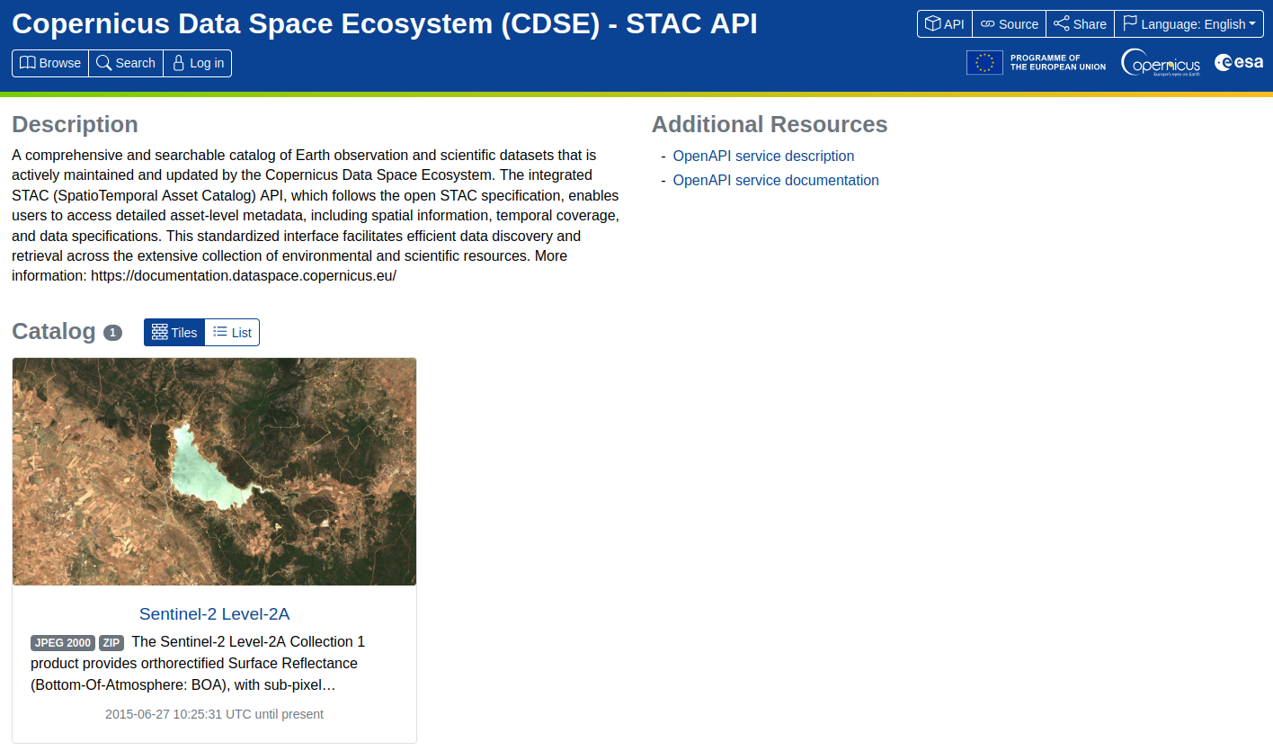
https://stac.dataspace.copernicus.eu/v1

Slide 4




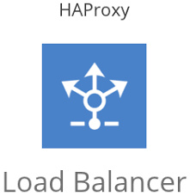



CDSE STAC Architecture
PGSTAC
FastAPI
300 replicas
1.5 CPU each
PGSTAC
RO replica
PGSTAC
RW replica
F5 Web Application
Firewall
with traffic limitting
STAC
JSON
user
PGSTAC
RO replica

Slide 5
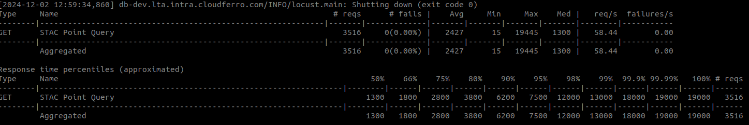
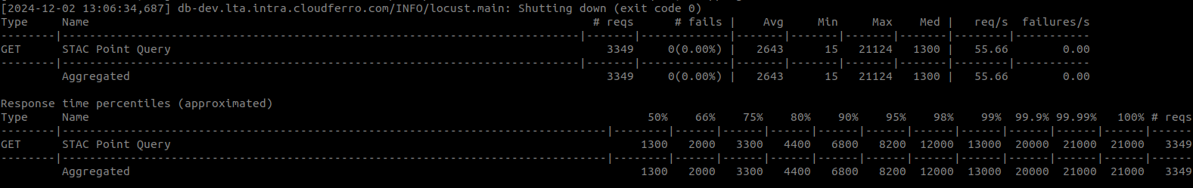
1000 users asking for 100 products at a time over Europe with random square polygon located in random place
10000 users asking for 100 products at a time over Europe with random square polygon located in random place
https://stac.dataspace.copernicus.eu/v1

Slide 6
CDSE STAC updates
Upcoming soon:
Sentinel-2 mosaics collection to be added (this week)
Testing full set of functionalities of the CDSE STAC API (this week)
Implementation of footprint simplification
Setting up limits for the CDSE STAC catalogue based on the performed benchmarks (next 2 weeks)
Setting up the ARGO Events K8S STAC item ingestion workflow based on the catalogue subscriptions to ingest
Sentinel-1 GRD COG collection
Sentinel-5P with data cube extension

Slide 7
CDSE STAC updates
Suggested limits:
?100 items per query?
30s timeout for query
10 000 parallel connections to STAC API
20 parallel request per IP
Whitelisting of some IP

Slide 8
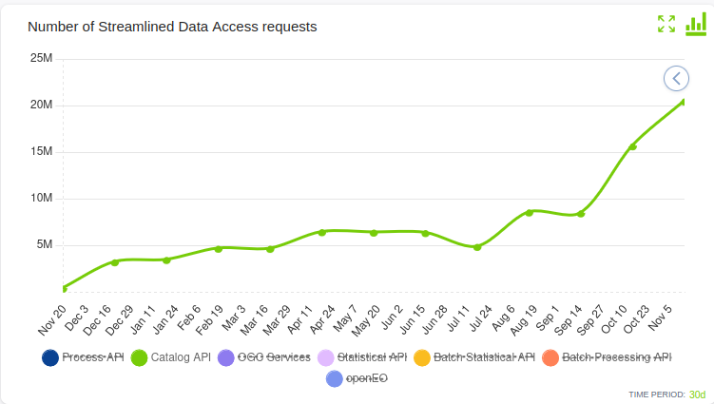
CDSE STAC problems
StackStac is not compatible with latest STACv1.1 implementation due to problem with EPSG code:
https://github.com/gjoseph92/stackstac/issues/262
STAC browser not compatible with EOPF extension
Burst DataTakeID vs MissionDataTakeID in annotation data
<downlinkValues>
<dataTakeId>61568</dataTakeId>
<adsHeader>
<missionDataTakeId>81016</missionDataTakeId>
Sentinel-5 repro no clear how to select new baseline
STAC Data Cube extension too big to be implemented for Sentinel-3
(Sentinel-3/SLSTR/SL_1_RBT___: 97 netCDF file(s), 356 dimensions, 1028 variables)
No reporting from CDSE STAC <- next year potentially may decrease the number of Odata CDSE catalogue requests. Potential problem for the annual report:

Slide 9
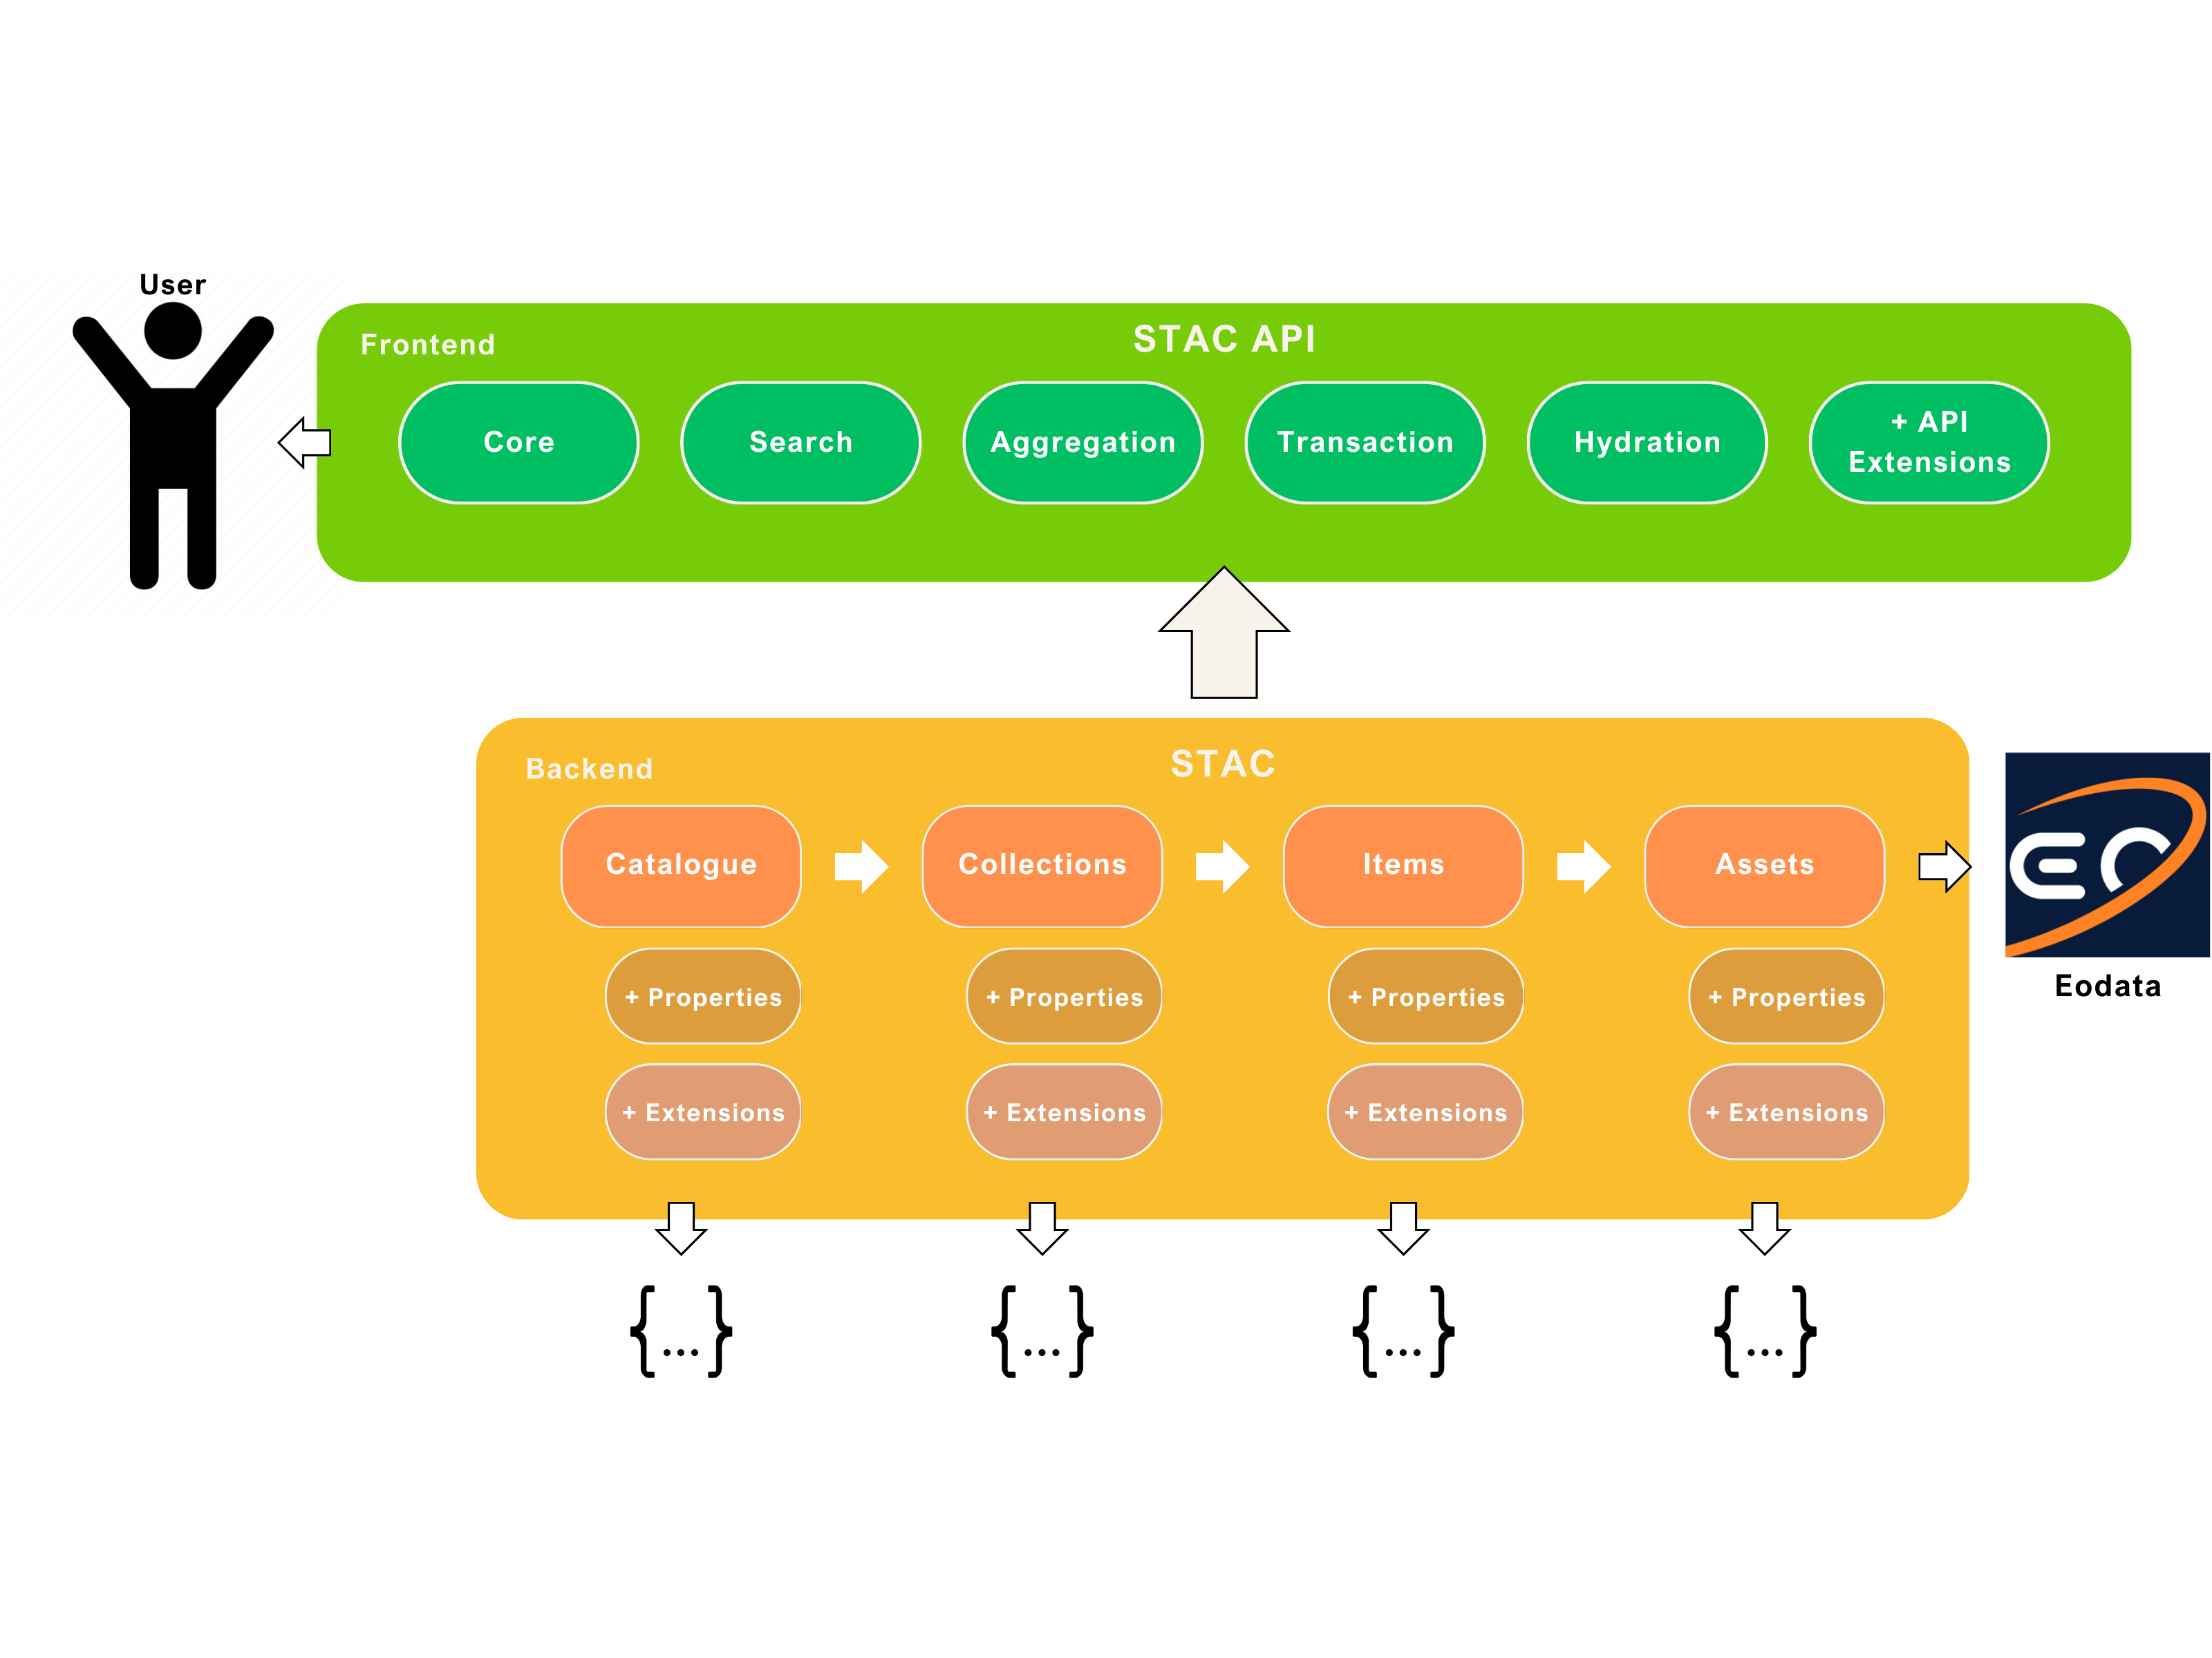
STAC Specification

Slide 10
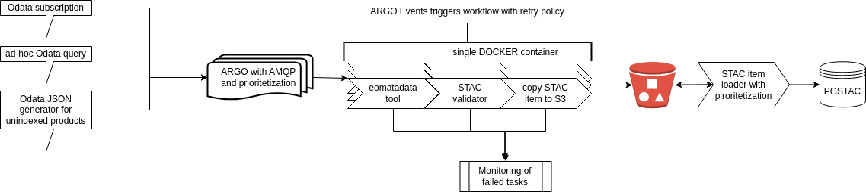
Workflow graph

Slide 11
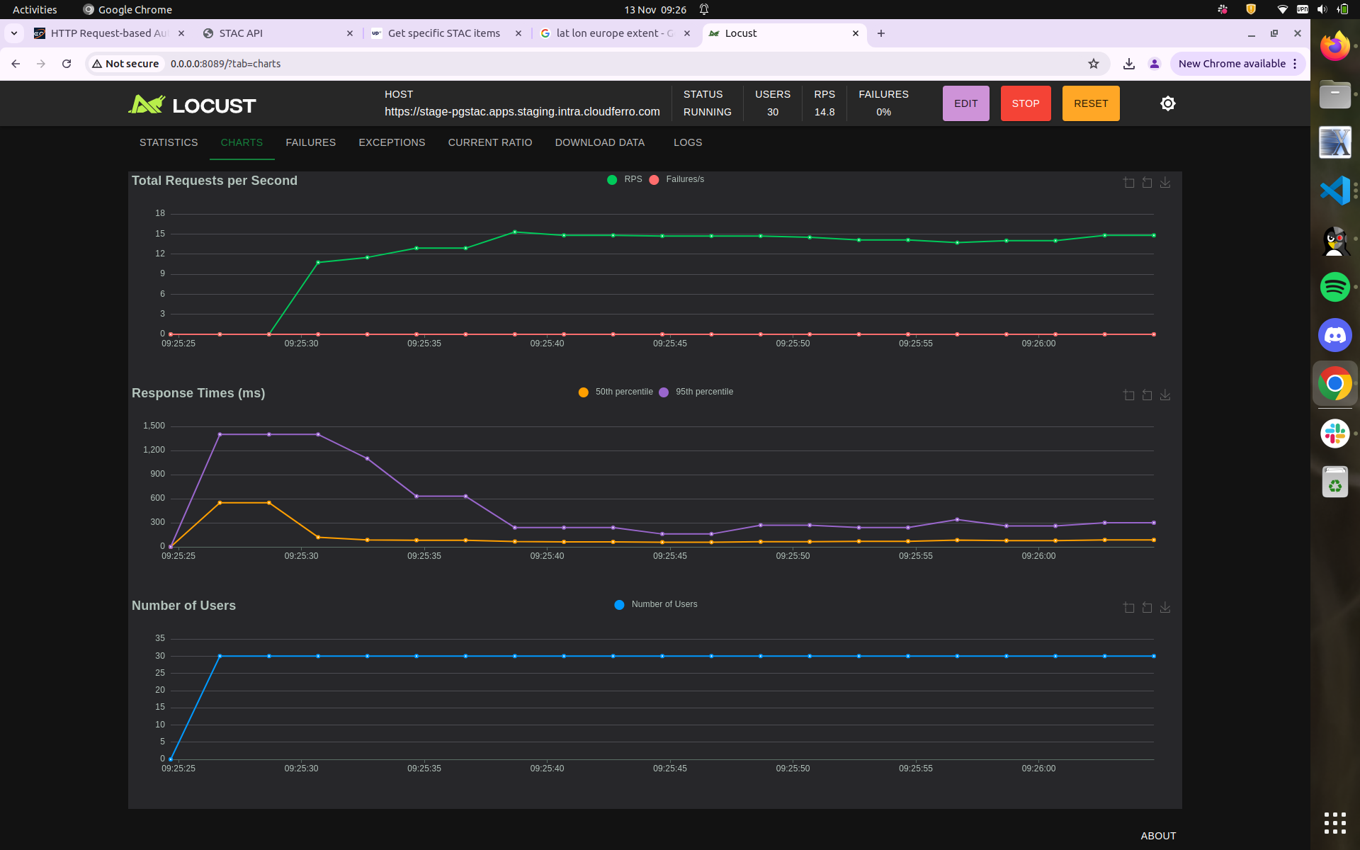
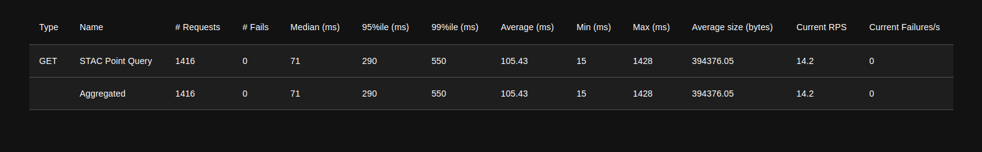
Locust benchmarking API

Slide 12
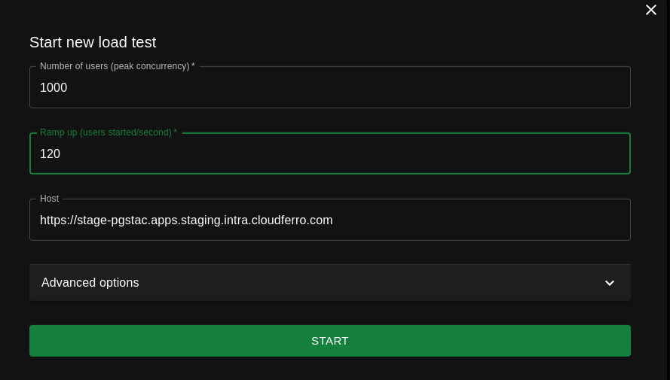
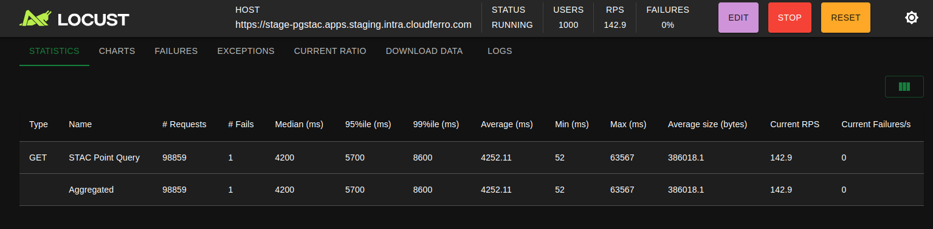
Locust benchmarking API

Slide 13
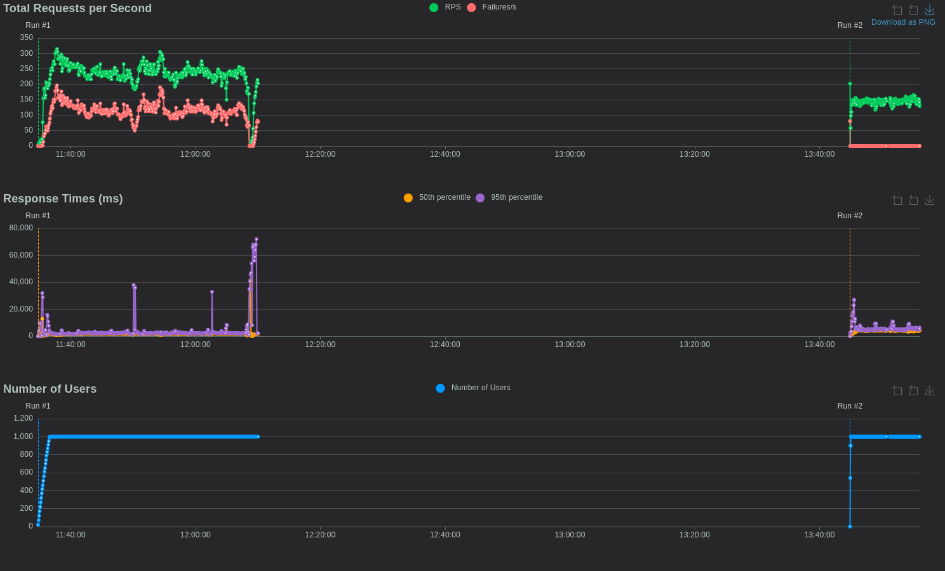
Locust benchmarking API

Slide 14
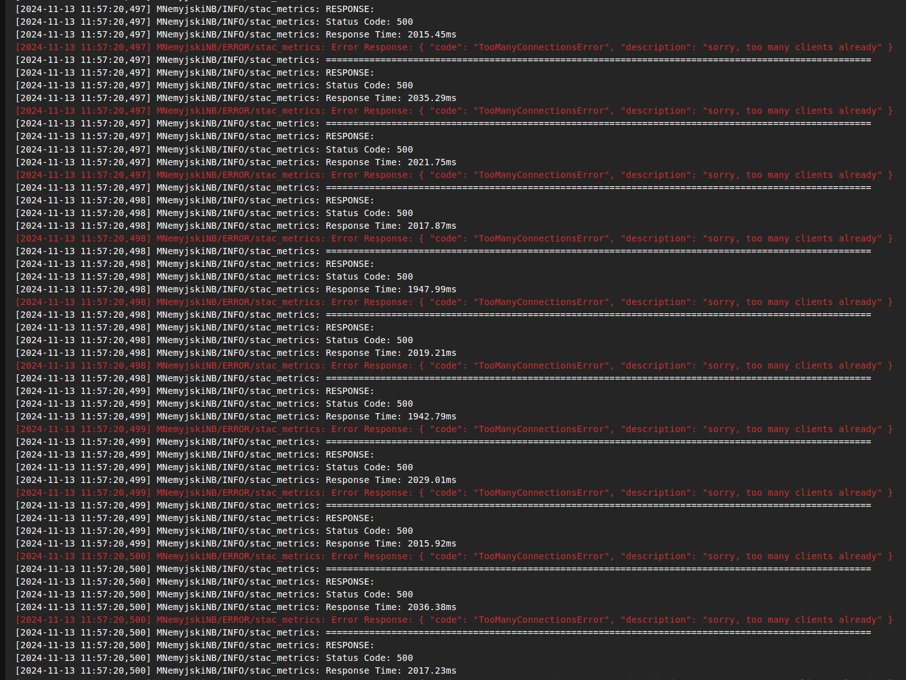
Locust benchmarking API

Slide 15
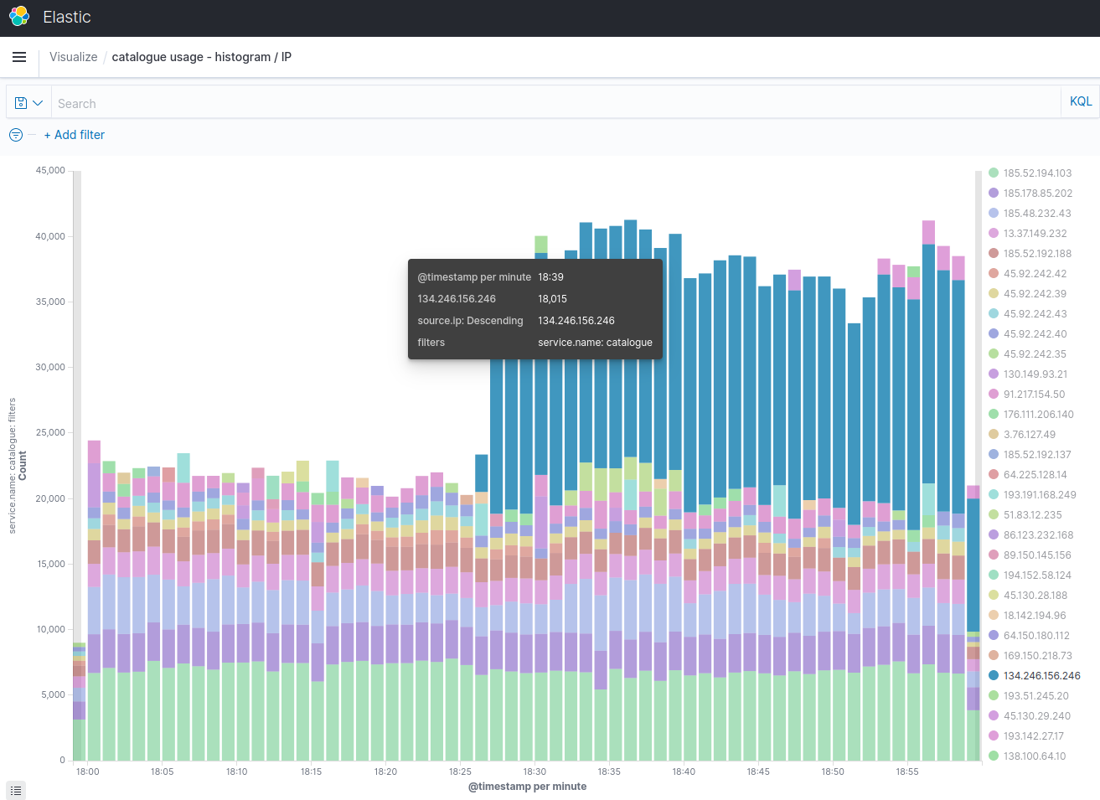
Odata requests per minute

Slide 16
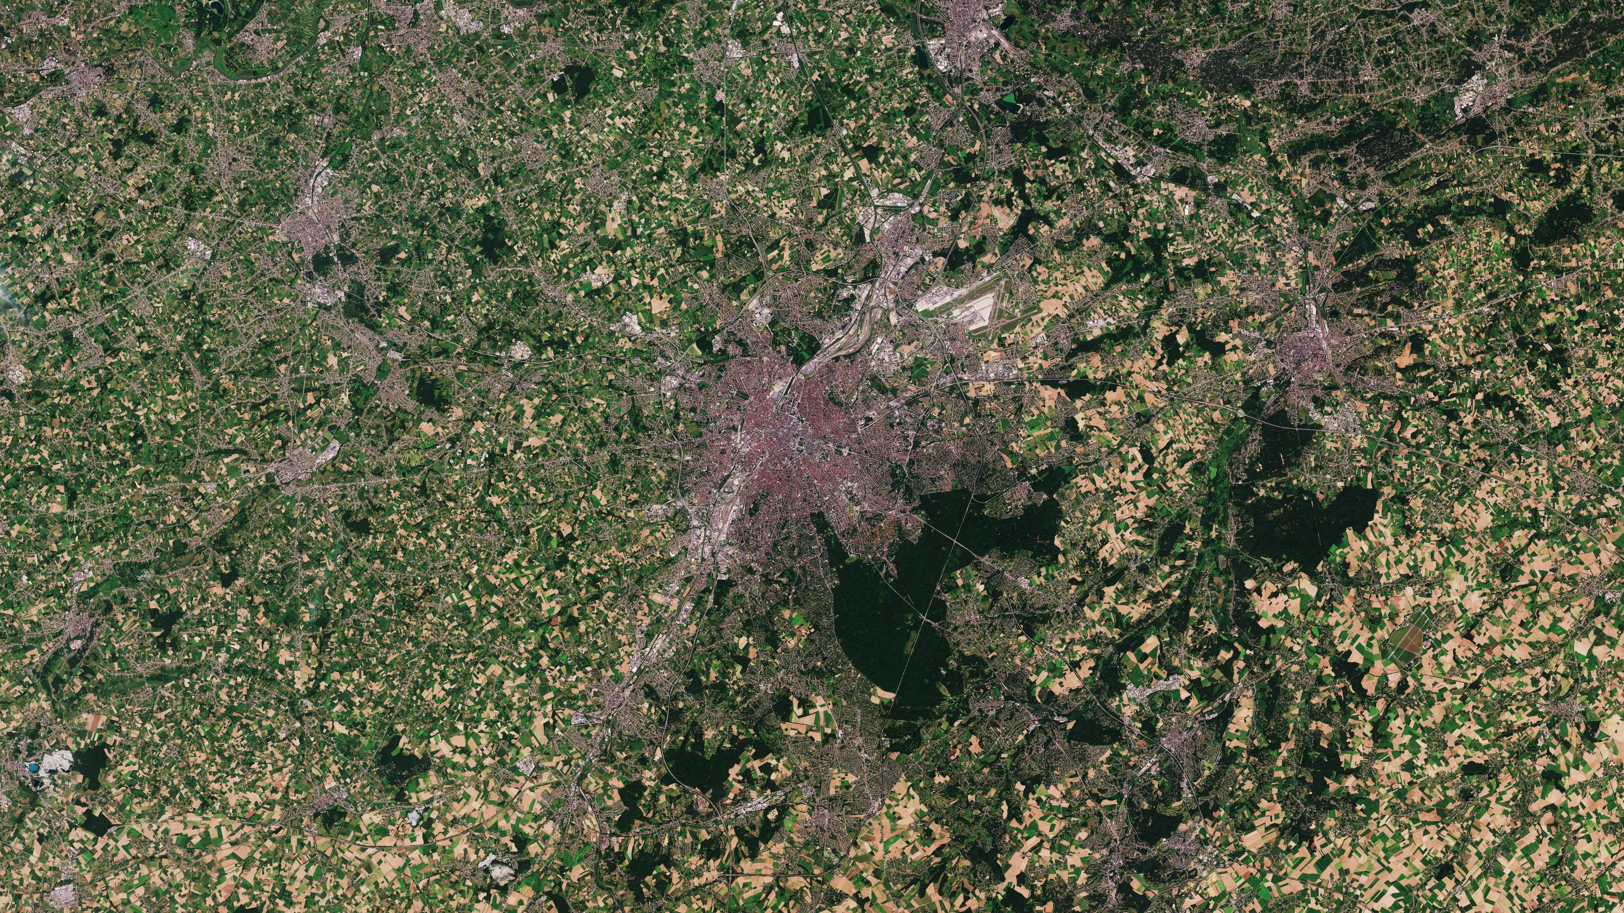
Thank you!
mniemyjski@cloudferro.com
jmusial@cloudferro.com

