Slide 1
Storing ZARR on S3 for STAC

Slide 2
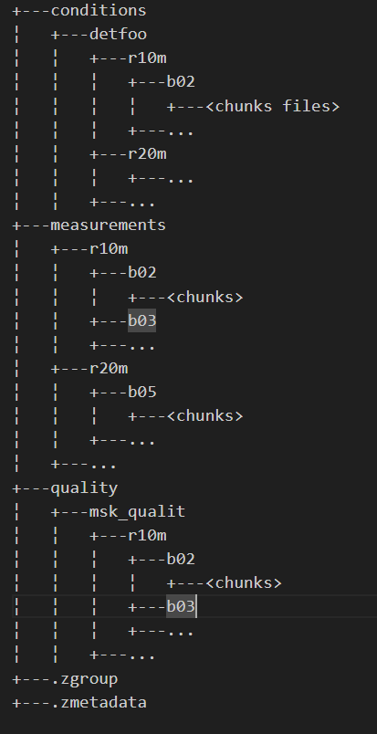
ZARR Structure on disk and Storing on S3 buckets
ZARR Structure
A Zarr container is persisted on disk as a structured tree of folders and files
Files are Zarr metadata or chunks of data
Folders represent the structure of variable hierarchy
Storing ZARR Container on S3
Two possible approaches:
ZARR archive : Create an archive (ZIP, TAR …) of the ZARR tree and upload this archive to an S3 bucket as a single object
exploded ZARR : Upload each individual files as S3 objects, by preserving their path in the filesystem as S3 prefixes
Retrieving a ZARR from S3
➔ 3 approaches identified depending on the storage approach (see next slides)

Slide 3
Retrieving a ZARR Archive from S3 Buckets (Approach 1)
Given the S3 URL of the stored ZARR archive
Retrieve the archive using the GetObject S3 API call (https://docs.aws.amazon.com/AmazonS3/latest/API/API_GetObject.html)
Store the returned data stream on disk
When completed, unzip the archive on disk
Use a ZARR library to explore the content of the ZARR container
Pros
  straightforward
  Only 1 S3 request
Cons
  Up to the archive extraction, it is needed to have at most twice the ZARR size as free storage
  Needs to download the complete ZARR content even if only some specific variables/chunks data are needed

Slide 4
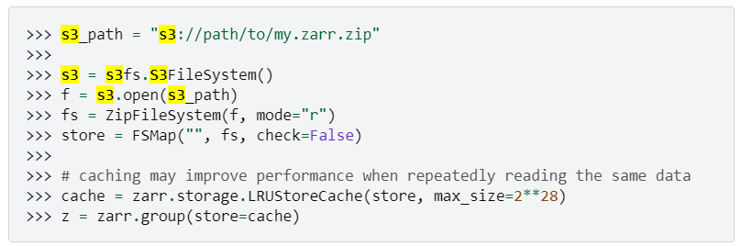
Retrieving partial content of ZARR Archive from S3 Buckets (Approach 2)
https://zarr.readthedocs.io/en/stable/tutorial.html#accessing-zip-archives-on-s3 proposes a solution leveraging ZipFileSystem class from fsspec package and s3fs
This approach should be interesting for downloading only the needed part of the ZARR content for a specific use case.
However it has to be verified with a running demonstrator. Efficient usage of S3 API shall also be assessed (example : how many S3 request to retreive all the chunks of a given variable) ?

Slide 5
Retrieving an exploded ZARR (Approach 3)
Given the S3 URL of the root folder of the ZARR container
Retrieve the list of all objects stored under this folder leveraging the ListObjectsV2 S3 API call (https://docs.aws.amazon.com/AmazonS3/latest/API/API_ListObjectsV2.html)
For each object keys returned, download the object on local storage preserving the hierarchy of folders defined by the key prefixes and « / » délimiter
Use a ZARR library to explore the content from the ZARR container
Note : this is how the CLI « aws s3 cp <S3 URL> <LOCAL PATH> --recursive» works under the hood
Pros
  Rather straightforward leveraging S3 API, SDK or CLI
  No twice the storage needed
  No archive extraction needed
Cons
  At least an S3 query for each files of the ZARR container ➔ potential extra costs depending on the S3 pricing model of the Cloud Provider
  Listing objects on an S3 folder may be a time consuming operation depending on the S3 implementation and may be a bottleneck for massive ZARR downloads

Slide 6

STAC and ZARR
Use cases to support:
UC-1 : Download the full ZARR container
UC-2 : Download a single asset stored in the ZARR
Objective : prevent any data duplication on S3
Both use cases implies that a dedicated Asset is defined in the STAC Items to point to the expected content.
Retrieving Approach | UC1 | UC2
Approach 1 (ZARR archive) | Well supported but extra storage and computing cost for local archive extraction. Best solution if access to the internal content of the ZARR is not required (LTA for example) | Well supported but extra storage and computing cost for local archive extraction + download of uneeded data
Approach 2 (ZARR Archive with s3fs) | Well supported with a possible improvement wrt approach 1 (to be check) | Well supported with a possible improvement wrt approach 1 (to be check)
Approach 3 (exploded ZARR) | Well supported but extra costs from S3 API calls and potential increased latency | Well supported with best trade off between S3 API calls, content download and local storage/computing
Whatever the retrieving approach used, getting the representable form (eg. JPEG image) of an individual asset of the ZARR requires a specific ZARR content processing from the STAC Client

Slide 7
Possible solution to download the representable form of a STAC Asset
5. Process ZARR data and convert
to the representable form
4. Retrieve related ZARR data
S3 Buckets
STAC Catalog
Asset Proxy Server
ZARR Object
Item
URL points to
6. Return the representable form
Refers to
Asset
JPEG Image
PRIP
1. Get an Item
STAC Client
3. Retrieve asset
2. Extract asset URL

