Slide 1
Context of Zarr in EOPF re-engineering
Vincent Dumoulin
ESA ESRIN
16/04/2025

Slide 2
Agenda
Sentinels Data Processors and Data Format Evolution
DGGS

Slide 3
Sentinels data processors and data format evolution

Slide 4
Why evolve the Sentinel Data Format?
It’s not just a ‘nice-to-have’—it’s a strategic priority to:
Enhance optimized access to the vast data volumes generated since Sentinel-1 operations began in 2014, and prepare for the exponentially larger volumes expected from the Copernicus Expansion missions starting in 2028.
Enable seamless integration of multi-Sentinel data by harmonising data representation and access across all missions.
Shift from individual product downloads to a more efficient, user-driven access model—facilitating streamlined retrieval of specific data subsets across missions and over time.
Ensure Sentinel data is ready for AI-driven analysis and applications, supporting innovation and automation in Earth observation.
Maintain and strengthen Europe’s leadership in the advanced exploitation of Earth observation data.
N.B. The current Sentinel data format, based on the Standard Archive Format for Europe (SAFE), was originally designed for long-term archival rather than modern data access and exploitation.

Slide 5
Why evolve the Sentinel Data Processors?
Not just a convenience—but a critical objective to:
Safeguard the long-term capability to process the invaluable amounts of data generated by the Sentinel satellites.
Ensure sustainable maintenance and evolution of Sentinel data algorithms and processors over time.
Avoid industrial and technical lock-ins, helping to maintain affordability and long-term viability of the programme.
Strengthen European industrial competitiveness and foster innovation in Earth observation technologies.
Maximise flexibility in future data processing and access, enabling custom solutions for diverse user needs and applications—unlocking even greater value from Sentinel data.

Slide 6
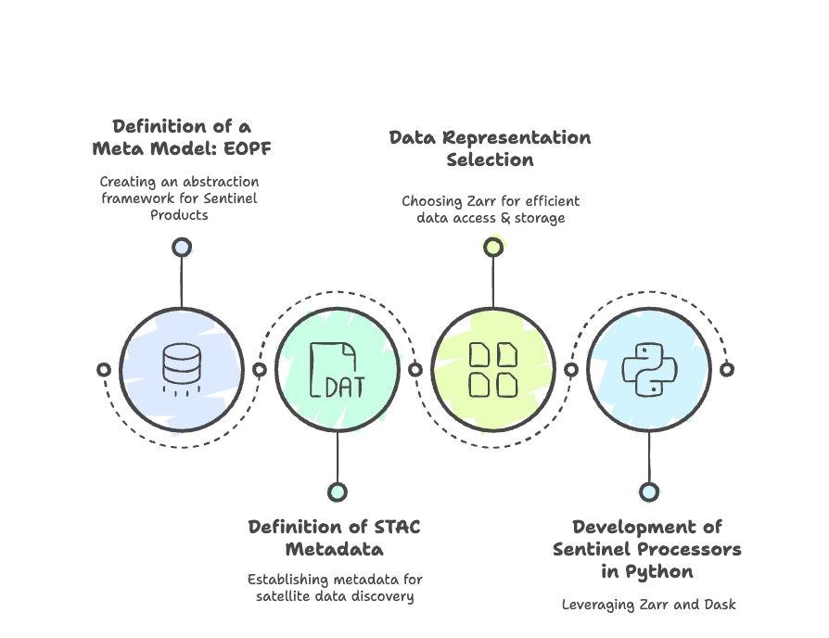
Evolution Overview

Slide 7
Data Model and Product Design
Cloud Optimized Format
Cloud storage for data dissemination and concurrent processing
Open Source
Python-based, native support to dask/numpy/xarray
Large adoption in the data science and EO community
Self-explanatory Product
Clear documentation of the metadata
Compliant with CF standard
Cloud-optimized data formats
User accessibility
Based on Unidata Common Data Model
Well-established formats and best practices
Interoperability
Flexible and Scalable
Harmonized Structure
Conversion Capabilities
Unified structure across Sentinels
Standards and protocols for easy integration of EO datasets and applications
Accommodate different types of EO data and sensor technologies
From small scale observation to large datasets
Backward compatibility
New EOPF model to SAFE/COG/NETCDF
Time series ready
Copernicus Expansion
SAFE to new EOPF model

Slide 8
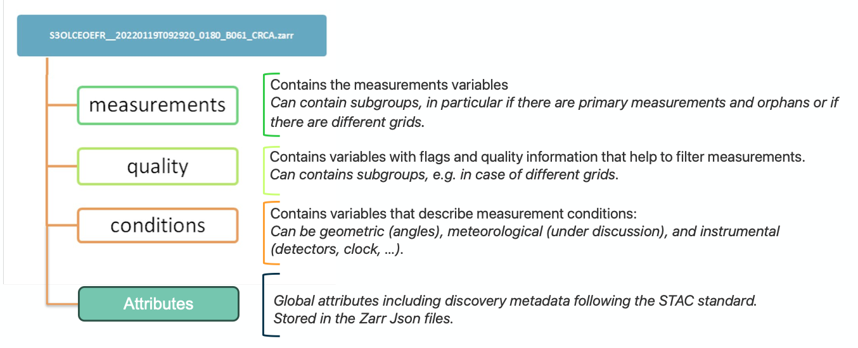
EOPF Product Structure
The EOPF Product Structure is a standardized meta model applicable across all Sentinel missions and generally any EO mission, offering complete flexibility for defining extensions, which is then tailored in detail for each Sentinel product.
EOPF Product

Slide 9
EOPF Metadata
The Product Global Attribute incorporates three primary metadata categories:
Discovery Metadata → STAC Standard:
  Can utilise extensions encompassing “processing,” “sat,” "sar," “view,” “eo,” “scientific,” “projection,” and “classification.”
  Integration of mission-specific extensions is avoided to achieve harmonized metadata across various missions.
  Additionally, an EOPF STAC extension to accommodate specific fields typical to (ESA) EO catalogues, such as processing baseline, datatake_id, etc.
Other Metadata → JSON: elements beyond product discovery, providing extensive details such as sensor states, orbit parameters, etc.
Processing History Metadata → JSON: a comprehensive record of all processing steps post-acquisition.

Slide 10
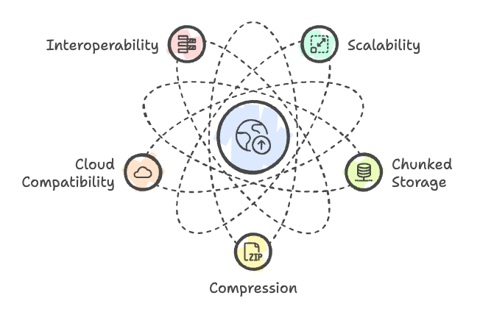
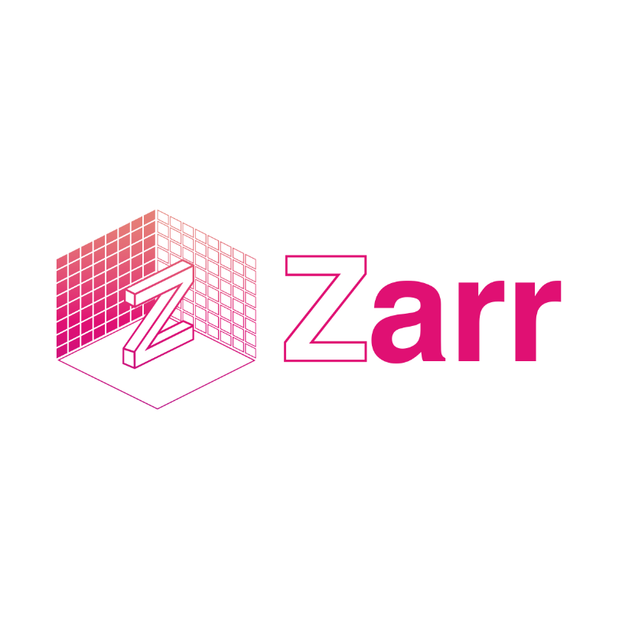
EOPF data representation
Zarr is an open-source format for chunked, compressed, N-dimensional arrays
Notes:
Scalability: Zarr is designed to handle large datasets efficiently, making it ideal for the vast amounts of data generated by Earth Observation satellites and sensors.
Chunked Storage: Zarr allows data to be stored in chunks, enabling faster access and processing of subsets of data without the need to load entire datasets into memory.
Compression: Zarr supports various compression algorithms, reducing storage requirements and improving data transfer speeds, which is crucial for remote sensing applications.
Cloud Compatibility: Zarr is compatible with cloud storage solutions, facilitating easy sharing and collaboration among researchers and organizations working with EO data.
Interoperability: Zarr's format is compatible with popular data analysis libraries such as NumPy and Dask, allowing seamless integration into existing workflows for data analysis and visualization.

Slide 11
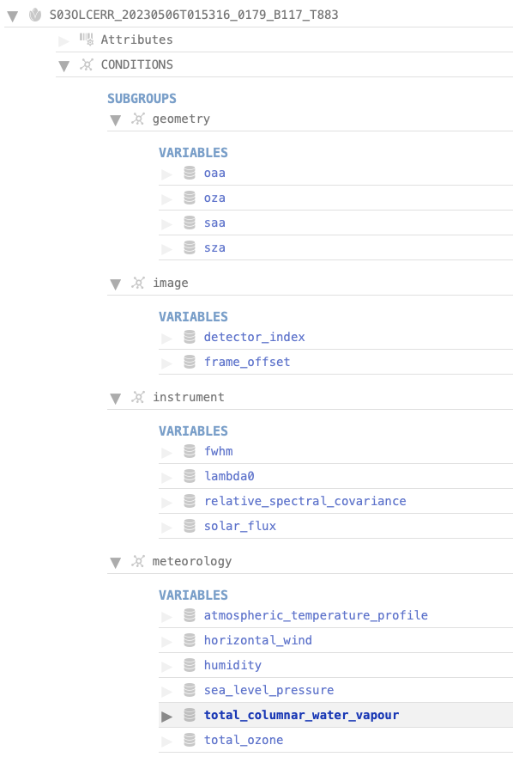
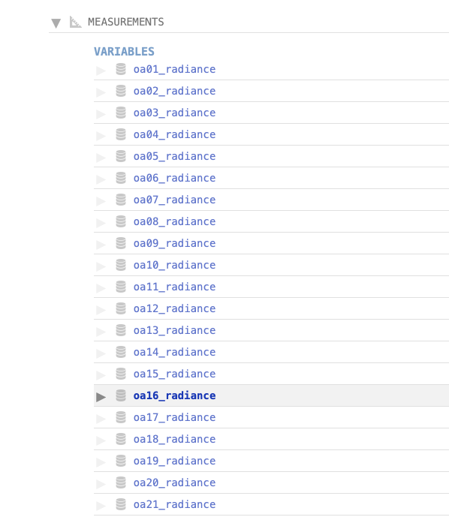
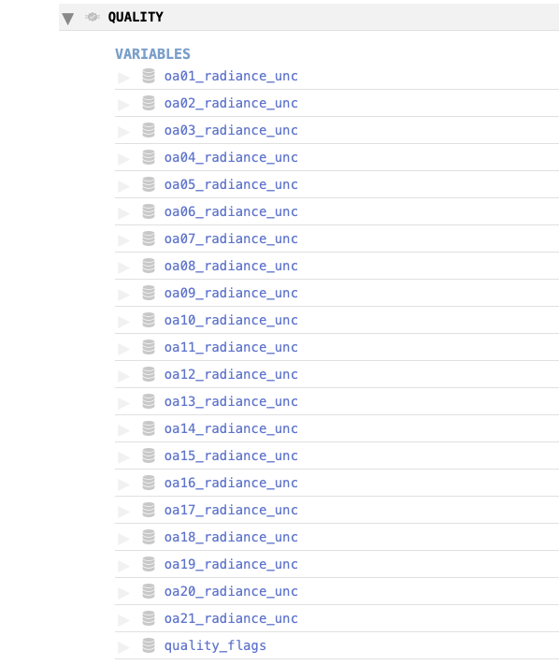
EOPF Product Storage: Example S3 L1 OLCI ERR

Slide 12

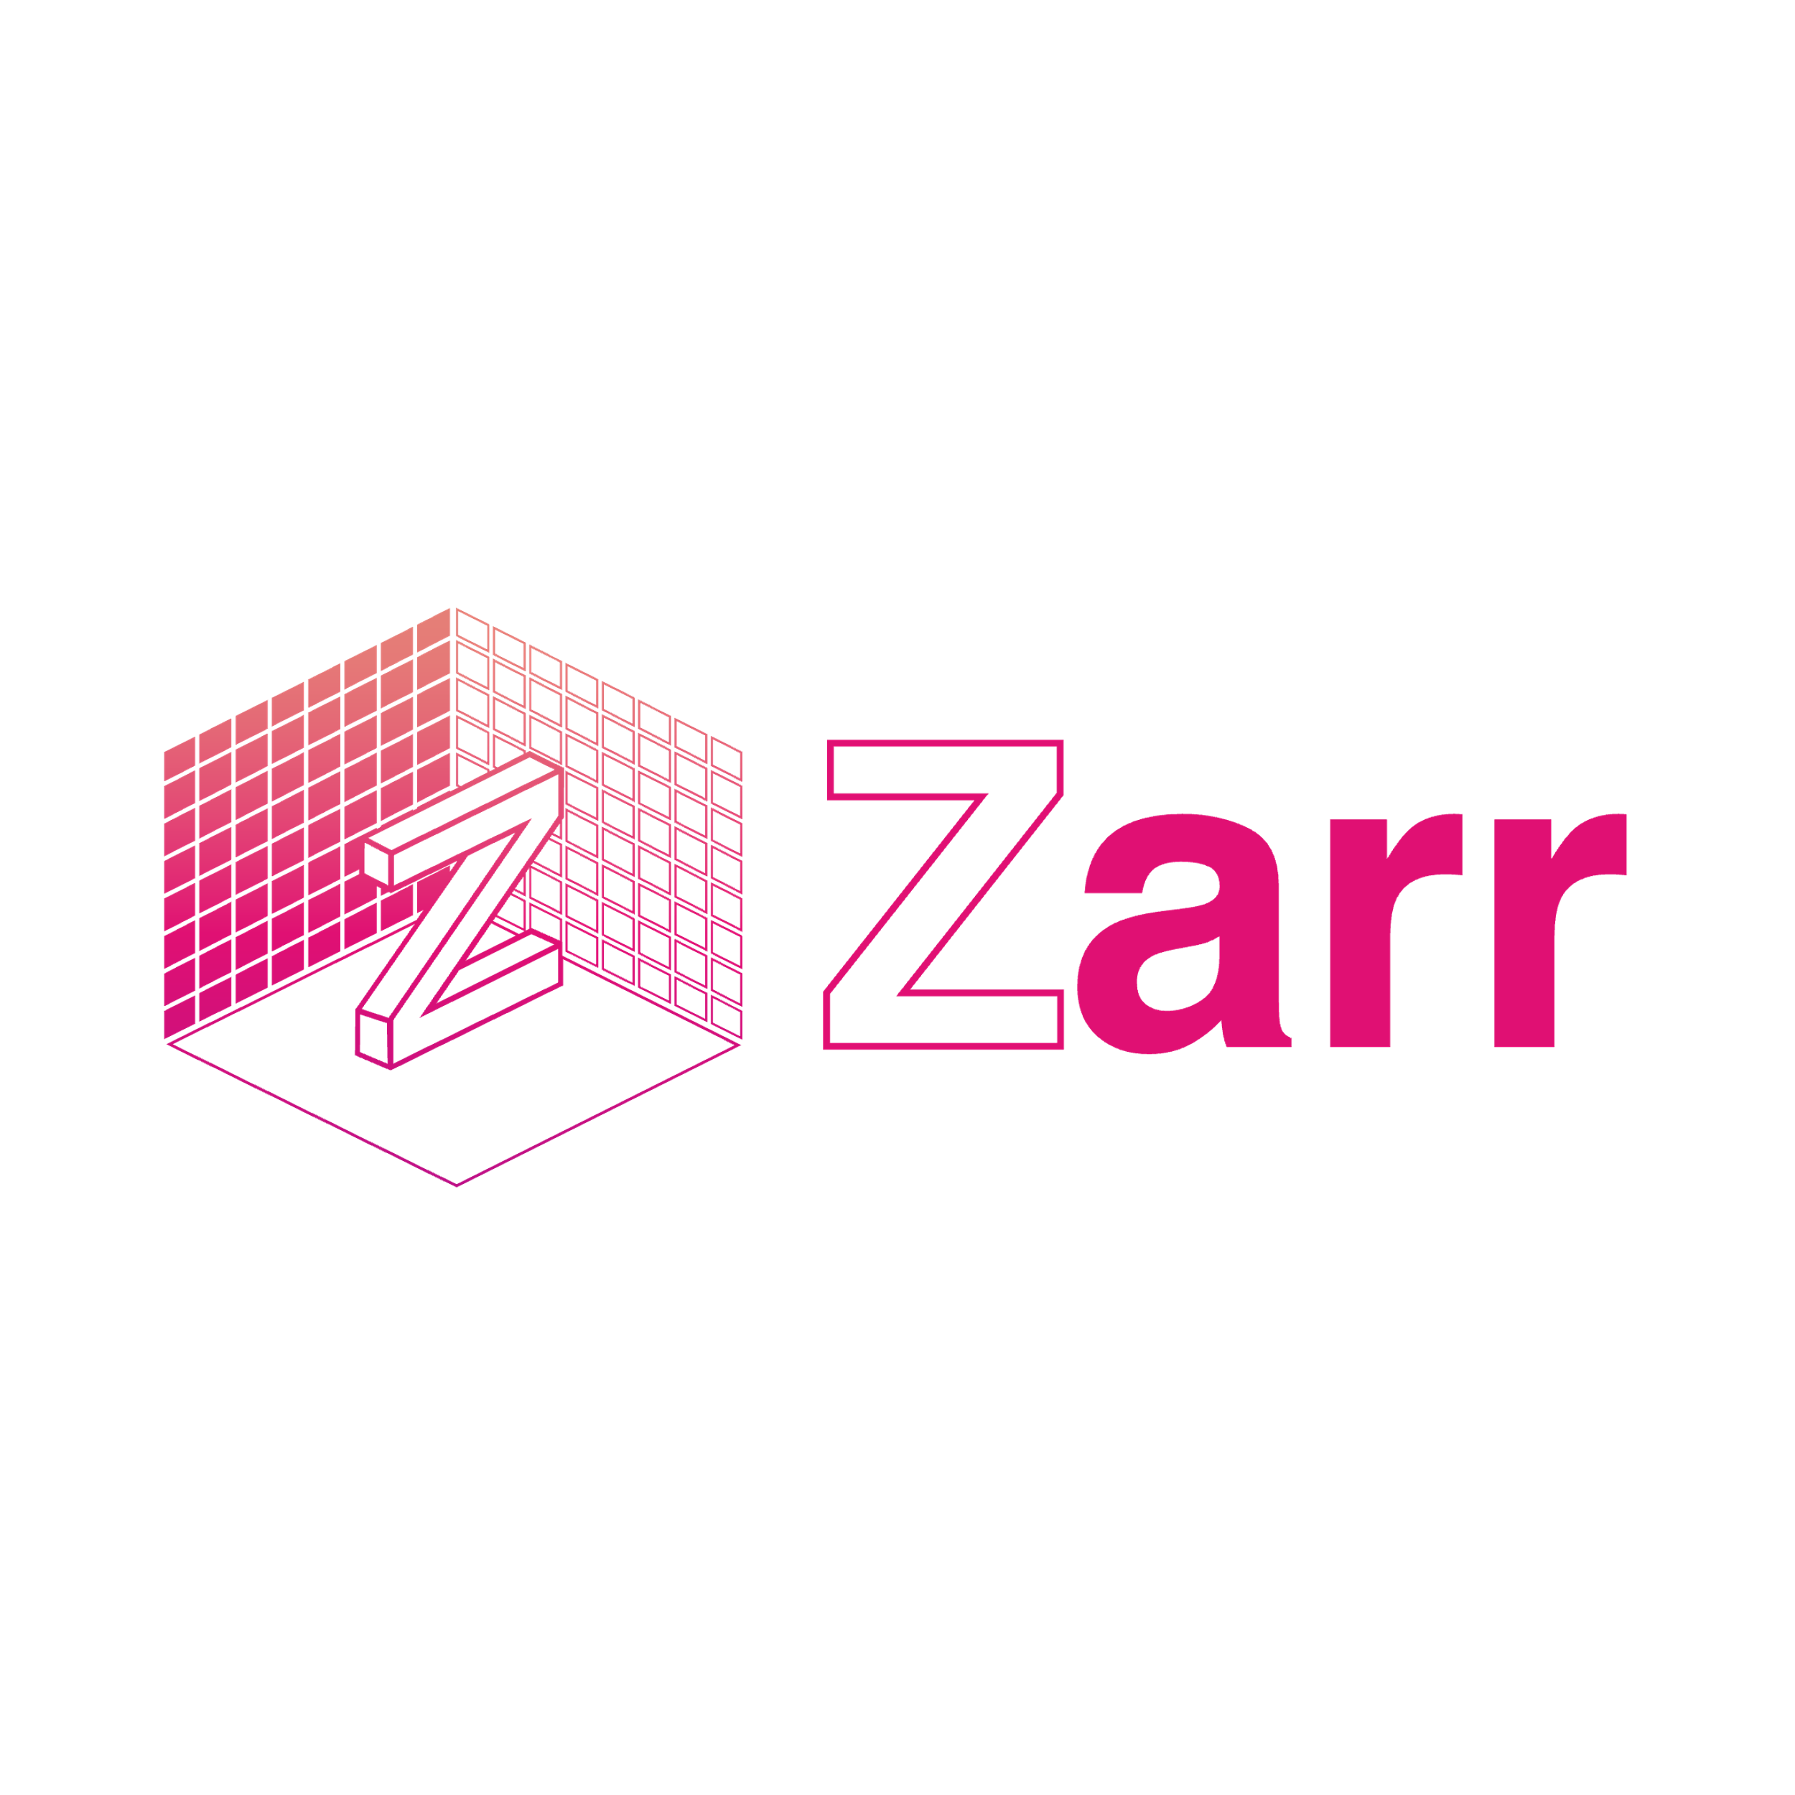

Sentinel data processors redesign
Open-source code
Benefit from new technologies
Preserving the original algorithm and data quality
Legacy Sentinel data processors modernisation
Generic Framework for future missions (COPEX, NG, …)
Native Zarr data management
ESA Copernicus Earth Observation Processor Framework (EOPF) facilitates the transition of the Copernicus Sentinel operations towards a more optimized approach which:
enables customizable processing,
enhances flexibility and scalability,
streamlines access to large volumes of data.
Availability of a first version of the Processors is expected for second half of 2025

Slide 13
Available resources
All the resources can be found here:
  https://eopf.copernicus.eu/
Product format currently available:
  Common Product Spec: https://cpm.pages.eopf.copernicus.eu/eopf-cpm/main/PSFD/
  Common ADF: https://cpm.pages.eopf.copernicus.eu/adf-auxiliary-data-file/main/adfs/index.html
  Sentinel 1: https://s1.pages.eopf.copernicus.eu/s1-l12-rp/main/pfs/index.html
  Sentinel 2: https://s2.pages.eopf.copernicus.eu/pdfs-adfs/
  Sentinel 3: https://s3.pages.eopf.copernicus.eu/pdfs-adfs/
Source code for the CPM library:
  https://gitlab.eopf.copernicus.eu/cpm/eopf-cpm

Slide 14
Discrete Global Grid Systems (DGGS)

Slide 15
Introduction & Background
Context:
  The Copernicus Space Component and the Destination Earth (DestinE) initiative generate and make available vast amounts of diverse Earth Observation (EO) and climate data.
  Different data representation, structures, projections and formats complicate the synergetic use and analysis of large volumes of diverse data.
Need:
  An interoperable data representation that streamlines the combination of large volumes of EO and climate data for easier processing, visualization, and analysis.
Solution:
  Adoption of Discrete Global Grid Systems (DGGS) in combination with the Zarr cloud-optimized format (EOPF for the Sentinels) to harmonise the data representation across diverse types of data, including different types of EO sensors and climate data.

Slide 16
Discrete Global Grid Systems (DGGS)
Definition:
  A DGGS partitions the Earth’s surface into a hierarchy of cells with discrete boundaries, enabling systematic storage, indexing, and analysis of geospatial data.
Key Features:
  Multi-Resolution: Cells can be refined at finer levels while preserving relationships to coarser grids.
  Spatial Indexing: Each cell has a unique identifier, supporting efficient queries and data retrieval.
  Uniform Coverage: Ensures consistent global representation with minimal distortion.
  Interoperability: Standardizes data representation across different sources and scales.
Why DGGS?
  Facilitates seamless integration of large volumes of EO multi-mission and multi-domain data.
  Enables fast, scalable analytics in cloud-based or big data environments.
  Offers a common reference framework for diverse geospatial applications.

Slide 17
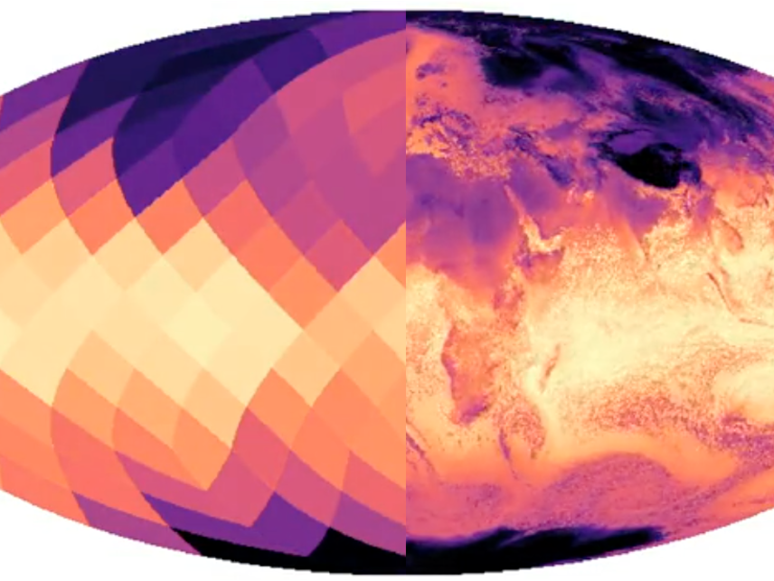
HEALPix (Hierarchical Equal Area isoLatitude Pixelation)
Overview:
  A specific DGGS originally developed for astronomy (cosmic microwave background mapping).
  Provides an equal-area, iso-latitude tiling of the sphere, ensuring uniform coverage.
Core Characteristics:
  Equal Area: Each cell covers the same surface area, avoiding spatial bias.
  Hierarchical: Resolutions can be subdivided while preserving cell boundaries.
  isoLatitude: Rows of pixels lie on lines of constant latitude, simplifying certain spherical computations.
  Efficient Indexing: Unique integer indices enable fast lookups.
HEALPix in This Project:
  Chosen as the spatial backbone for the DGGS-based format
  Well-supported by open-source libraries, making it easier to adopt and extend.
  Allows multi-resolution Earth observation data to be integrated consistently.
  Currently used in DestinE for DT Climate
  Support for efficient Earth Data Cube

Slide 18
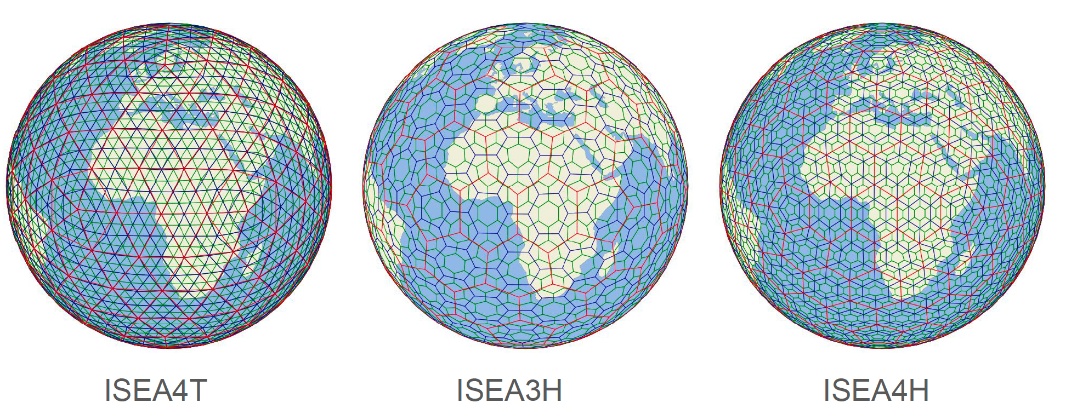
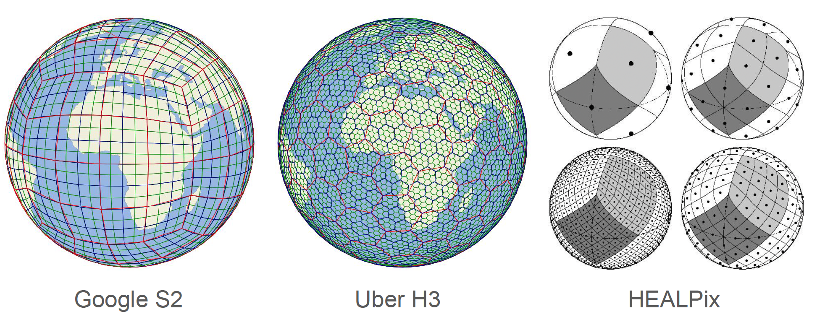
Discrete Global Grid Systems (DGGS)

Slide 19
Objectives
Design a Generic DGGS representation
  Based on HEALPix and Zarr V3 to store and access EO and climate data efficiently.
Instantiate Format for Sentinel & DestinE Products
  Sentinel data starting with Sentinel-2 (L1C/L2A) and Sentinel-3 (OLCI/SLSTR/SYN),
  DestinE atmospheric/climate datasets,
  Copernicus DEM.
Develop & Demonstrate Processing Workflows
  Demonstrate benefits in geometric corrections, DEM integration, sensor calibration
  Demonstrate benefits in synergetic data analysis and data combination.
Implement Operational Converters
  Allowing to convert legacy datasets into the EOPF-DGGS-based representation (e.g. current Sentinel data into the EOPF-DGGS-based representation)
Introduce native DGGS data representation in the data processors
  Demonstrate benefits of performing data processing on data natively represented in the DGGS data representation
    Sentinel-2 processor (e.g. L1B -> L2A)
    Sentinel-3 SYN processor
Demonstrate the operational readiness processing DGGS-based data
  Initial step: deployment of the processors on the DestinE Core Platform to ease the combined use of Sentinel data with atmospheric/climate datasets

