Slide 1
STAC & Zarr Workshop
ESA ESRIN
16/04/2025

Slide 2
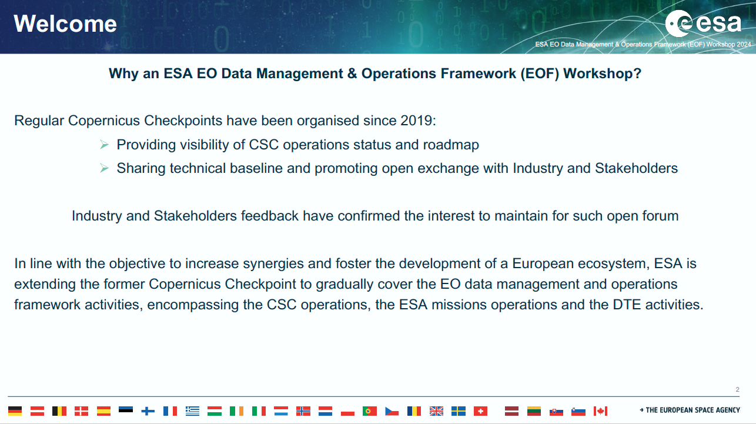
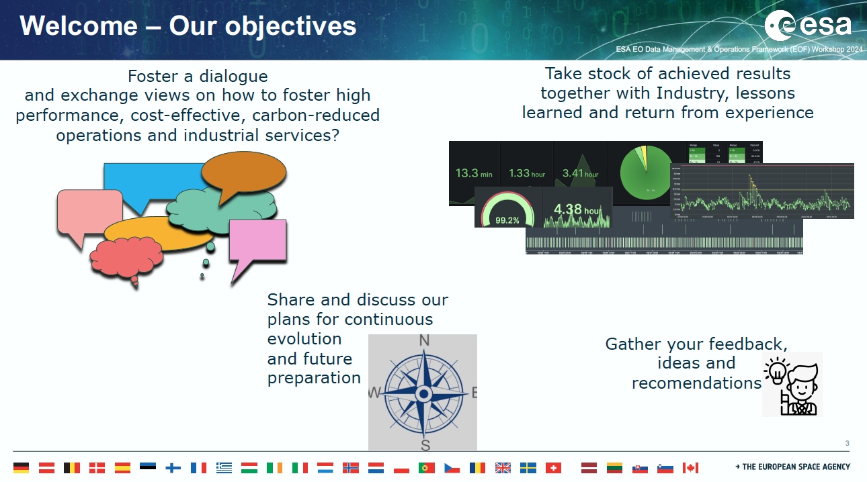
Welcome … to our spin off from the EOF workshop checkpoint

Slide 3
Key Timeline …
2023
2024
2025
2026
3rd EOF
Checkpoint
4th EOF
Checkpoint
5th EOF
Checkpoint
CDSE Full
Operations
1st STAC
Workshop
2nd STAC & Zarr
Workshop
Living Planet
Symposium

Slide 4
1st STAC Workshop
A first STAC Workshop was held in ESA/ESRIN & hybrid format on 6 June 2024 to take stock of the status of STAC across Copernicus and within the larger landscape.
20 presentations from diverse organisations (institutional & industry) provided the opportunity share status of current implementations and plans, benefits and perspectives.
Active interest from ~200 online attendees
Useful discussion on the current experiences and need for fostering further development and adoption.

Slide 5

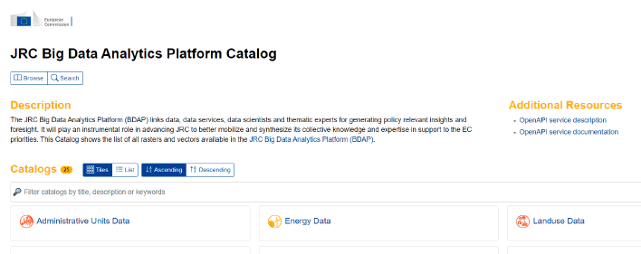
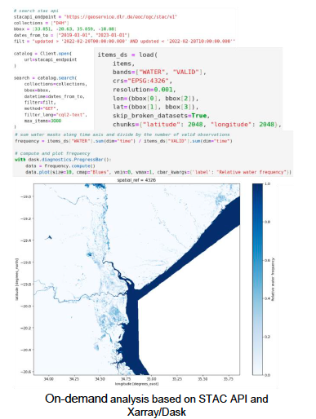
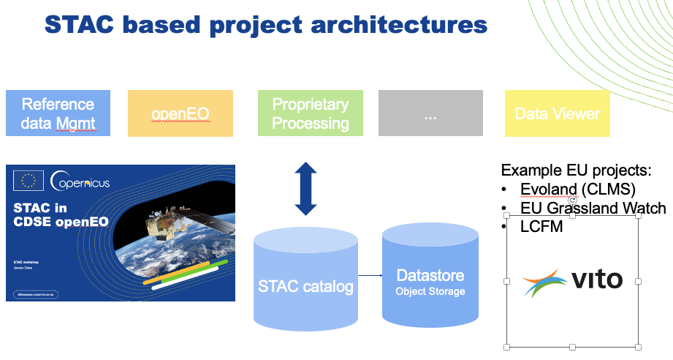


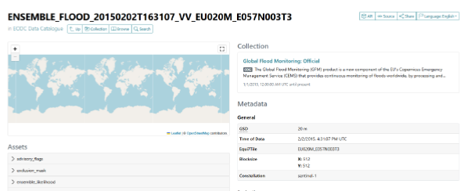
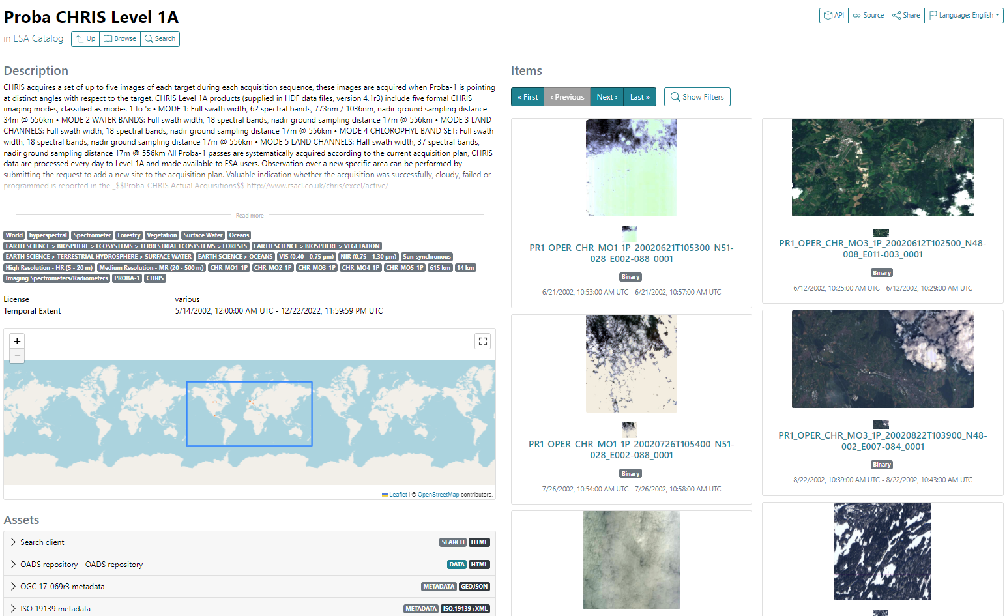

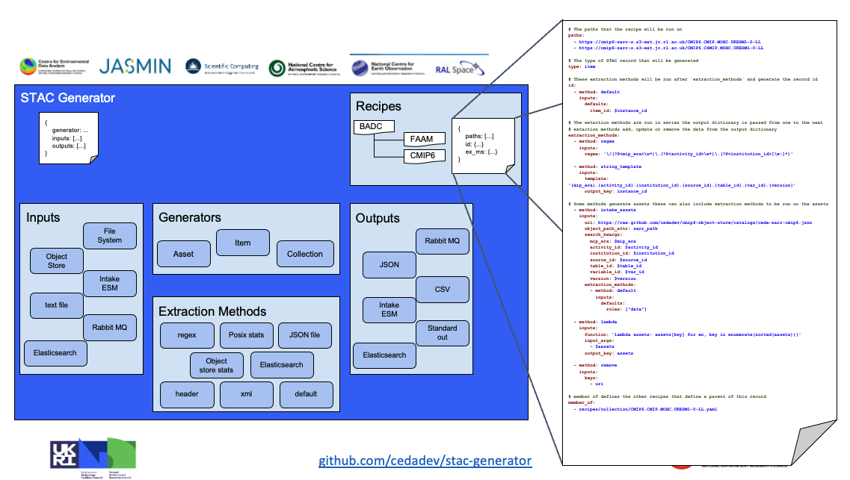
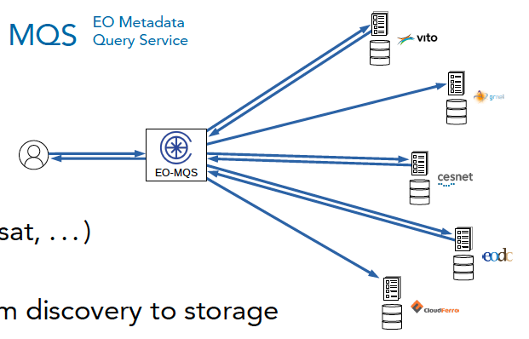

A wealth of experience in diverse domains
Workshop resources at: https://eoframework.esa.int/display/SSR/STAC+Workshop+-+June+6%2C+2024

Slide 6
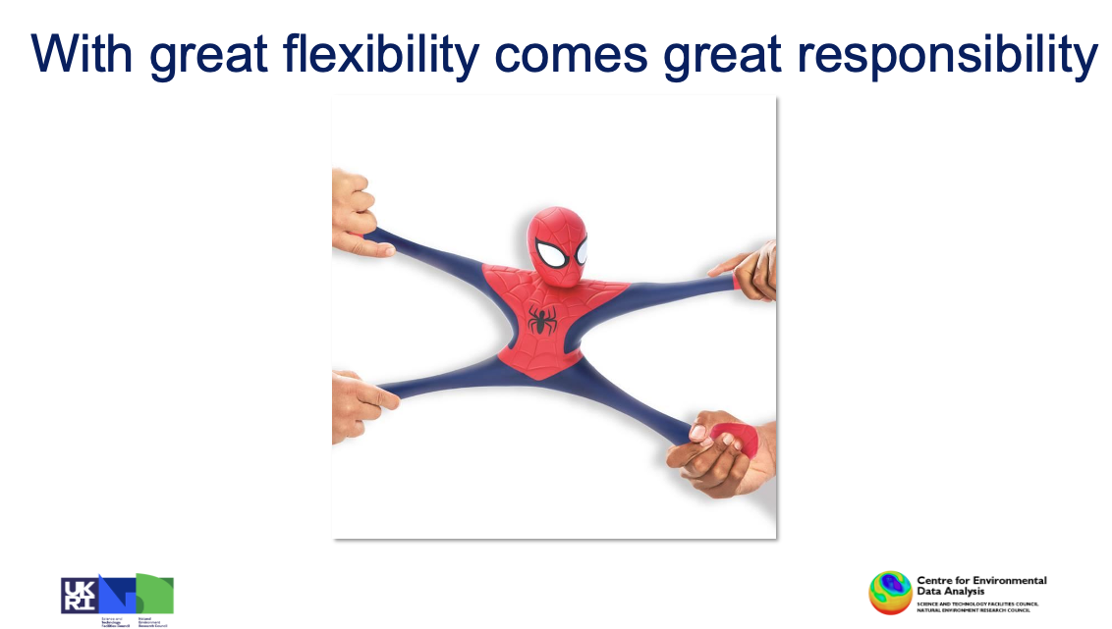
Some key messages
STAC has very useful and powerful extension mechanisms to tailor the specification to support diverse data sets and use cases (well beyond legacy lowest common denominator interoperability approaches).
Rich set of Open Source resources and libraries provides low barrier for implementations
STAC goes beyond data discovery and matches well to providing interoperable data access for cloud native datasets
There is an active community shaping the evolution of the standard, ready to contribute to the implementation.

Slide 7
Agenda - Morning
10:00 – 10:10 - Introduction - ESA
10:10 – 10:25 – STAC in the Copernicus Data Space Ecosystem - CF
10:25 – 10:40 - openEO interface using PG STAC - Sinergise
10:40 – 10:55 - Context of Zarr in EOPF re-engineering - ESA
10:55 – 11:05 - STAC in ESA EOPF Zarr - CS
11:05 – 11:20 - EOPF Sample Service - EODC
11:20 – 11:30 - STAC Assets for EOPF Zarr - DLR
11:30 – 11:40 - STAC for EOPF orchestration – Airbus
11:40 – 12:00 – Open Discussion

Slide 8
Agenda – Afternoon
14:00 – 14:15 – STAC at ECMWF - ECMWF
14:15 – 14:30 - Zarr for Sentinel-3 Marine Data - EUMETSAT
14:30 – 14:45 - Transforming research and operational pipelines: STAC at BEYOND - Νational Οbservatory of Αthens
14:45 – 15:00 - Earth Data Hub service: changing the paradigm from download to on-demand data access with STAC and Zarr – B-Open
15:00 – 15:15 - GeoZarr – Development Seed
15:15 – 15:25 - STAC in OGC Application Package Best Practices - EURAC
15:25 – 15:40 - STAC in ESA Common Services - Spacebel
15:40 – 16:00 – Open Discussion and Conclusion

Slide 9
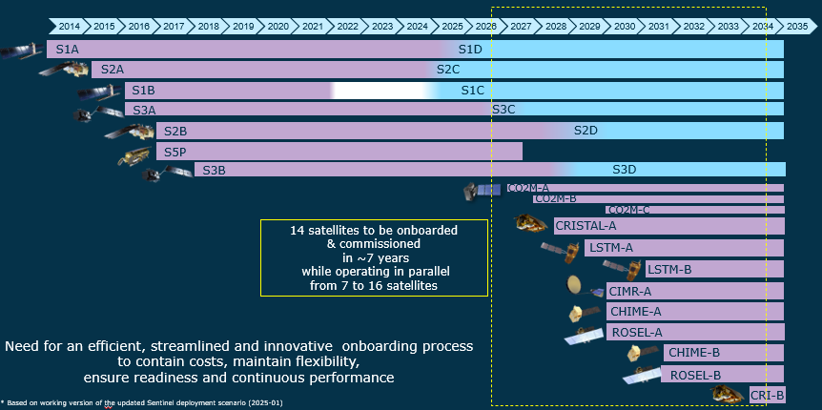
Evolution of the operations
Notes:
Looking at the future
6 new mission s in op
1st approach

Slide 10
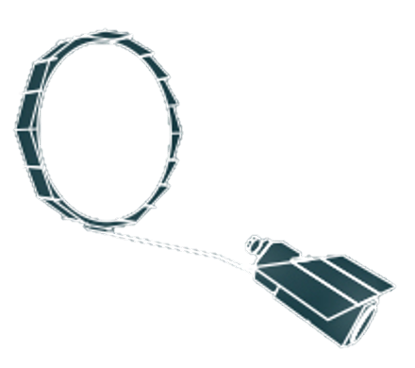




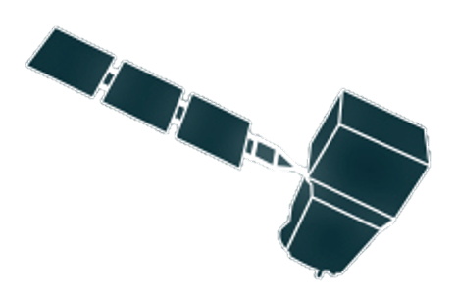
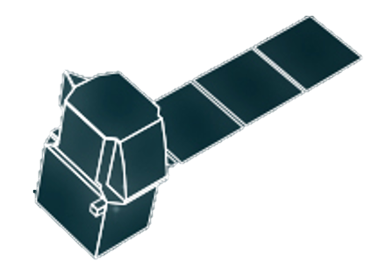

Data Volumes to a new level…
daily budgets x 1 satellite unit
CIMR (*)
LSTM
CIMR
3.13 TiB
CRISTAL
0.16 TiB
Copernicus
Operations
Framework
CRISTAL
2.17 TiB
1.05 TiB
CO2M
1.35 TiB
CO2M
1.35 TiB
44.82 TiB
2.01 TiB
LSTM
48.16 TiB
CHIME
2.72 TiB
33.9 TiB
10.35 TiB
ROSE-L (*)
CHIME
S2
S2
ROSE-L
(*) no L2 yet estimated
S1
S1
Preliminary values under consolidation
*Based on decompressed data volumes

Slide 11
Preparing the future
From legacy data operations to new Zarr-based operations
On-going
legacy data processors
& legacy data flow operations
Start of new data processors
& Zarr-EOPF data flow operations
2025
2026
Familiarisation activities:
Documentation, webinars, notebooks, sample data access….
Up to date documentation and sample data
Initial format defintion and sample data
Access to a representative live reformated sample data
Parallel availability of legacy and new data flow to support operational transition and risk management, before interruption of legacy processors and legacy data flow
Webinars, notebooks, use cases, documentation, …
Access to live sample data new processors
Software, tools, plug-ins:
Open source software to support access, processing and integration of new data formats in user activities
Up to date format conversion tools
Initial format convertors
Tools & interfaces for efficient access & processing
& Open-source libraries & plug-ins for EO community tools
Regular udates
OS procesisng worksflow management software (Reference system) & Regular updates
Open Source data processors & Regular updates
OS common processing framework tools
Up to date evolutions availability
Key supporting
industrial activities and teams
Reference system workflow
Sample Zarr Service & Other supporting activities
DDGS defintion, implementaiton; initial service in the frame of DestinE
OS Data processors implementation, operational validation, maintenance

Slide 12
Supporting the transition
Key principles and action lines
Preparing and supporting the transition from the current CSC operations scenario to the target scenario (Zarr-EOPF based processing and data access)
Ensure backwards compatibility with format conversion tools
Availability of tools, libraries and plug-ins to support adaptation of user applications
Early availability of representative data flow, APIs, notebooks, AI worksflows… to demonstrate benefits and foster early adoption
Allow for sufficient familiarisation time before start of new operational data flow
Early advance notice and information to support familiarisation and planning
Foresee a period of parallel availability of legacy and new data flow to support smooth user adaptation
Foster coherence across Copernicus and DestinE/DTE technical data management
Dedicated Collaborative
support activities

Slide 13
Thank you
20/02/2025
Notes:
One last thing, the title of my presentation was zarr is all you need. This is a reference to Transformer model with attention mechanism. ChatGPT, LLAMA, Mistral would have not be what they are without a Transformer model. On small detail in the way to process the data has change the world forever. We believe zarr format is the transformer of EO data format.

