Slide 1
STAC at ECMWF
James Hawkes, James Varndell
Thomas Hodson, Mathilde Leuridan, Marcus Zanacchi, Angel Lopez Alos
James.Hawkes@ecmwf.int, James.Varndell@ecmwf.int

Slide 2
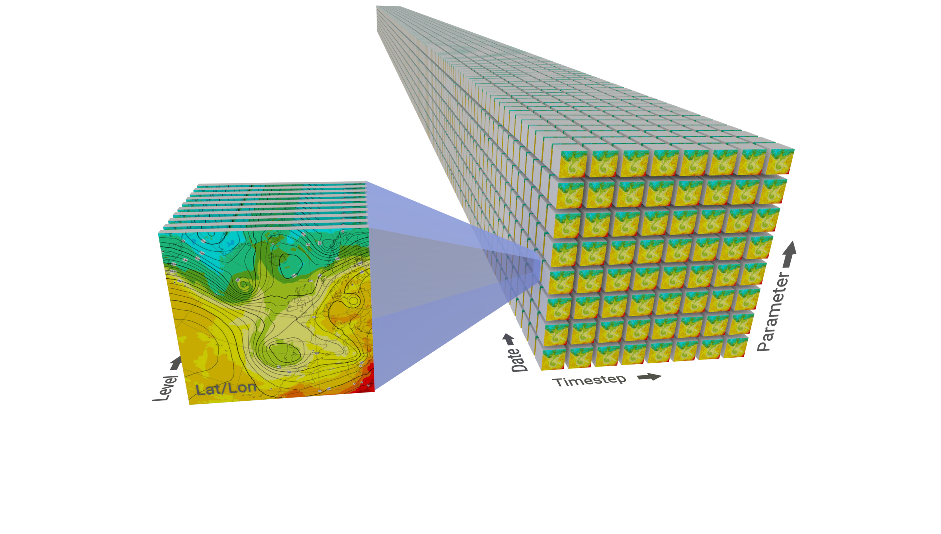
STAC for Datacubes
  Weather and Climate data is typically represented as a datacube
    where the object granularity is a single field
    And we have lots of structure we can leverage
  This granularity is not well-matched to STAC
    Storing a STAC Item for each field is not practical
    Users often want to query multiple axes at a time
    Users want to retrieve hundreds or thousands of fields in one request
    Navigating an unstructured tree to retrieve individual fields isn’t useful
  STAC Collections can help in one dimension, but it’s not enough
    Requesting ranges by time for example
  Reducing the granularity forces a dataset structure that user’s may not want
    Particularly important when serving both weather and climate data

Slide 3
STAC Extension for Templated URIs
  We are proposing an extension to STAC which allows templated URI links
    Taken from OGC Record standards
    Allows a STAC Item or STAC Catalog to offer multi-selection of sub-items or sub-catalogs
    Combined with a URL schema for representing ranges/lists of values
    Allows for the resulting selection to dynamically create a STAC entry representing that multi-selection
{
"type": "Catalog",
…
"linkTemplates": [
{
"rel": "child",
"title": "Expver - Experiment Version",
"uriTemplate": "http://my_catalogue?class={class}",
"type": "application/json",
"variables" : {
“class" : {
"description": "Experiment class.",
"type" : "string",
"enum" : [“d1", “oper"],
"value_descriptions" : [“Destination Earth", “ECMWF Operational Data"],
"optional" : false,
}
}
},
],
}

Slide 4
Example: Browsing a small datacube with STAC
catalog.com?class=d1&date=20250115&step=0
catalog.com?class=d1&date=20250115
step: 0
Asset link
date: 20250115
STAC Item
catalog.com?class=d1
STAC Catalog
step: 1
class: d1
date: 20250114
STAC Item
STAC Catalog
STAC Catalog
step: 2
date: 20250113
STAC Item
STAC Catalog

Slide 5
Example: Browsing a small datacube with STAC and templated URIs
catalog.com?class=d1&date=(20250115,20250114)&step=(from=1,to=3)
catalog.com?class=d1&date=(20250115,20250114)
catalog.com?class=d1
date:
20250115
20250114
step:
1
2
3
class: d1
Asset link
STAC Catalog
STAC Catalog
STAC Item
Asset link is a request to MARS, CDS, Polytope
  This API should also provide a powerful way to drive lazy-loading views in xarray/zarr

Slide 6
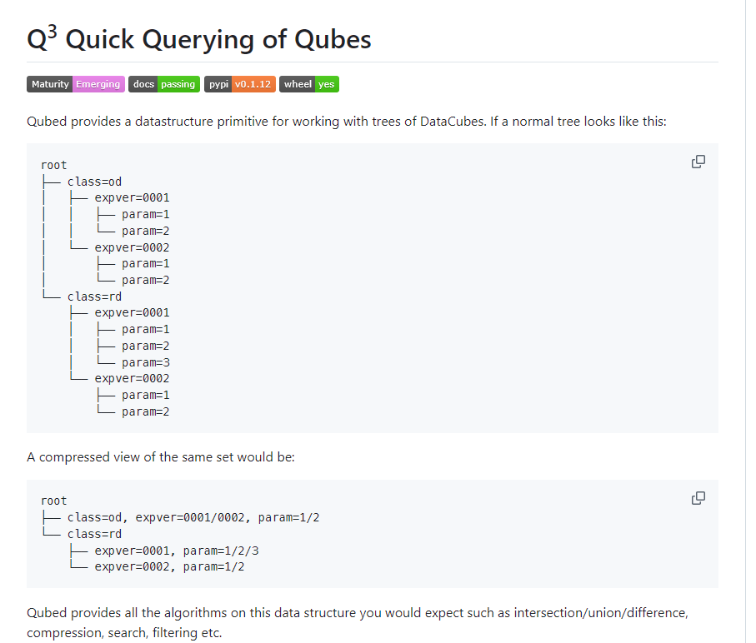
Behind the Scenes
  Q³
    The engine driving the storage/indexing of the catalogue
    Includes an efficient compressed-tree data structure
    Includes algebraic tools for slicing and dicing and merging catalogues
    Includes backends to plug in to our data store indexes
github.com/ecmwf/qubed

Slide 7
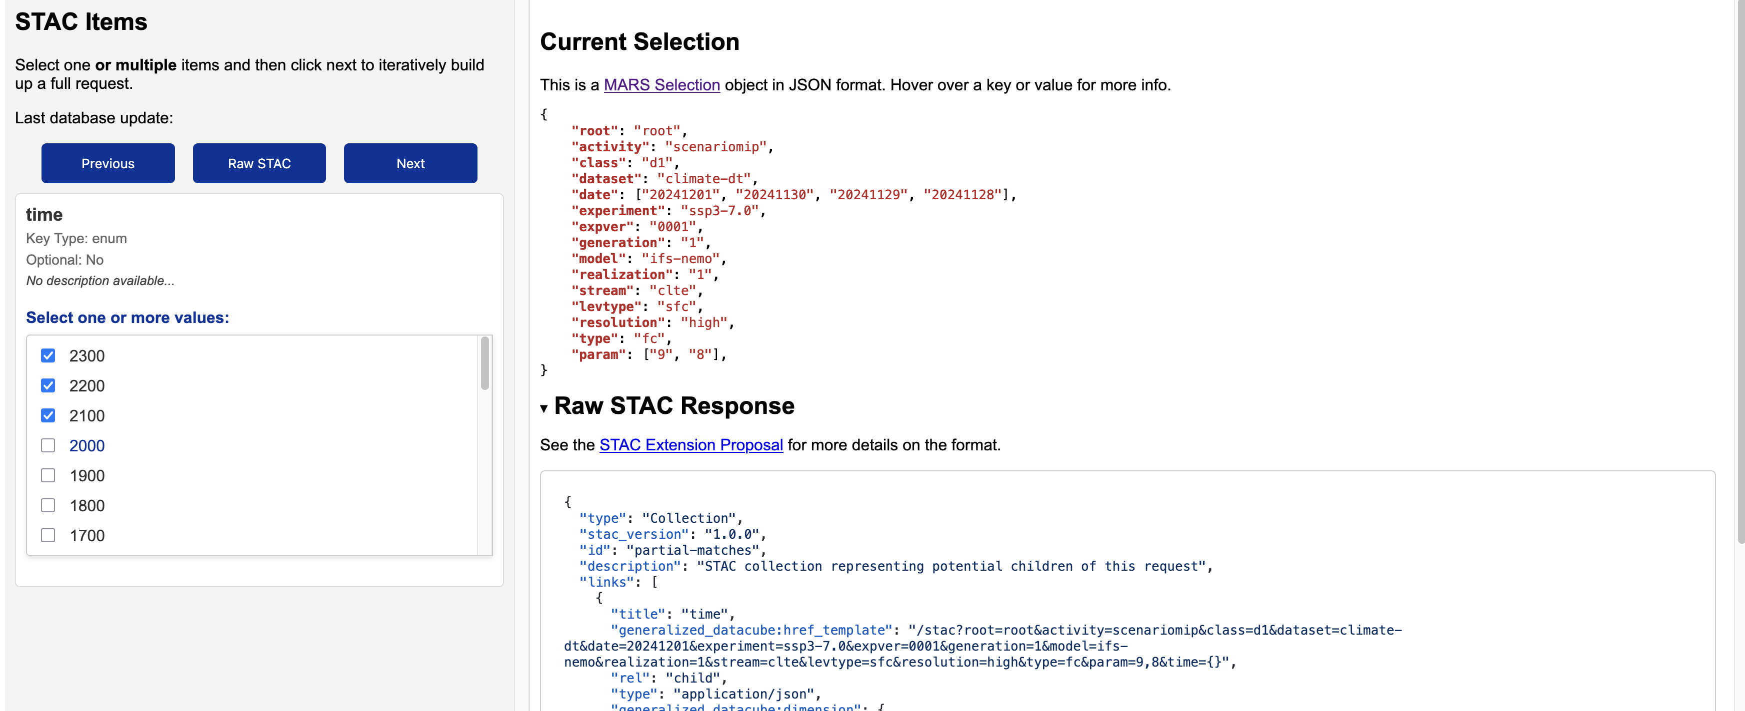
In Destination Earth
  Prototype of this catalogue is up and running
  Climate Digital Twin is approximately 8.6 million fields
  JSON representation of the entire tree ~145MB
  Our STAC extension makes it easy to build a dynamic request for 1000’s of fields at once

Slide 8
STAC in Copernicus Data Stores

Slide 9
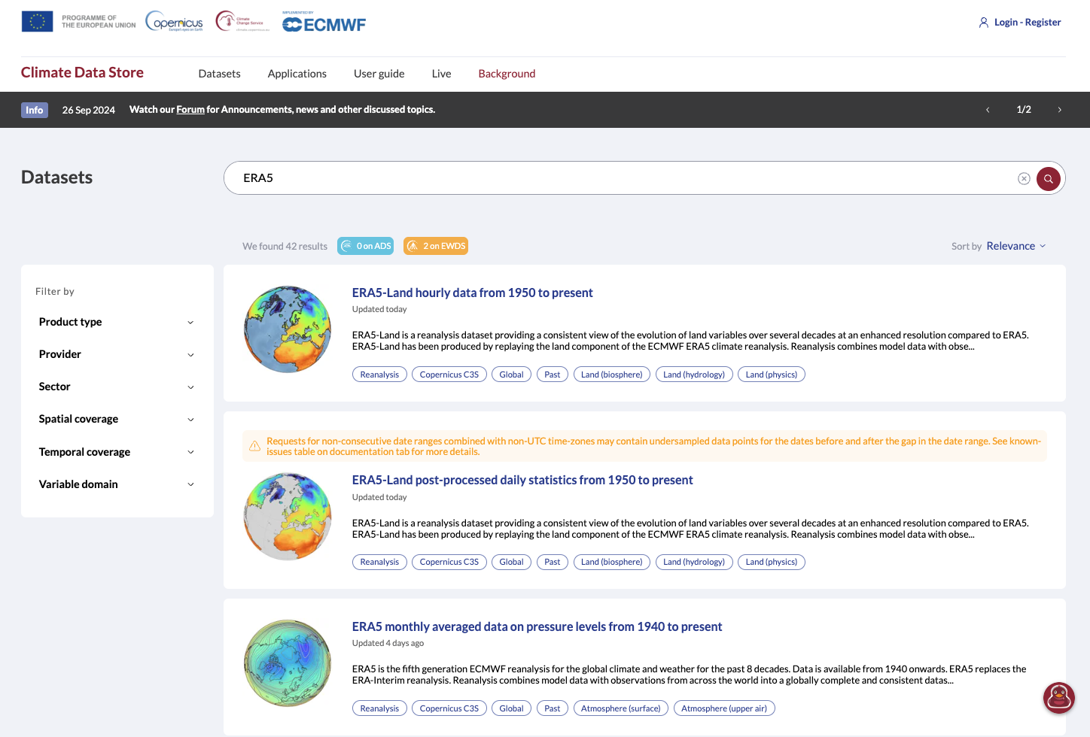
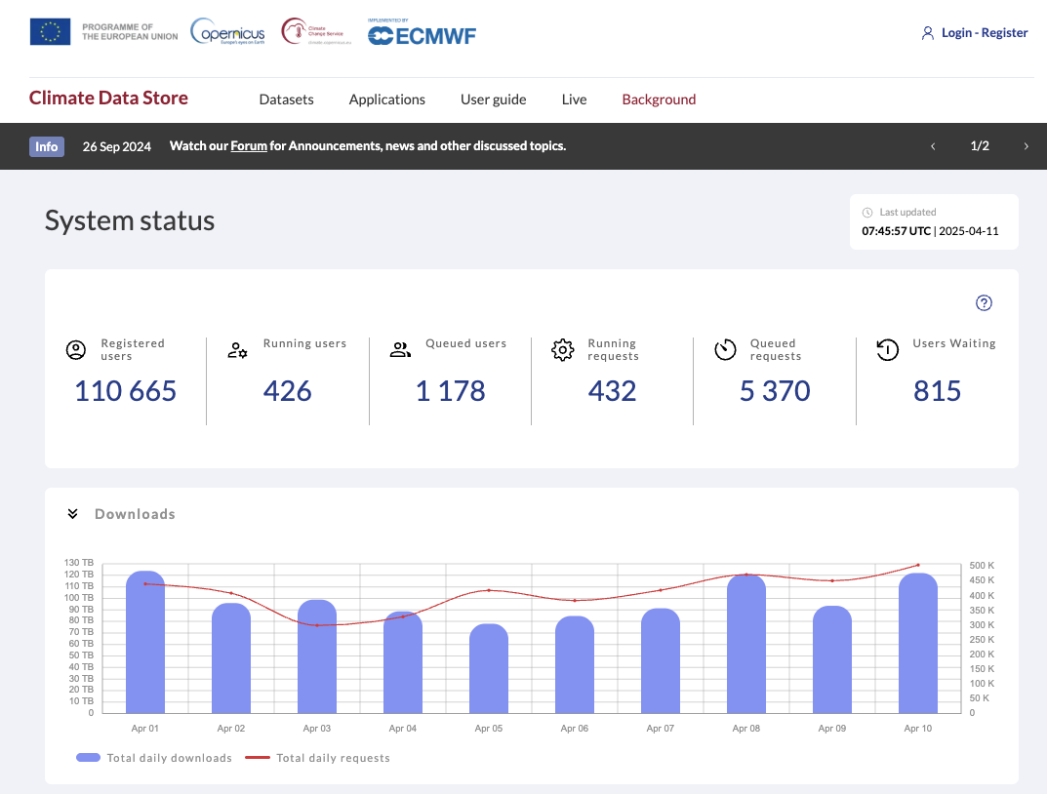
Data Stores Operational Context
CDS + ADS + EWDS hold more than 150 datasets
Very diverse data sources.
> 80% Regularly updated (some daily)
CDS Operations (daily stats)
Over 4.5k Active Users
~ 500k requests, over 100 TB

Slide 10
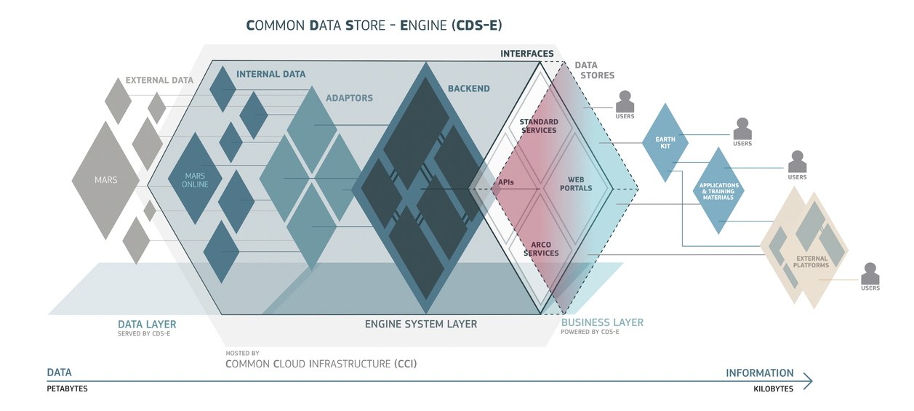
Data Stores Design

Slide 11
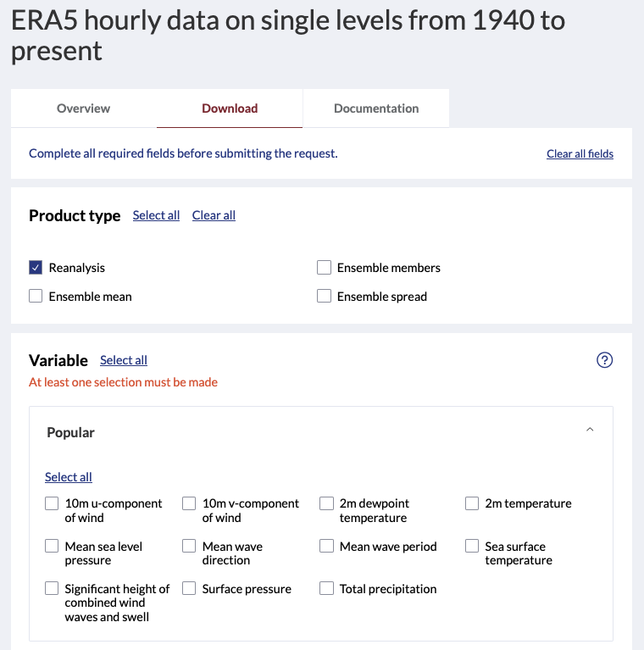
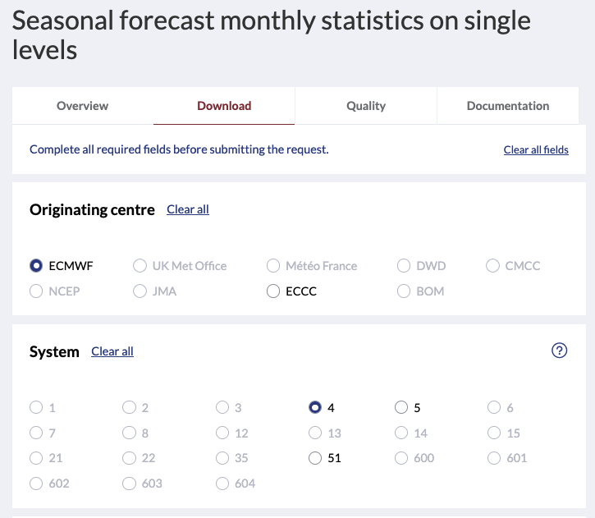
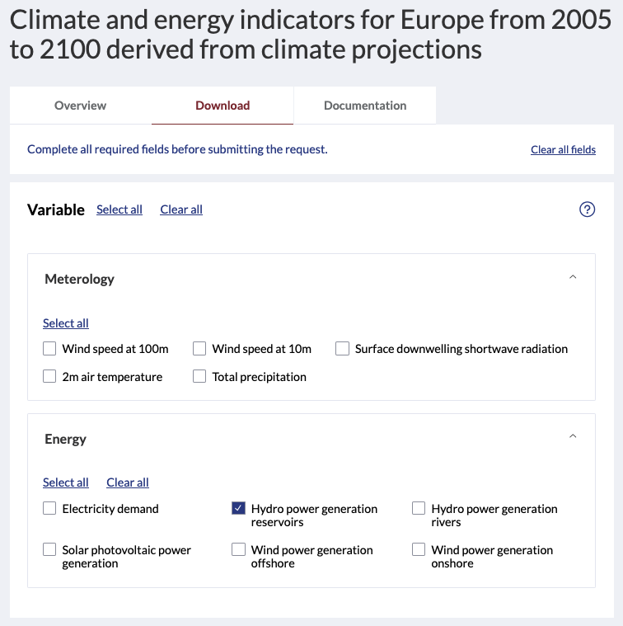
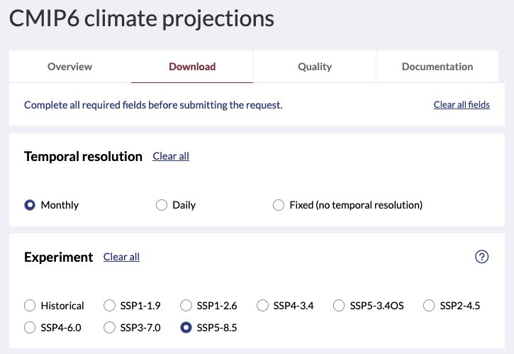
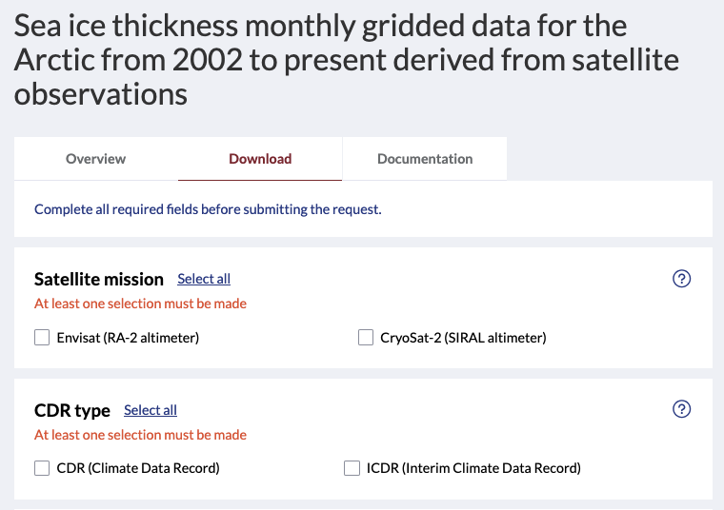
Unified Interface

Slide 12

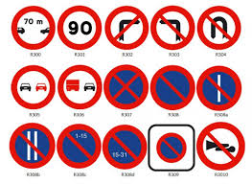


Data Stores Service and STAC in a nutshell
Data Stores Service (DSS)
MARS Adaptor
DSS Catalogue
( > 170 records)
DS STAC
ARCO Adaptor
S3 ARCO
ARCO - STAC
Powered by DSS
Powered by DSS
Petabytes
Terabytes
We have in place different mechanisms to control the traffic

Slide 13
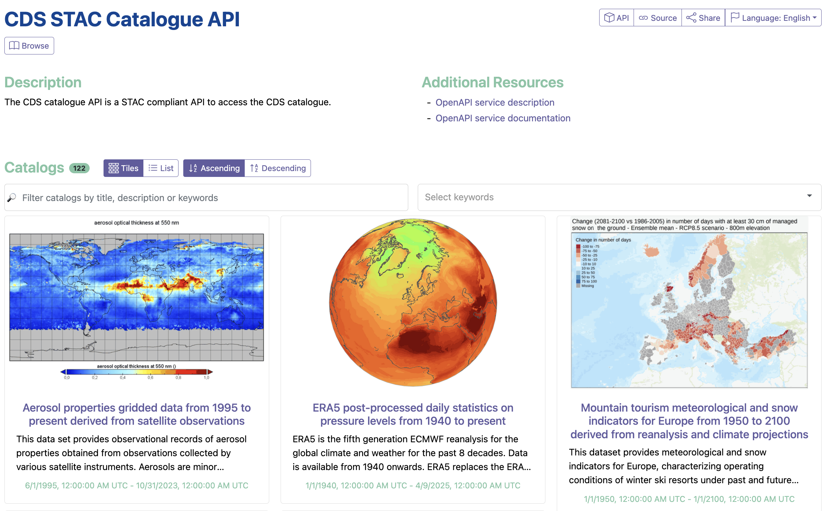
cds.climate.copernicus.eu/stac-browser/

Slide 14
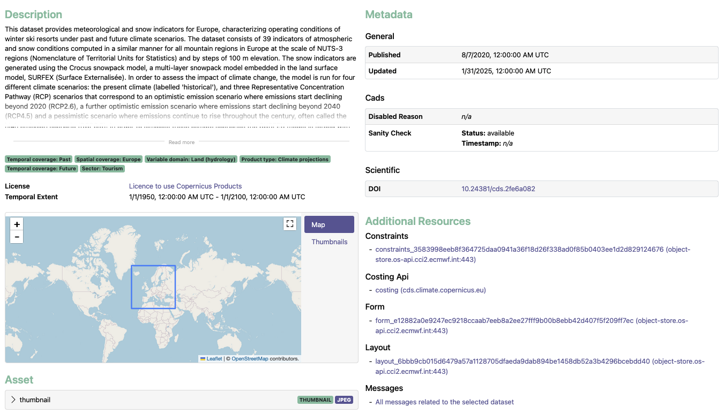
cds.climate.copernicus.eu/stac-browser/

Slide 15
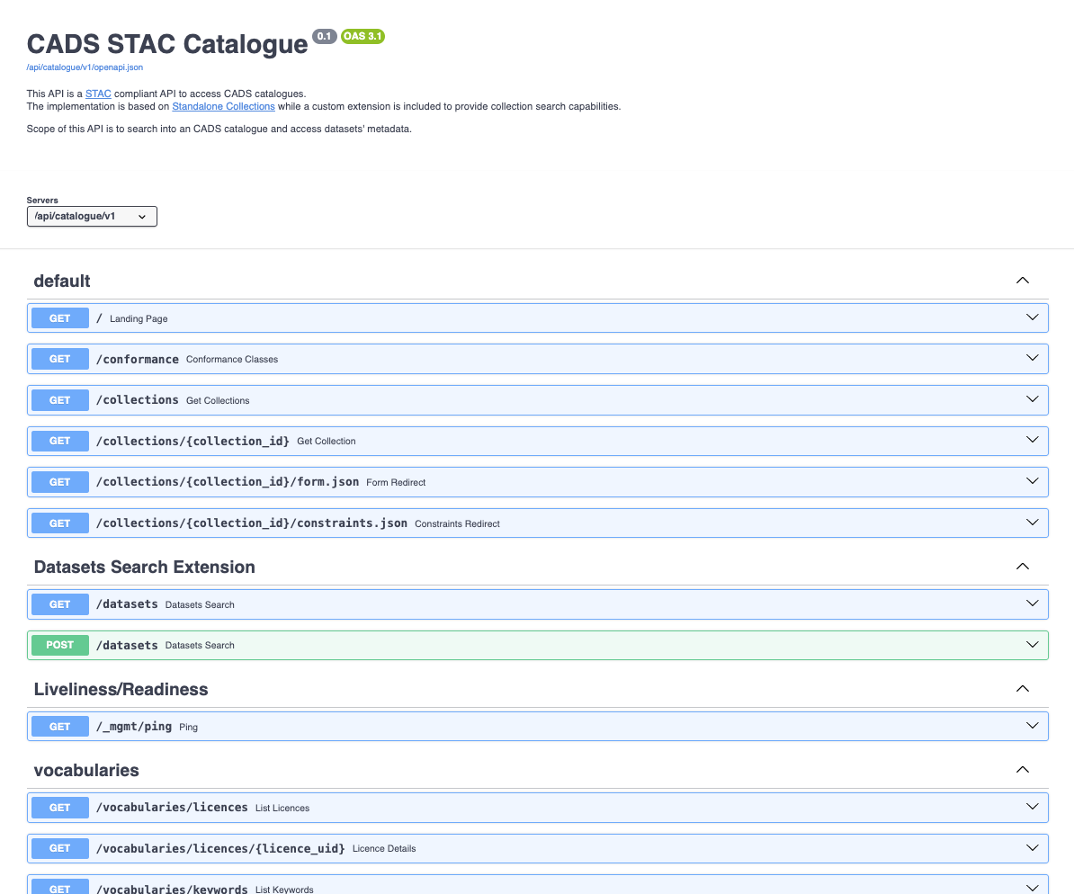
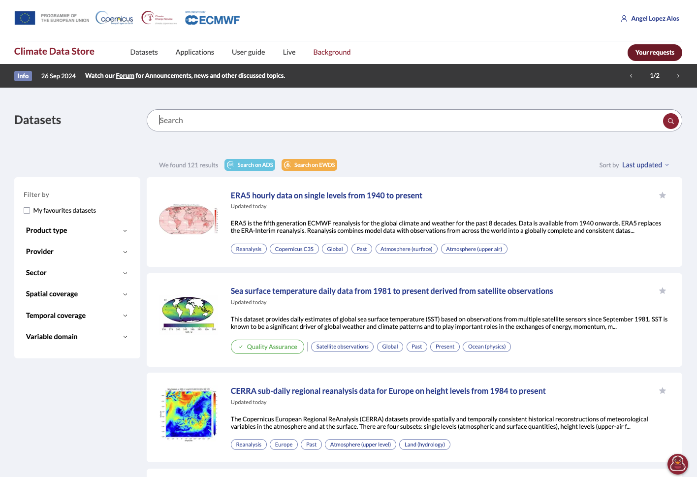
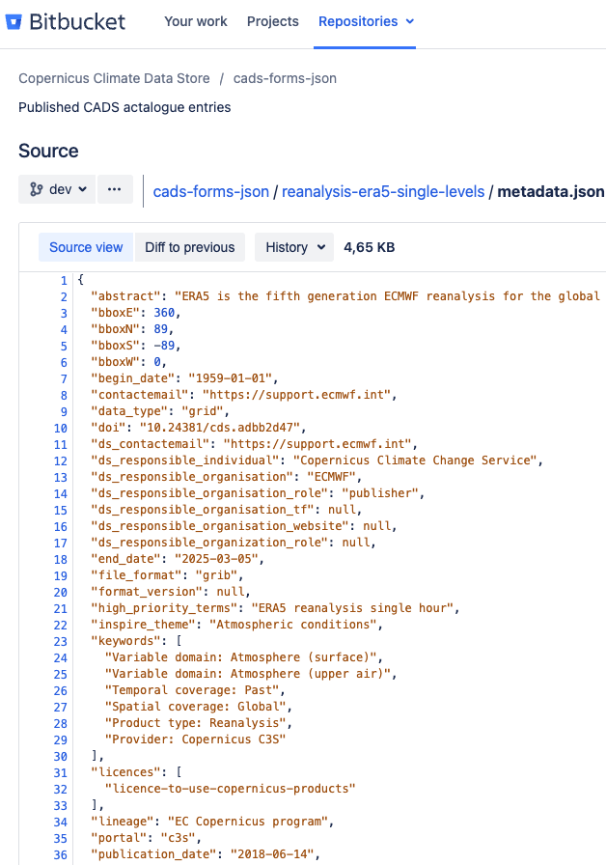
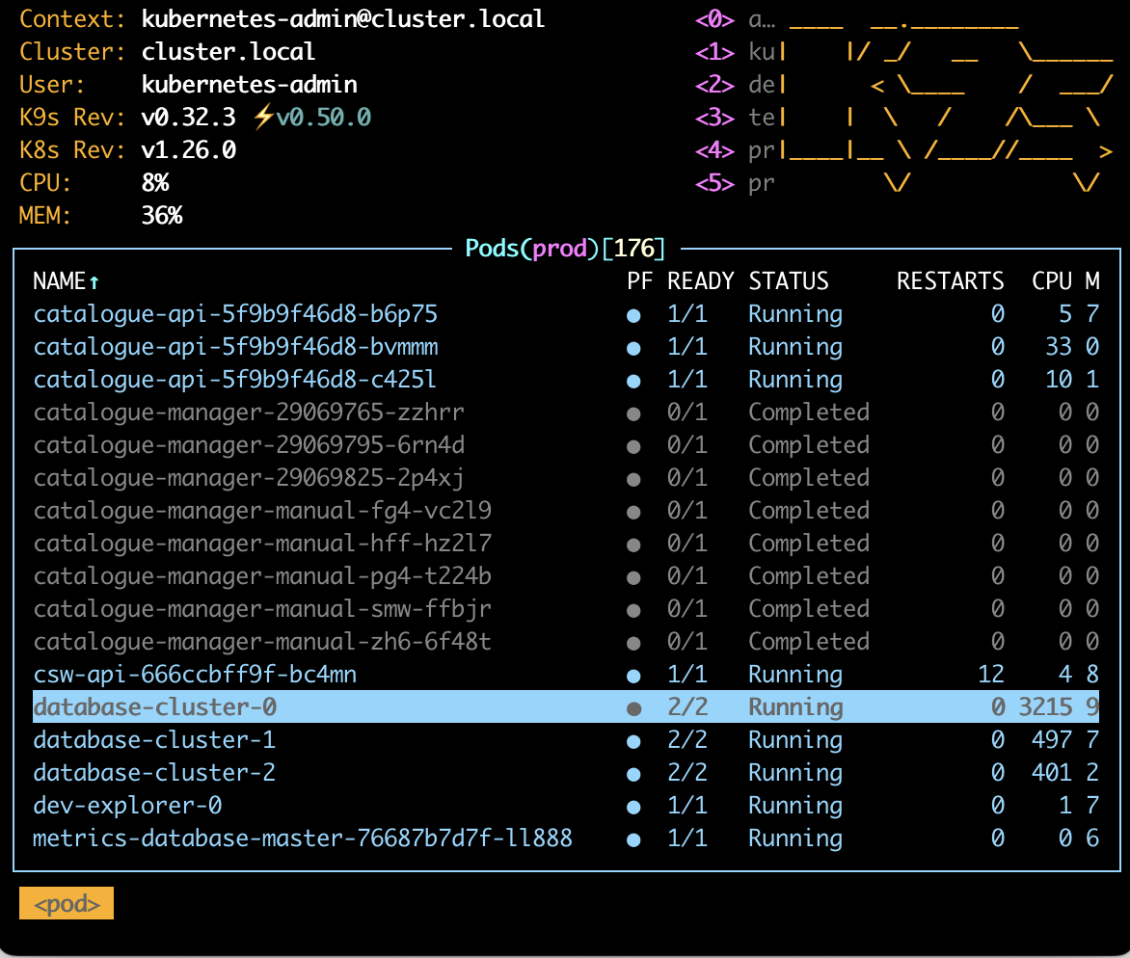

DSS Catalogue Management
DSS configuration files
STAC Compliant API
DSS Web Portals
DSS – System
Catalogue Backend
Compliant formats and schemas
Other Standard Metadata and Catalogue APIs
(e.g. CSW)
Automatic catalogue harvesting by 3rd Parties

Slide 16






DSS Catalogue Management
DSS configuration files
STAC Compliant API
DSS Web Portals
DSS – System
Catalogue Backend
Compliant formats and schemas
Other Standard Metadata and Catalogue APIs
(eg. CSW)
Automatic catalogue harvesting by 3rd Parties
Automatic deployment
Versatile and Flexible.
Simplicity and consistency

Slide 17
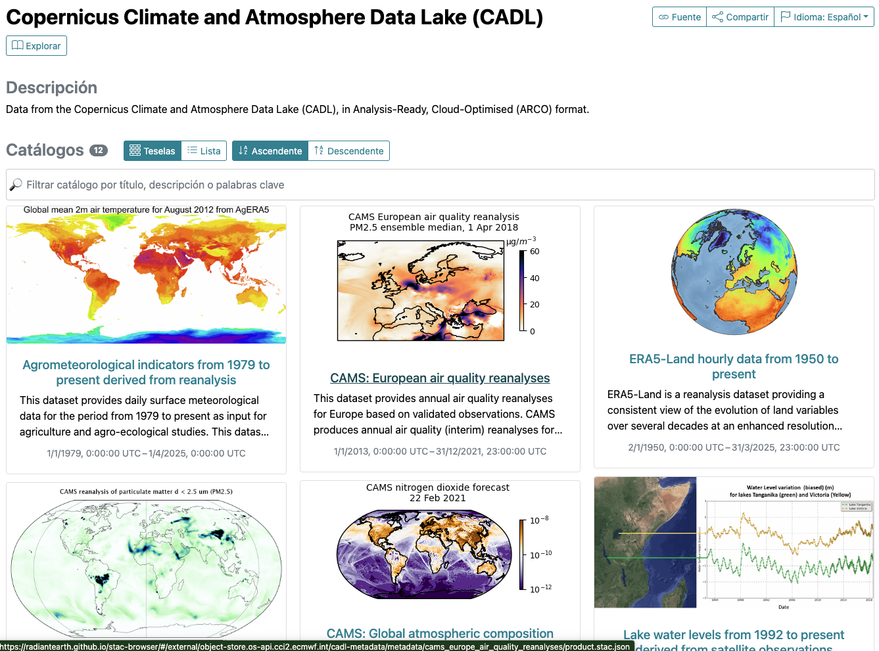
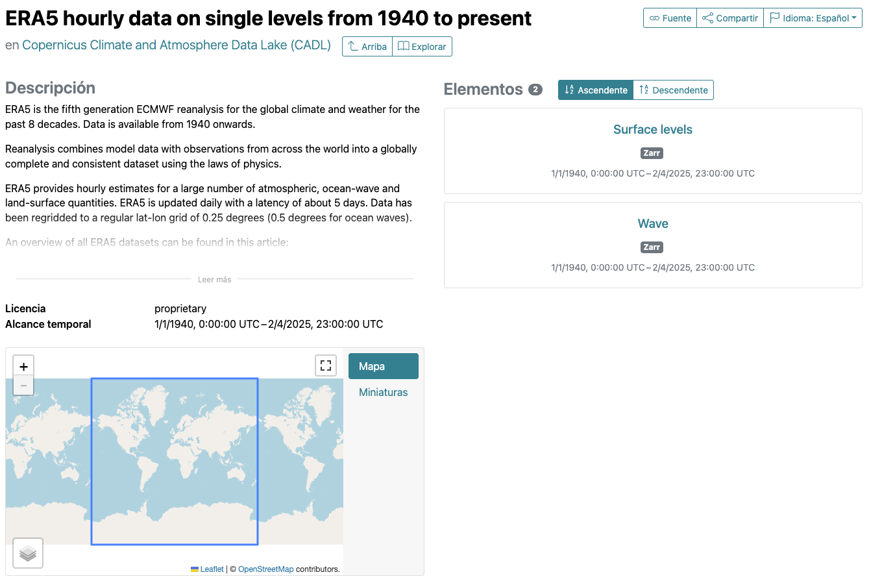
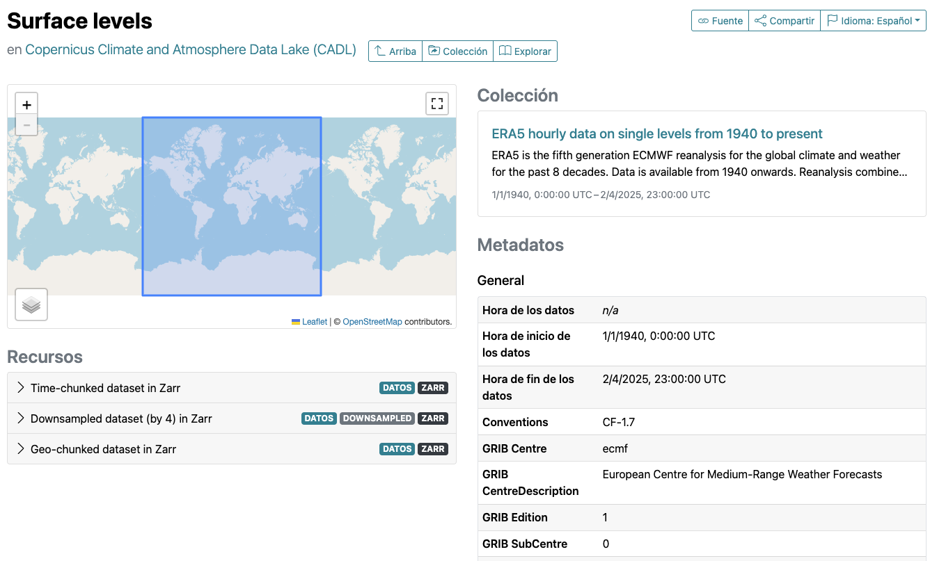
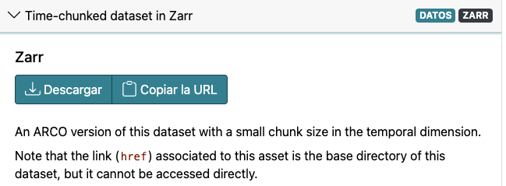
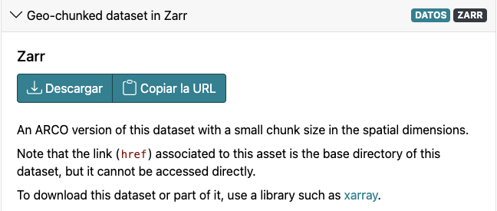
STAC – DS ARCO Data Lake ( not publicly exposed )
Data-Cubes and ingestion workflows are adapted to the particular idiosyncrasy of each dataset (archive format, scope, volume, demand, …)
Catalogue (eg. CDS)
Collection (eg. ERA5 Single Levels)
Items (eg. Surface Levels)
Standard Metadata elements are taken from parent records on DSS Catalogue (STAC API)
Assets = (Time-chunked data in Zarr
Geo-chunked data in Zarr)

Slide 18
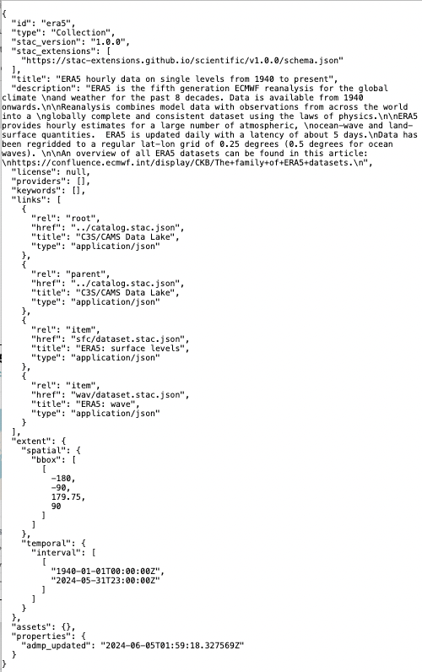
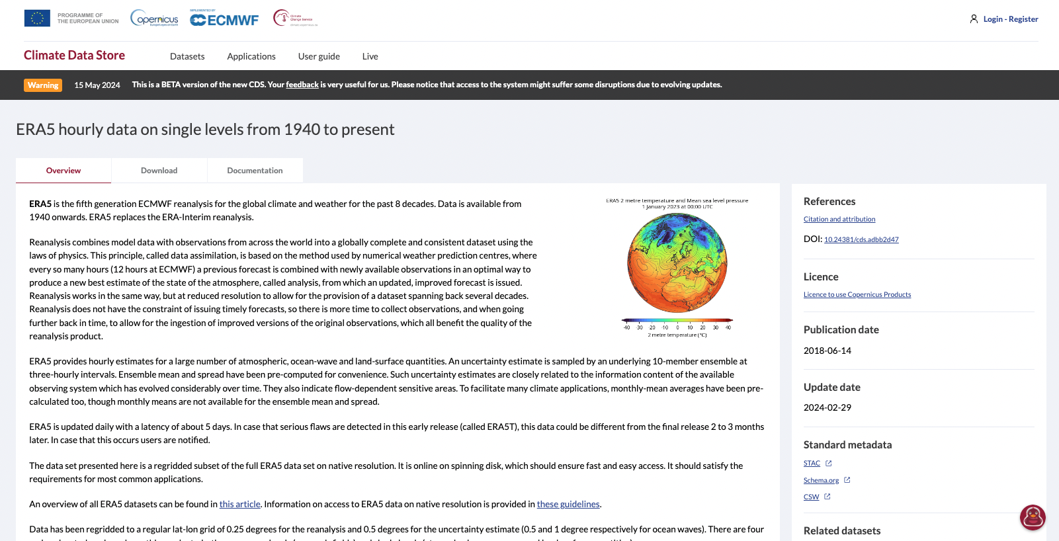
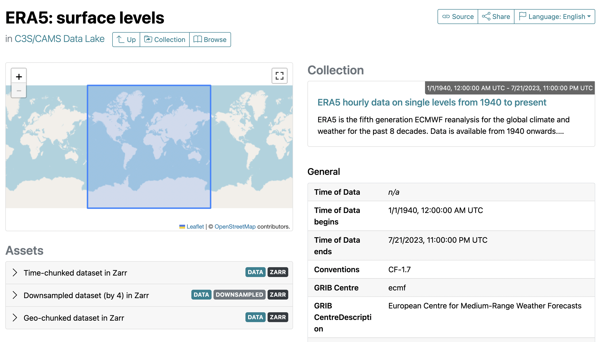
DSS STAC Catalogue
1 Dataset -> 1 to Many DSS Catalogue Records
(Granularity decided case by case during the integration phase based in multiple criteria – eg. User needs , Optimized way of structuring queries, others)
1 Catalogue record = 1 STAC Collection

Slide 19
STAC – DS ARCO Data Lake ( not publicly exposed )
Data-Cubes and ingestion workflows are adapted to the particular idiosyncrasy of each dataset (archive format, scope, volume, demand, …)
Catalogue (eg. CDS)
Collection (eg. ERA5 Single Levels)
Items (eg. Surface Levels)
Standard Metadata elements are taken from parent records on DSS Catalogue (STAC API)
Assets = (Time-chunked data in Zarr
Geo-chunked data in Zarr)

Slide 20
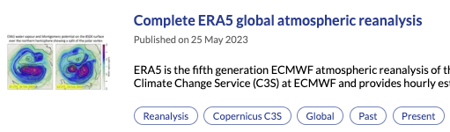
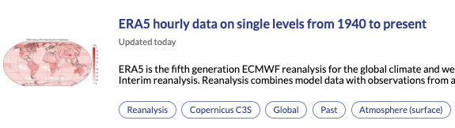
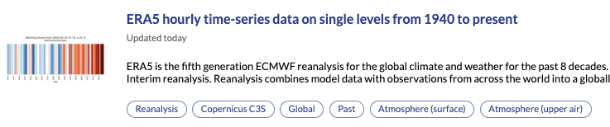
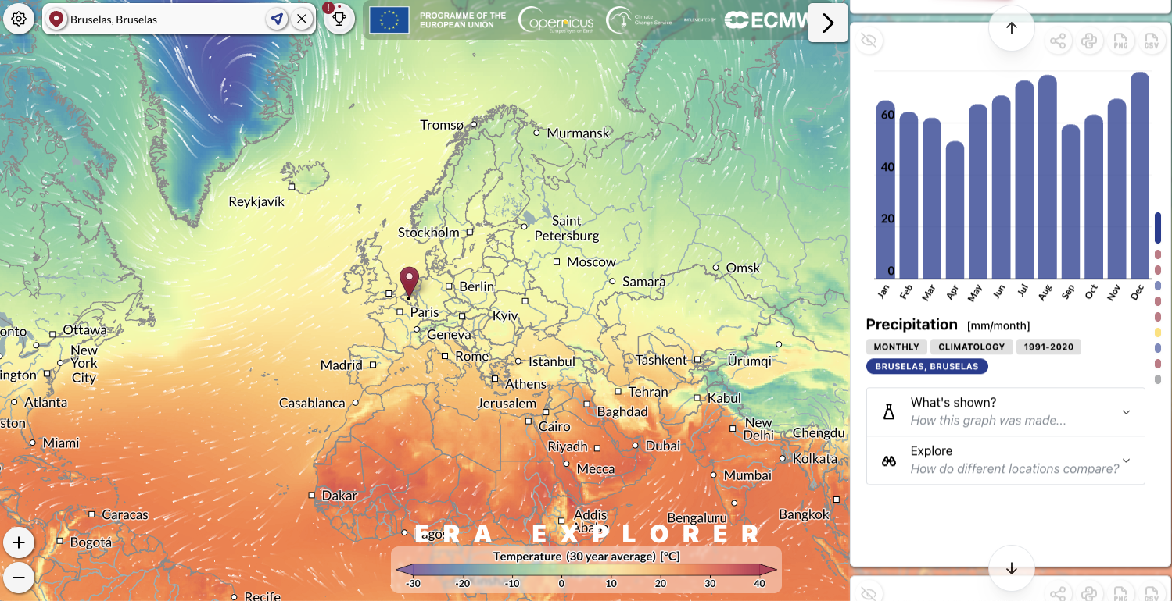
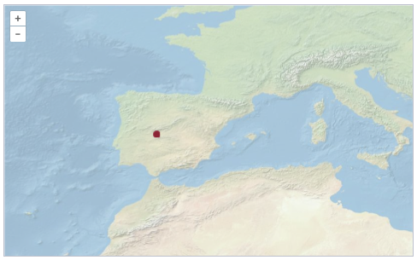
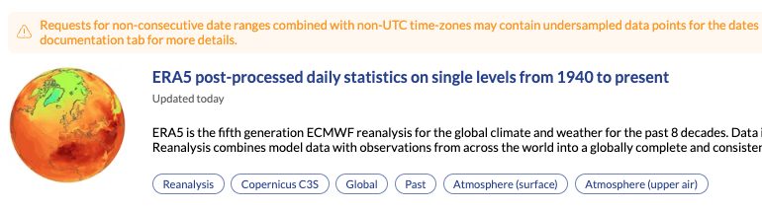
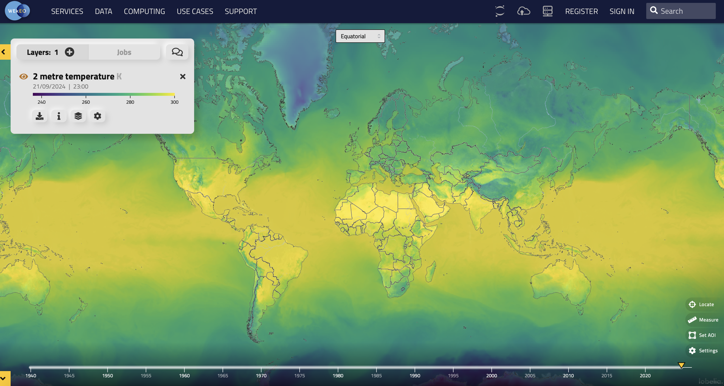
Case example: Global Atmospheric Reanalysis – ERA5
Timeseries & Post-processed (API + UI)
API Access only
API + Interactive forms
20
ERA5 Explorer App
Powered by DSS ARCO and earthkit
ECMWF MARS Archive
DHS + Tape Storage
+ 40 PB
All variables
DSS-STAC Catalogue
  API Access only
  MARS Adaptor
  Dedicated QoS
DSS MARS Archive
(In-house Cloud – On-disk)
+- 4PB
Most popular variables
DSS-STAC Catalogue
  UI and API access
  MARS Adaptor
  Dedicated QoS
DSS – ARCO DL
(In-house Cloud – S3)
+- 2TB
11 selected variables
DSS-STAC Catalogue
  ARCO Adaptor
    ARCO STAC+Zarr (Chunked by Spatial and Temporal - restricted access )
    Tokenize access to S3 (under evaluation)
  Dedicated QoS
  UI and API open access
Map Services (tiled)
MB
10 selected variables
Viewer – Open access
Visual Interactive Content
KB
Free access
Automatic suites triggered daily
Data -> Metadata -> Forms/Constraints -> Maps
European Centre for Medium-Range Weather Forecasts
20

Slide 21
Conclusion
  We already provide STAC interfaces to some of our metadata
  Raw STAC doesn’t quite work for NWP datacubes
  We are working on an extension for more powerful navigation and exploration of datacube data

Slide 22

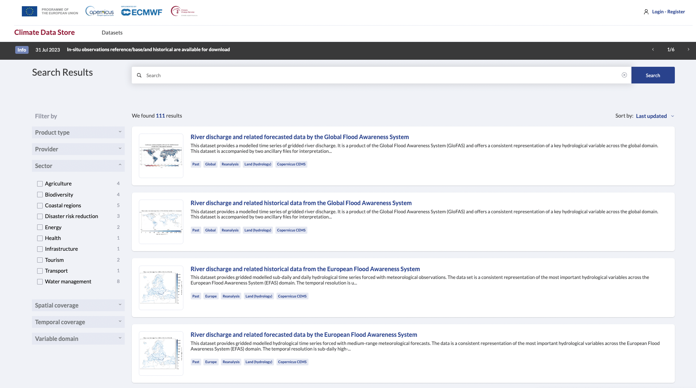







Content Management (Metadata)
Automatic deployment
Versatile and Flexible.
Simplicity and consistency
DS Web Portals
(CDS, ADS, EWDS)
DSS configuration files
Ingestion ready files
DSS – System
Catalogue Backend
Compliant formats and schemas
Standard Metadata Services
STAC based API service for DSS Catalogues
(YAML)
(JSON)
Metadata
form, mapping and constraints
page contents and layout
CIM-EQC
Datasets

Slide 23


Data access levels
Data Layer
System Layer
CDS Web Portal
Business Layer
ECMWF MARS
Hosting raw ERA5, Seasonal, …
CDS
Adaptor
Metadata + Configuration
Catalogue
External Platforms
Automatic Suites
EDS
On-line
MARS
ERA5 Daily Single Levels
ERA5 Daily Single Levels
ERA5 Daily Single Levels
Earthkit
ERA5 Daily Pressure Levels
ERA5 Daily Pressure Levels
ERA5 Daily Pressure Levels
CDS API
ERA5 ARCO
ERA5 ARCO
ERA5 ARCO
Standard
End Points
-
CSW
STAC
ClimateLab
Workflows
ARCO Data Lake
Standard Interfaces
DHS + Tape Storage
+ 40 PB
All variables
Free Access
On-line disks
(In-house Cloud)
+- 4PB
Most popular variables
Free access
S3 - Data Cubes
(STAC + Zarr)
+- 2TB
10 selected variables
Chunked by Spatial and Temporal
Restricted access
WMTS Layers
MB
10 selected variables
Free access
Interactive applications
KB
Free access

Slide 24




CDS approach
ECMWF Common Data Stores
Scalability
Plug-in (Modular) architecture
MARS
Era6
FAIR Principles
Simplicity & consistency
Automatization
Monitoring & Observability
Synergies with other platforms
Open-source & Collaboration
Cutting-edge technologies
Served by CDS
Powered by CDS
Leverage technical and human capabilities to grow organically

Slide 25
In a nutshell
ECMWF Common Data Stores
Climate (CDS),
Atmosphere (ADS), …
MARS, URL, WPS, others
Catalogues, User Services,
Broker, QoS, APIs, Scheduler, EQC
Metadata:
CSW
STAC
Visualization:
WMTS
MARS, ESGF, SAF, others.
MARS on-line,
Obs-Repo, Datastore,
S3-ARCO Data Lake (restricted).
WEkEO, Climate Adapt, GDDS, Twins
Served by CDS
Powered by CDS
Served by CDS
Powered by CDS

Slide 26



Challenges
ECMWF Common Data Stores
> 2700k user/day
Real time Apps
Peaks over 200 TB/day
MARS
Era6
1 million requests/day reached
ERA6
On-line
External Platforms
AI / ML
3D Apps
Bots
ARCO Data cubes
Threats
Served by CDS
Powered by CDS
Malicious users
How to cope with heterogeneous and expanding catalogues, larger volumes and increasing demand from users
Exabytes?
The limits of human (or machines?) imagination

