Slide 1
STAC in ESA Common Services
Yves Coene (Spacebel for ESA),
Mattia Stipa (ESA), Roberto Alacevich (ESA)
STAC & Zarr Workshop
16/04/2025

Slide 2
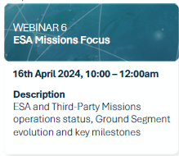
Outline
Introduction
STAC catalogue use cases
  search & browse
Main (STAC) features
Tool support
Conclusion

Slide 3
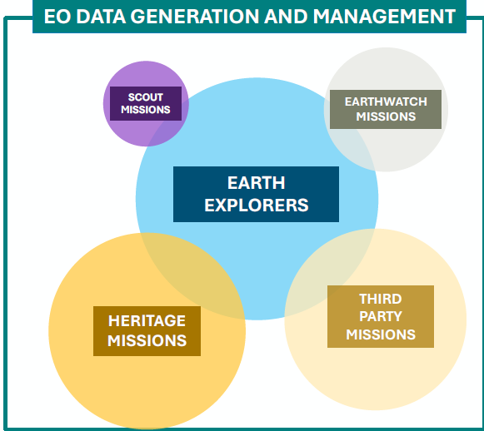
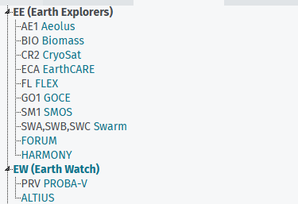
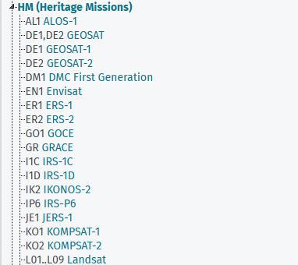
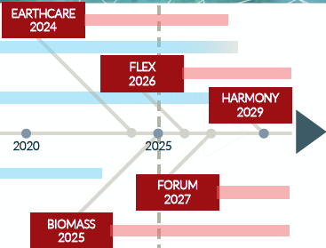
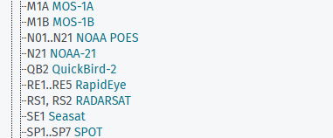
Introduction
ESA and Third Party Missions Portfolio
EO Data Generation and Mgt
  Foster EO science advancements with state-of-the-art data and services to boost EO science data usage.
Streamlined “Common Services” approach:
  Operational synergies in data mgt. activities.
  Competences and services can be used depending on specific mission constraints.

Slide 4




Common Services Catalogue
Data Discovery and Access
  Current: “EOCAT” (https://exploringearth.eo.esa.int/)
    Discovery of collections
    Discovery, visualisation and direct download of Earth Observation (EO)
    products from multiple missions:
    41.2 million granules/products, 199 collections.
    Discovery of related tools/services (planned).
  Data Management Services Evolution (“Precursor Services”): “ESA MAAP” (https://portal.maap.eo.esa.int/)
    “Multi-Mission Algorithm and Analysis Platform”.
    Advanced data access and processing for collaborative earth observation ground segment.
    To provide access to Biomass, EarthCARE and other Earth Explorer data.

Slide 5
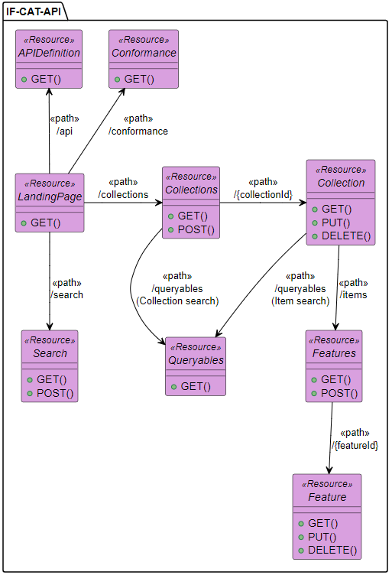
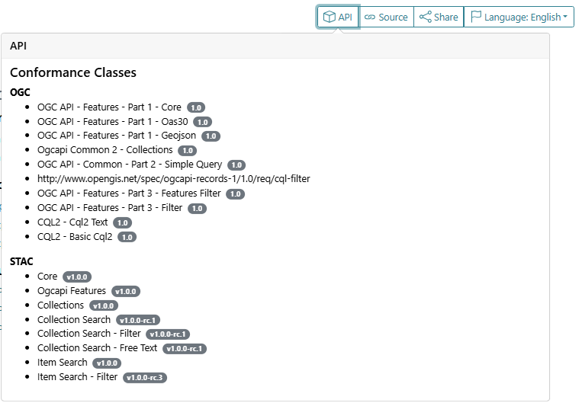
STAC Catalogue – “searching”
STAC Collection search
(/collections)
STAC API (Dynamic STAC Catalogue) with many conformance
classes
Collection and item search (filter extension, CQL2, ..)
Collections annotated with SKOS concepts (controlled keywords:
ESA, GCMD): platform, instrument, science keywords.
Queryables advertised per collection
STAC Item search
(/items)
STAC Item search
(/search) GET + POST
Notes:
https://radiantearth.github.io/stac-browser/#/external/eocat.esa.int/eo-catalogue
https://github.com/radiantearth/stac-spec/blob/master/best-practices.md#static-and-dynamic-catalogs

Slide 6
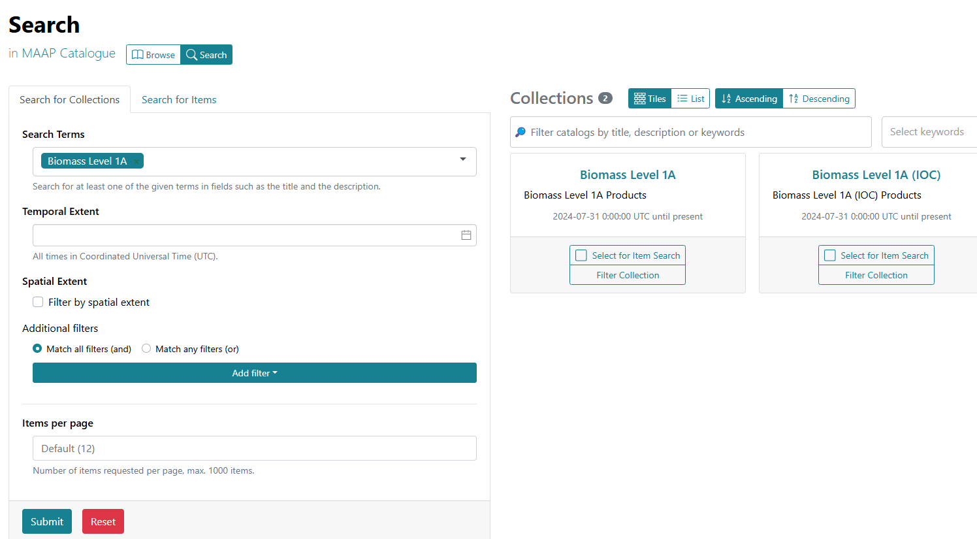
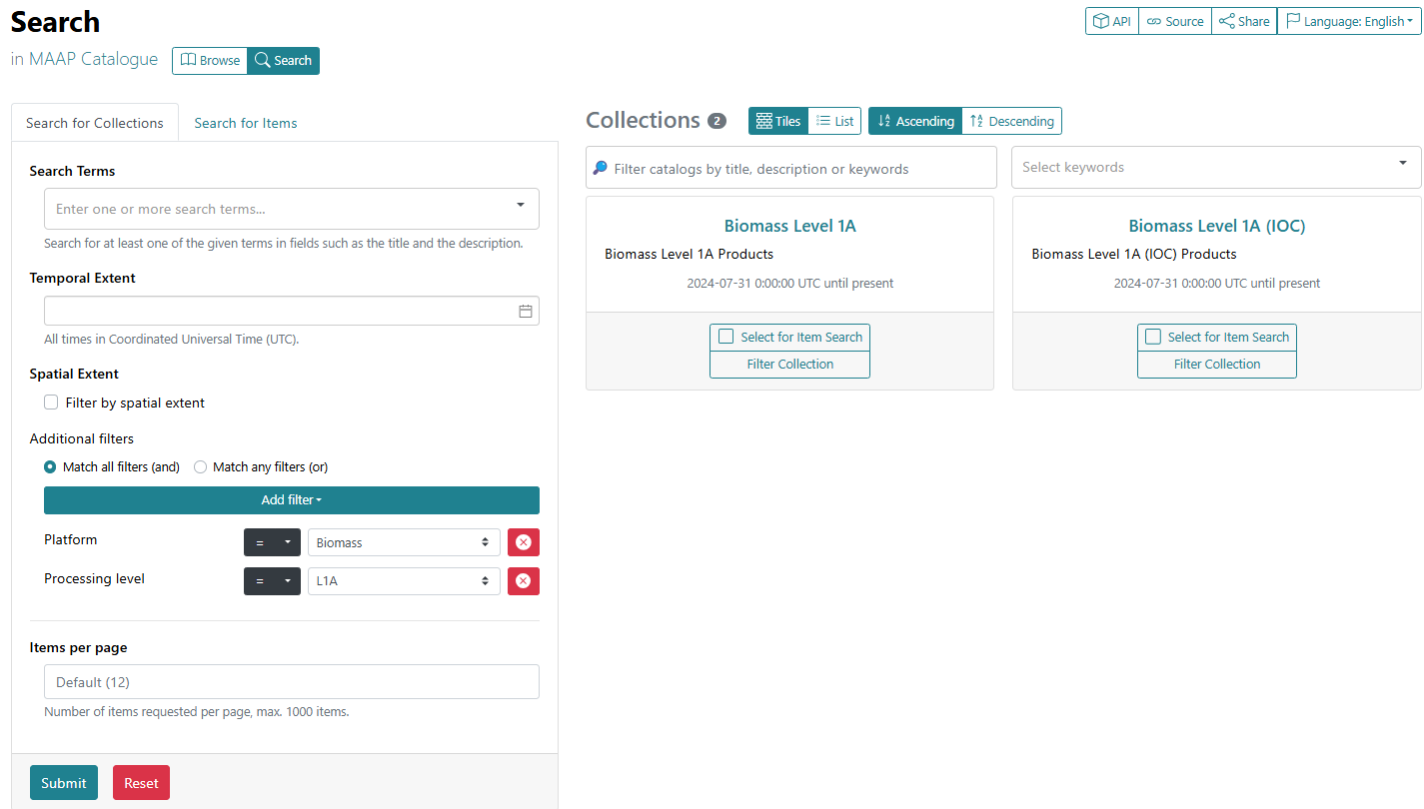
STAC Catalogue – Collection search
STACBrowser Collection search (/collections)
  Free text search
  CQL2 filter expressions:
    Platform, Instrument,
    Processing Level etc.

Slide 7
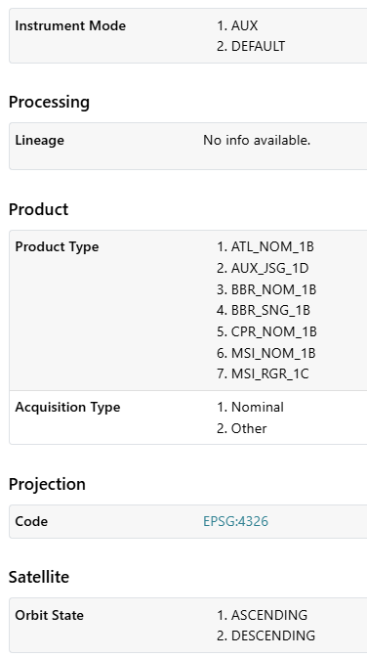
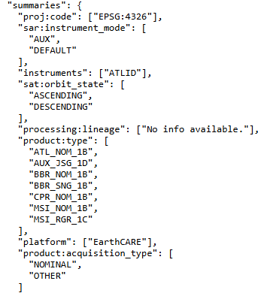
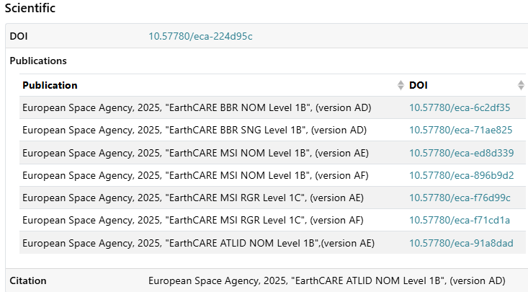
STAC Catalogue – Collections
Collection metadata includes:
  “summaries”
  “item assets”
  DOI and publications/citation when available.
EarthCARE L1 Products example:

Slide 8
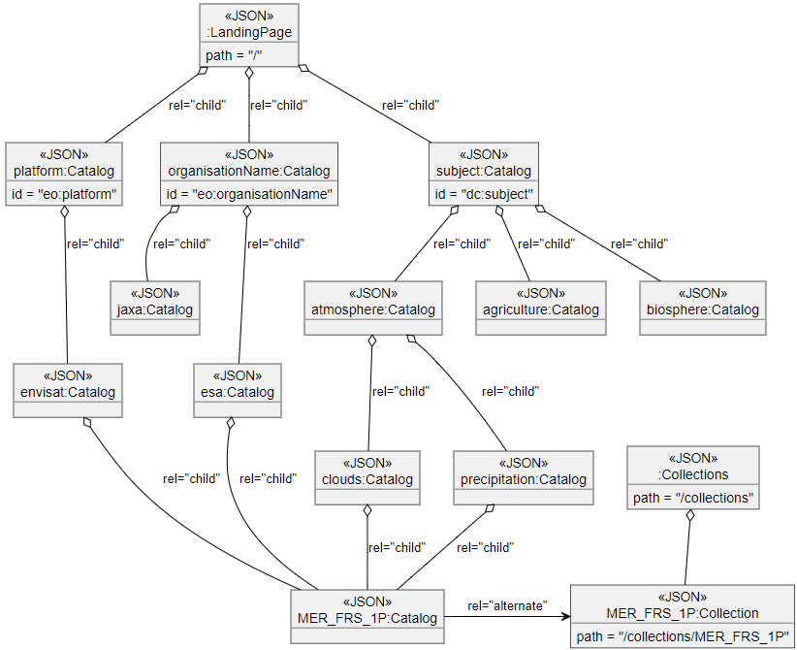
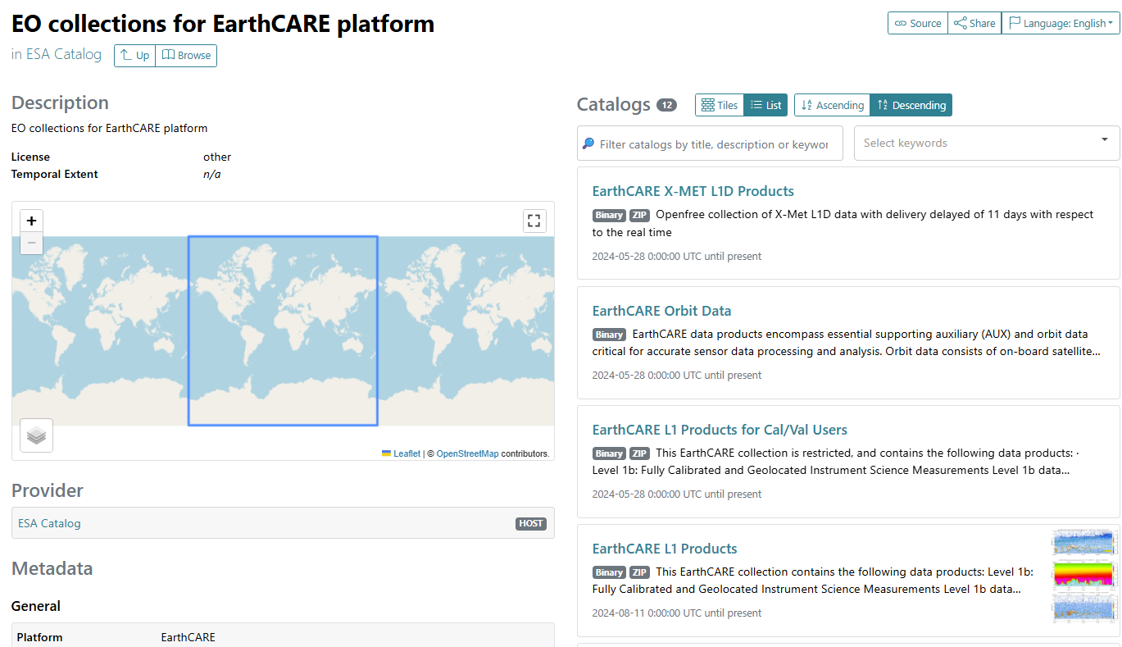
STAC Catalogue – “browsing”
STAC pseudo-static Catalogue:
  Extensive use of subcatalogs to drill-down to collections / products
  Views on content of “dynamic catalogue”.
  Via “platform”, “instrument”, “science keyword” (any SKOS thesaurus), Year, Month, Day, Product
Notes:
https://radiantearth.github.io/stac-browser/#/external/eocat.esa.int/eo-catalogue
https://github.com/radiantearth/stac-spec/blob/master/best-practices.md#static-and-dynamic-catalogs

Slide 9
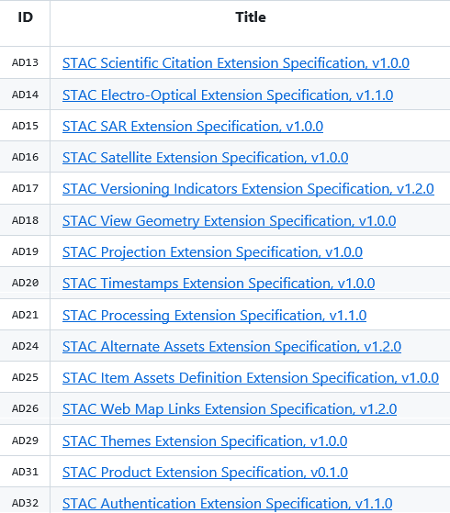
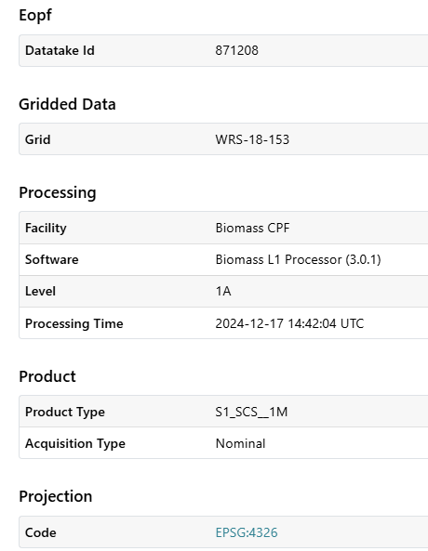
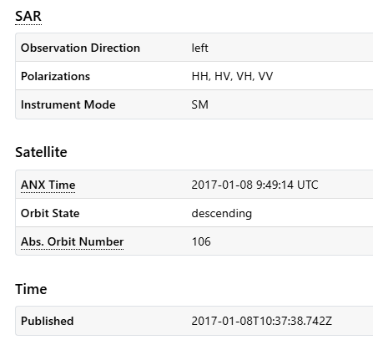
STAC Catalogue - Extensions
Aligned with CEOS Collection and Granule Discovery
Best Practices
  https://github.com/ceos-org/stac-collection-and-granule-discovery-best-practices
Metadata expressed using pre-existing STAC extensions, including EOPF extension.

Slide 10







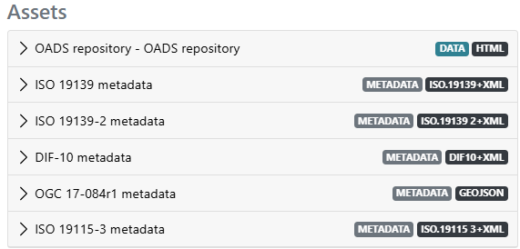
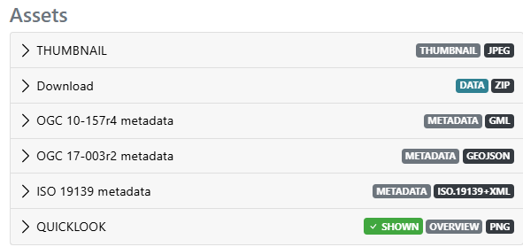
Main Features – Metadata assets
REST API supports content-negotiation:
  STAC API is not the only interface. OGC API-Features and OpenSearch remain available. OpenAPI description describes API and media types.
  STAC collection/item are not the only metadata formats supported:
    Other Collection Metadata formats available as STAC collection assets (and content negotiation at /collections/{collection-id} endpoint)
    Other Product Metadata formats available as STAC assets (and content negotiation at /items/{product-id} endpoint)
Collection assets
Item assets

Slide 11
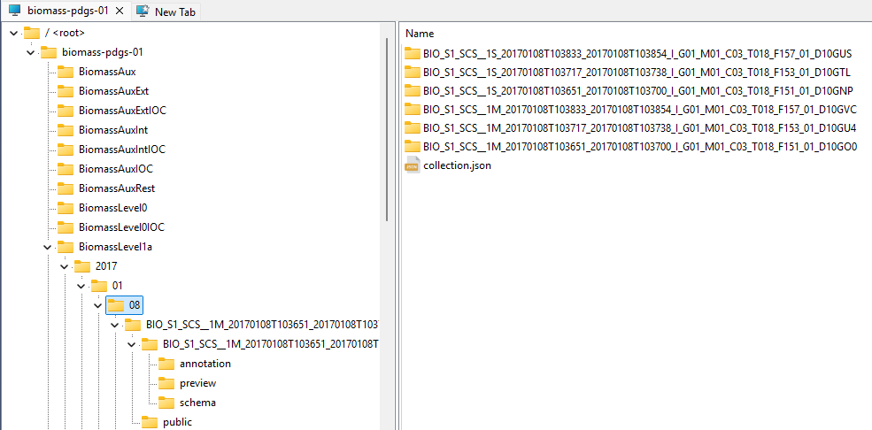
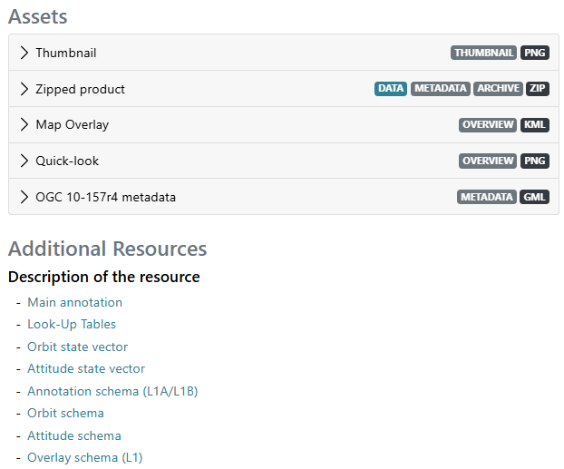
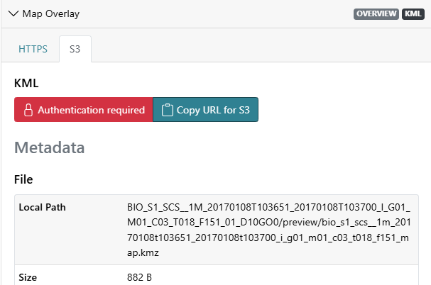

Access to individual assets in a product package
Example: “Biomass” products
  Data storage on the cloud – product packages are “unpacked” in object storage
  Access via HTTPS (and local S3 protocol) to individual parts
Notes:
https://radiantearth.github.io/stac-browser/#/external/catalog.maap.eo.esa.int/data/biomass-pdgs-01/catalog.json?.language=en

Slide 12
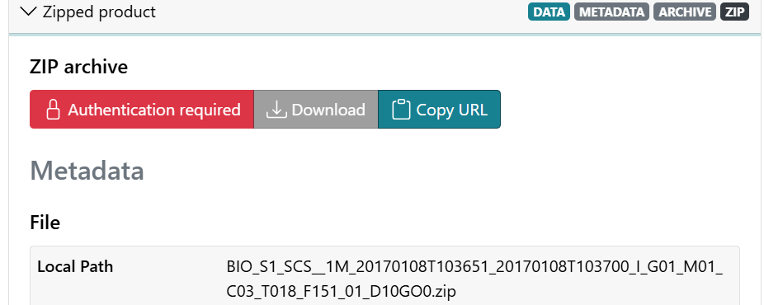
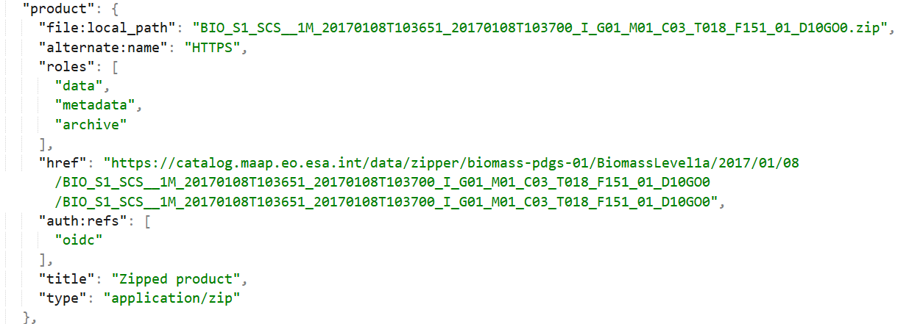

Access to individual assets in a product package
STAC items encoding:
  STAC Alternate Assets Extension (S3, HTTPS)
  STAC Authentication Extension (OIDC)
On-the-fly “zipping” of product – download link
OpenID Connect authentication
(authorization header with bearer token).

Slide 13
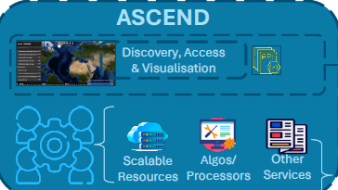
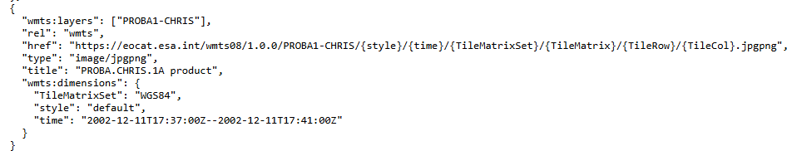
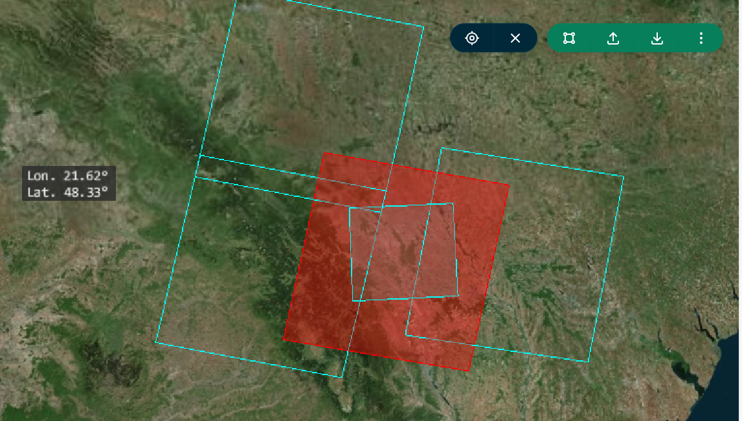
Main Features: Web Map Links Extension
ESA EOCAT and MAAP provide pixel-based data access services:
  Visualisation and Access via Explorer
  Pixel-based services WMS and WMTS (available as OGC offerings)
  Quicklooks are included in STAC item responses with
    STAC Web Map Links Extension (WMS, WMTS)
  STACBrowser supports WMS. WMTS support planned.
ESA MAAP

Slide 14
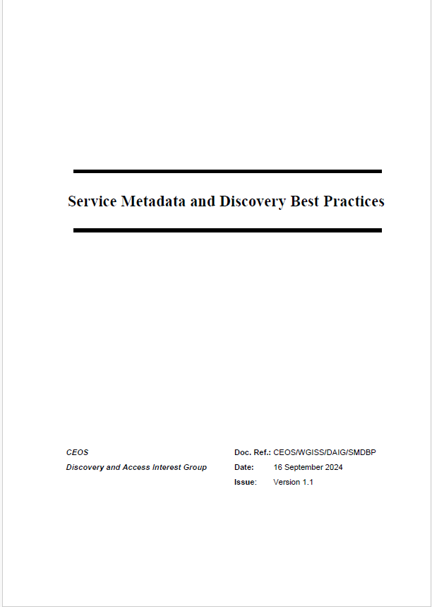
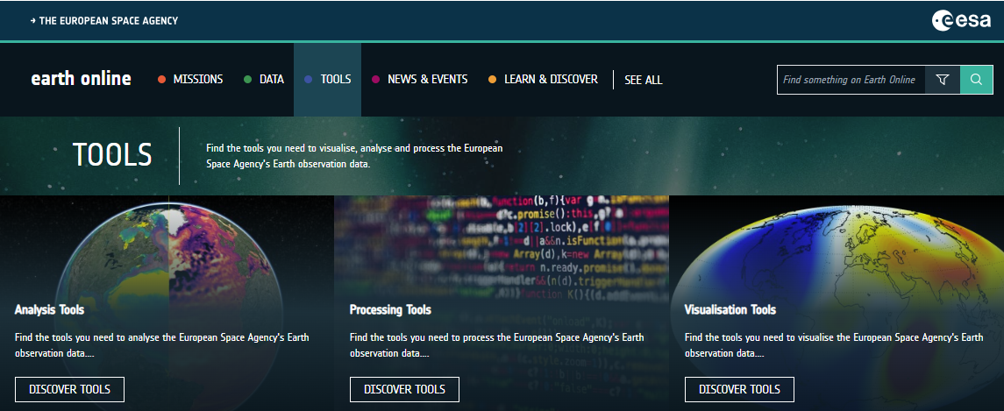
Main Features: Tool/Services discovery
CEOS Best Practices for Service Metadata and Discovery
  Use cases for service and tool discovery
  Best Practices and recommendations
    Service metadata model (minimal)
    Metadata encodings
    Service discovery interfaces
  Updated in September 2024 to include STAC
Implemented in EOCAT software
  Preparation of
  metadata for
  “earth online” tools
  and coupling
  being analysed.

Slide 15
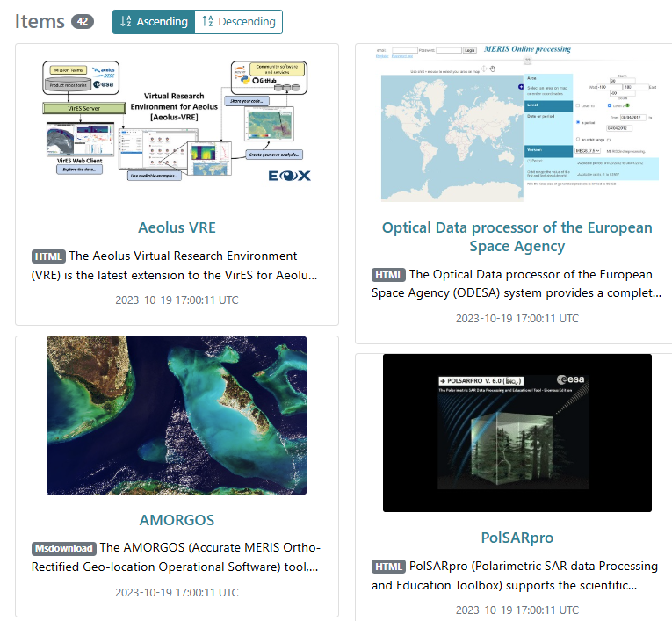
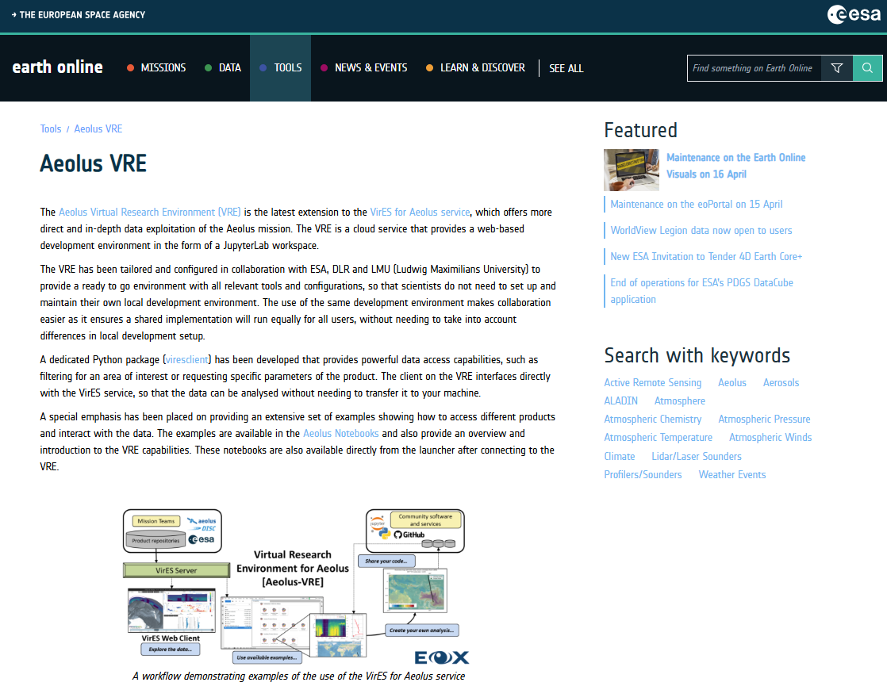
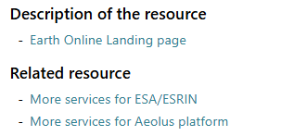
Main Features: Tool/Services discovery
Objective:
  Discovery of ESA “earth online” tools and services.
  Cross-links to additional tools/services.
  Resource coupling (to STAC collections)

Slide 16
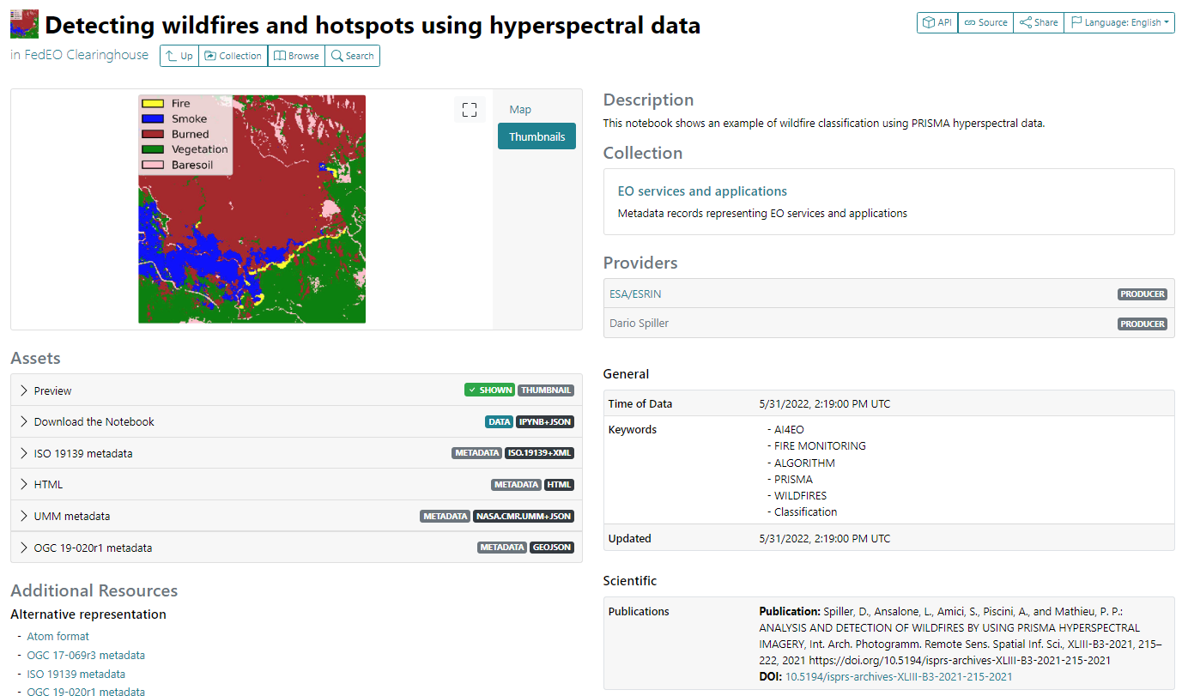
Tool/Services discovery – Notebook example
ESA AI4EO Notebook metadata (STAC).
Download
Notebook
Scientific STAC
Extension (for associated DOI,
e.g. publications)

Slide 17
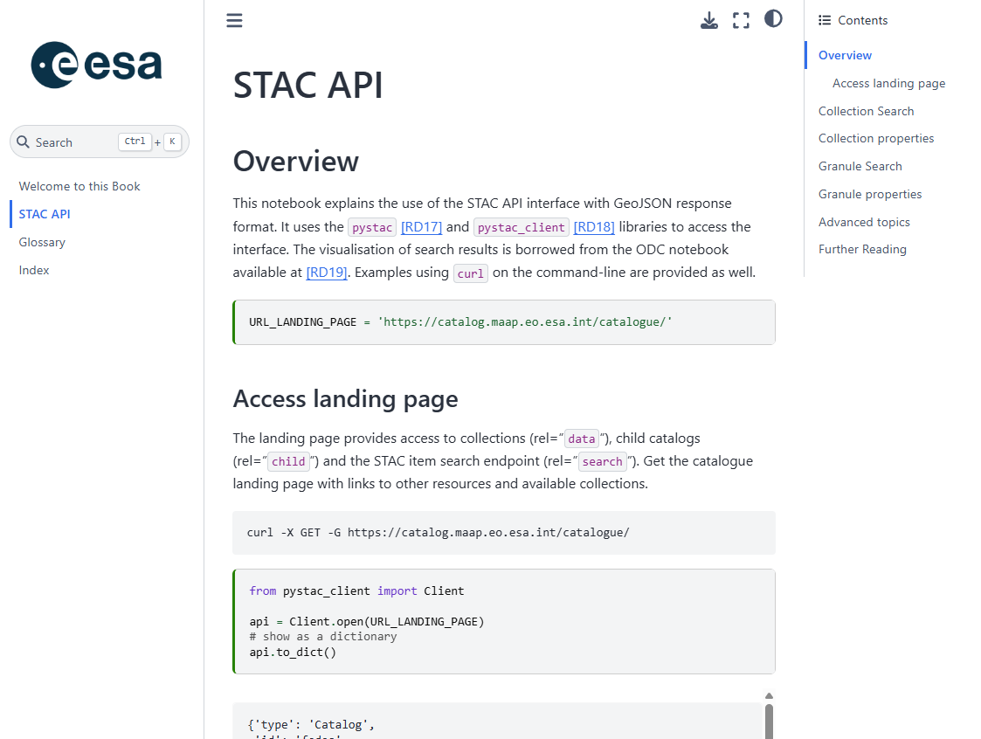


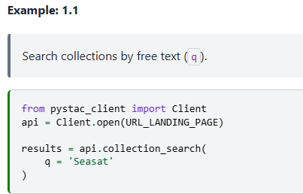
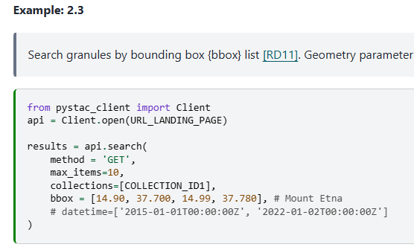

Online STAC
Documentation
STAC documentation for STAC API
  Pystac_client Python library
  Collection and item search
  Filter and CQL2 examples
API Online Documentation:
https://catalog.maap.eo.esa.int/doc/intro.html
https://eocat.esa.int/eo-catalogue/stac.html

Slide 18
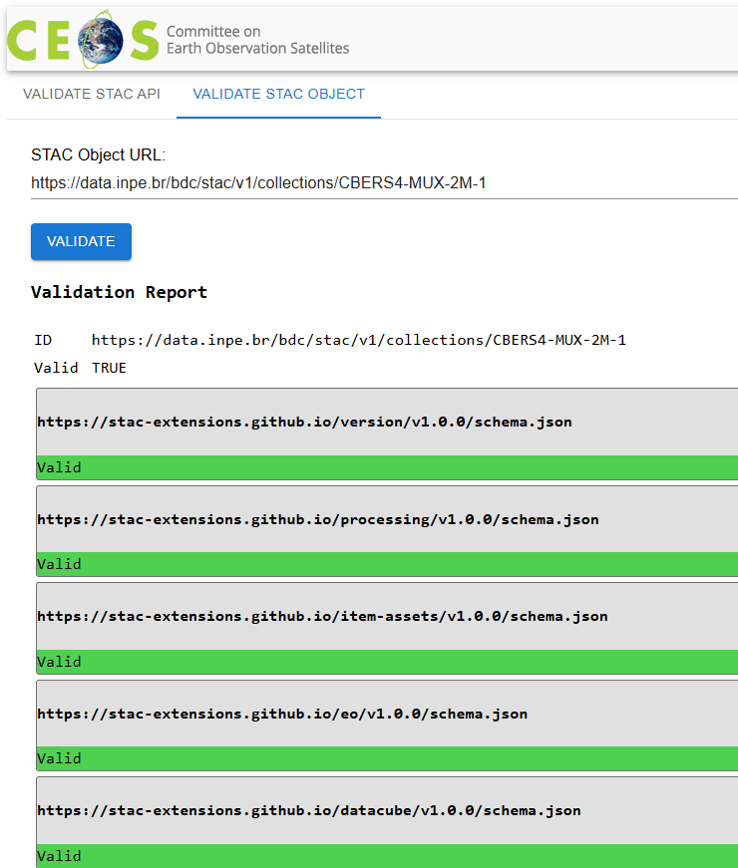
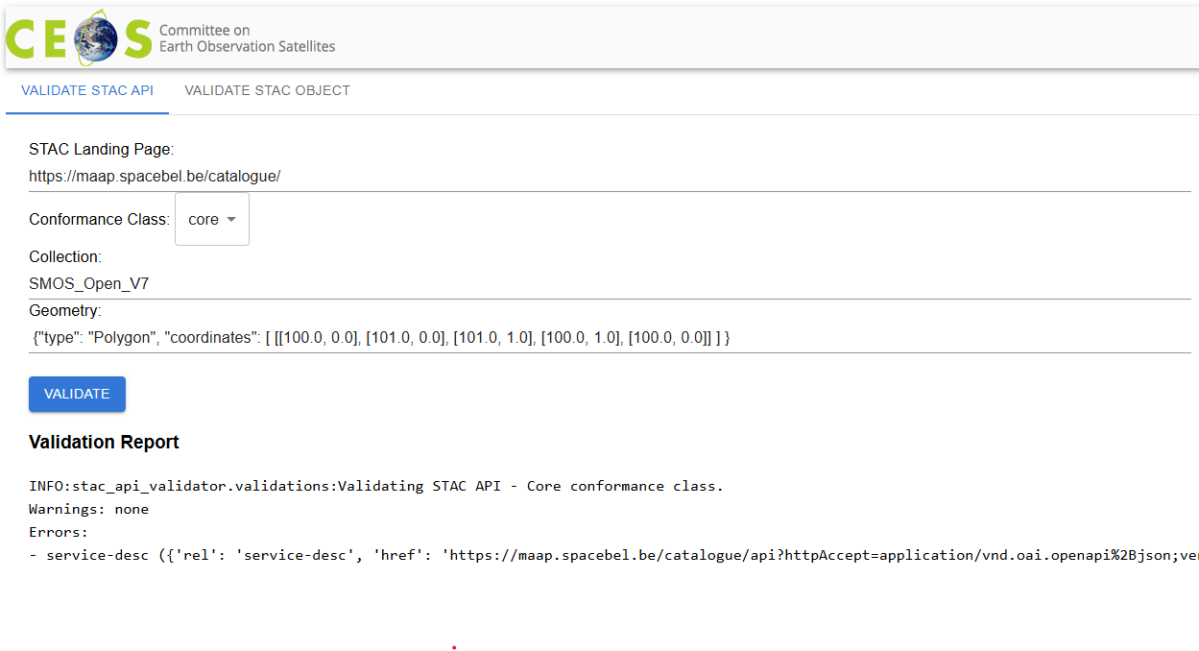
Tool support - CEOS STAC Validator
CEOS WGISS Action underway:
  Easy to use Web interface: No need to install of Python / Node.js etc. to use it.
  Available from CEOS Web site and in CEOS GitHub (open-source)
  Combine checks from multiple open-source libraries to cover STAC API and STAC object checks.
  E.g. Web GUI in front of: “STAC API Validator” and “STAC Node Validator”.
  Changes expected to limit recursion, adopt hypermedia - HATEOAS (no fixed links), avoid loading assets etc.

Slide 19
Summary and Conclusion
Overview of EO missions supported by “Common Services”: EE, HM, TPM, EW.
STAC Catalogue is at the core of the current (EOCAT) and forthcoming (MAAP) Common Services data discovery and access process.
STAC Implementation according to CEOS Best Practices
STAC API and main STAC metadata encoding (use of extensions) similar to the Copernicus CDSE STAC API (next slide).
  Including use of OpenID Connect, alternate locations (S3), etc.

Slide 20
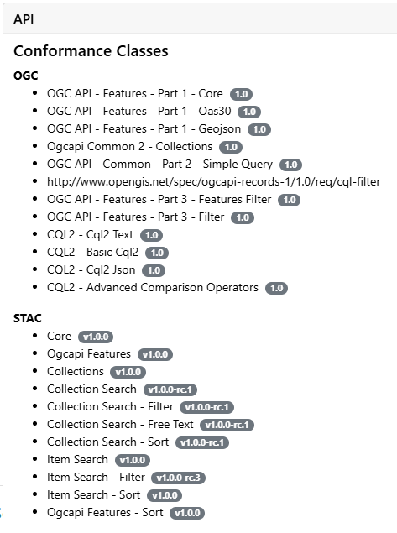
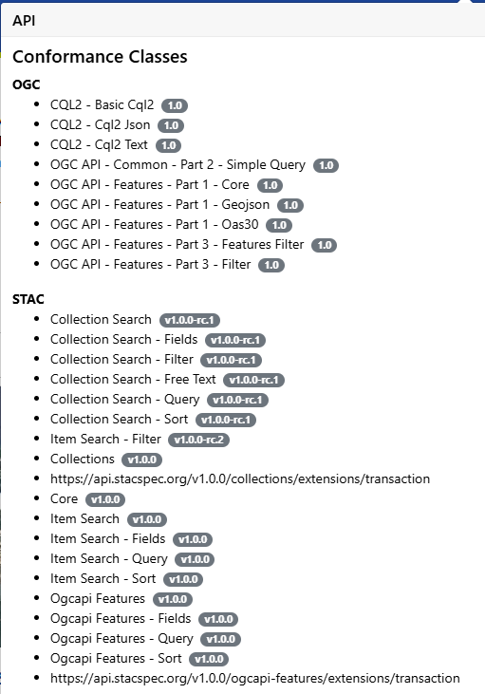
API Comparison: CDSE v Common Services
https://stac.dataspace.copernicus.eu/v1/
(24/02/2025)
Next ESA EOCAT/MAAP Release (under test)
Differences:
- Fields
- Query
- Transaction

Slide 21


